Slide 1


WCA Regional
Meeting
nutritioncluster.net
REUNION DE CONSULTATION REGIONALE SUR LA NUTRITION
Day 1
ONOMO Hotel, DOUALA
19-20 February 2024

Slide 2


L’agenda / Agenda
Discours d'ouverture
Briefing de sécurité /
Security briefing
Règles de base et gestion interne /
Ground rules and housekeeping
WCA Regional
Meeting

Slide 3
L’agenda / Agenda
Discours d'ouverture
Briefing de sécurité /
Security briefing
Règles de base et gestion interne /
Ground rules and housekeeping
WCA Regional
Meeting

Slide 4
L’agenda / Agenda
Discours d'ouverture
Briefing de sécurité /
Security briefing
Règles de base et gestion interne /
Ground rules and housekeeping
WCA Regional
Meeting

Slide 5
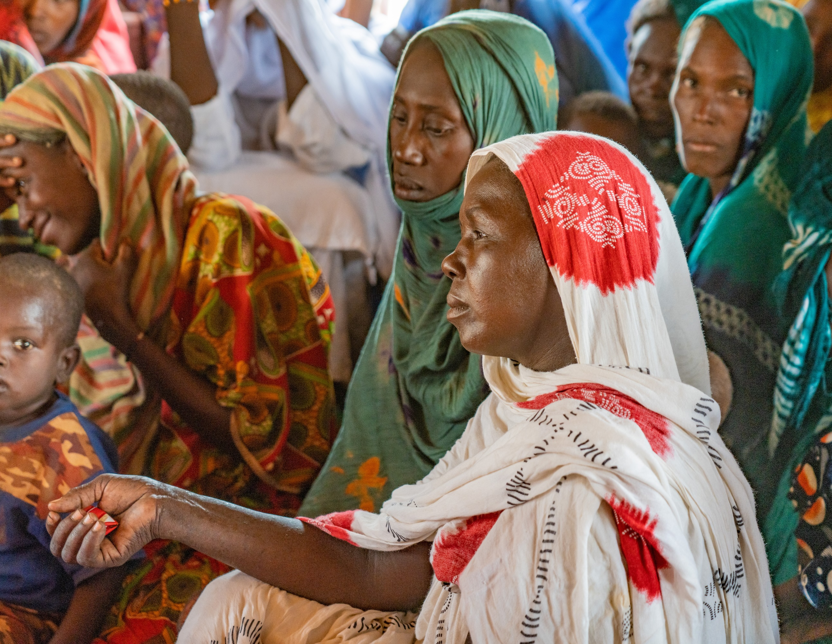
Partie 1 \ Part 1
Vue d'ensemble (niveau global et régional) / Global and Regional Level Overview
WCA Regional
Meeting

Slide 6
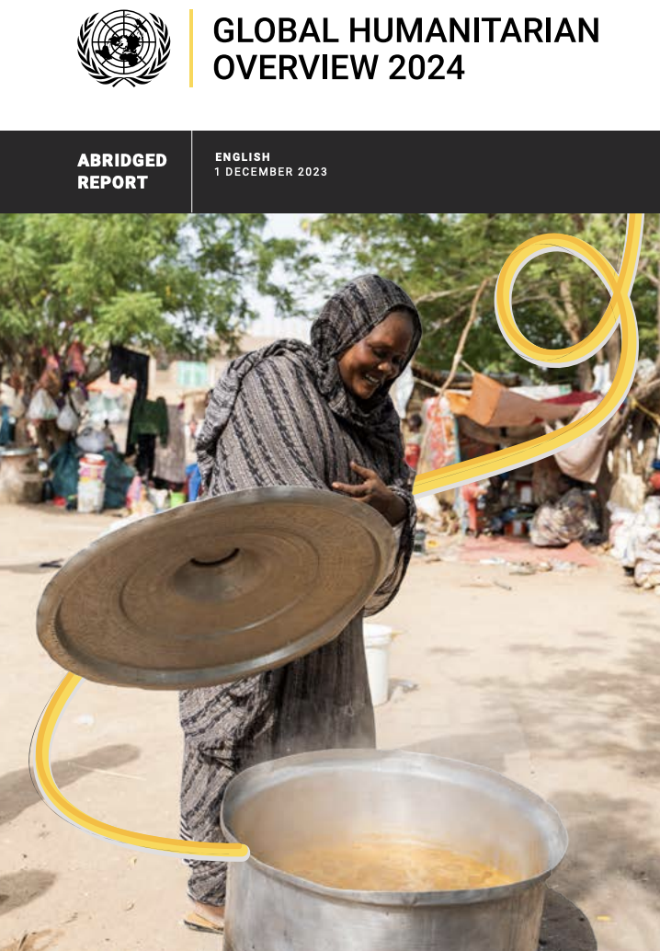

Panorama Global de la Nutrition /
Global Nutrition Landscape
Stevano Fedele
Global Nutrition Cluster Coordinator
Notes:
Introduce yourself (again)
The 2024 Global Humanitarian Overview is produced yearly and is a coordinated and comprehensive plan to address the growing humanitarian needs of people affected by crises globally. Each year we witness a growing number of affected people due to impacts from climate change to conflict, pandemics to epidemics.
The GHO assesses and analyzes those needs to help guide humanitarian response efforts. It helps in the coordination of respone efforts by providing a common understanding of the crisis including the funding needed to adequately address humanitarian needs. All of which are criticial components in our work in nutrition in emergencies.
In addition to identifiying the needs, the GHO also identifies ways forward and what we must implement at all levels into our response efforts.

Slide 7
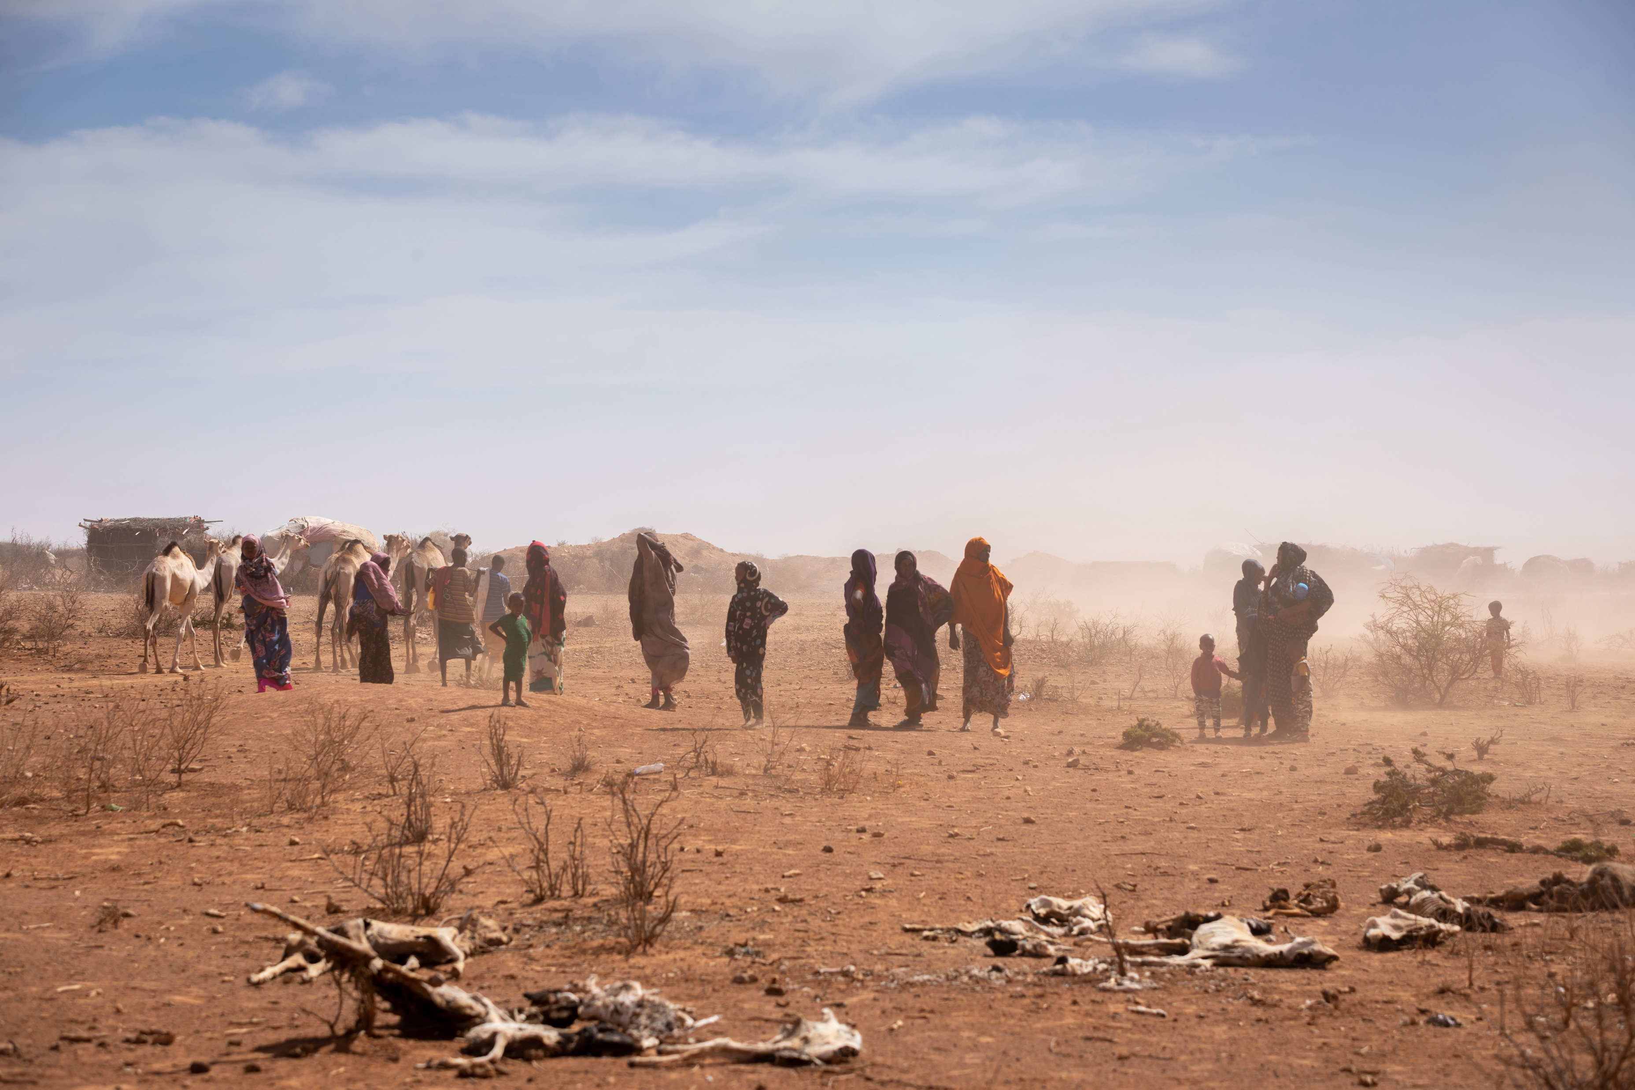
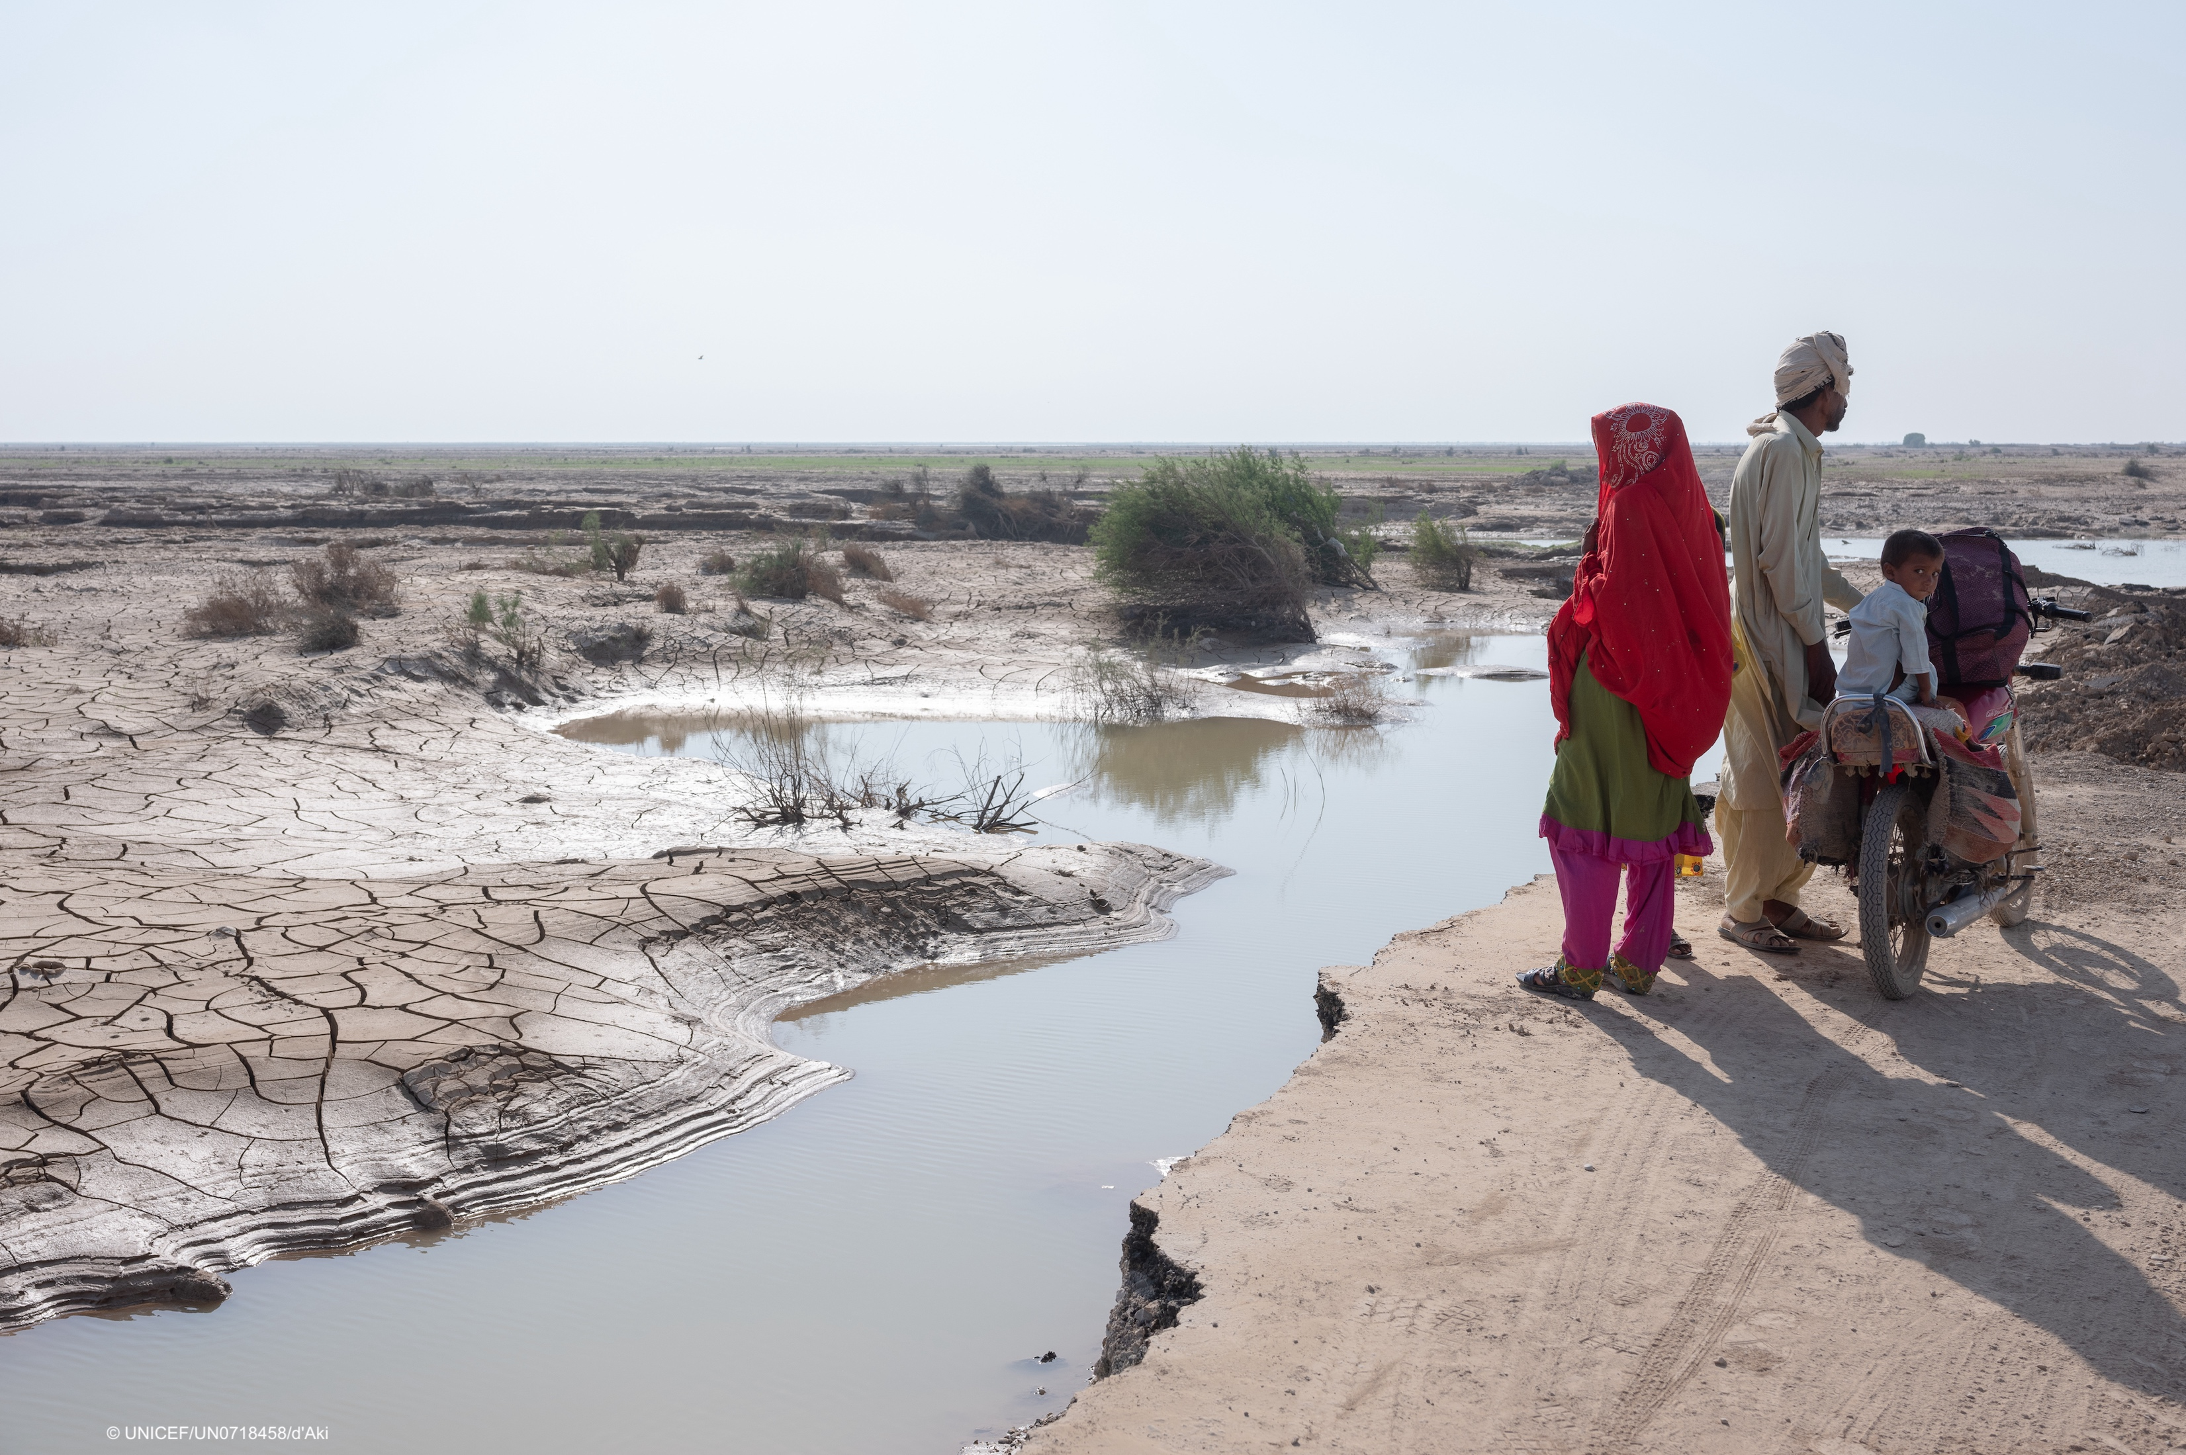
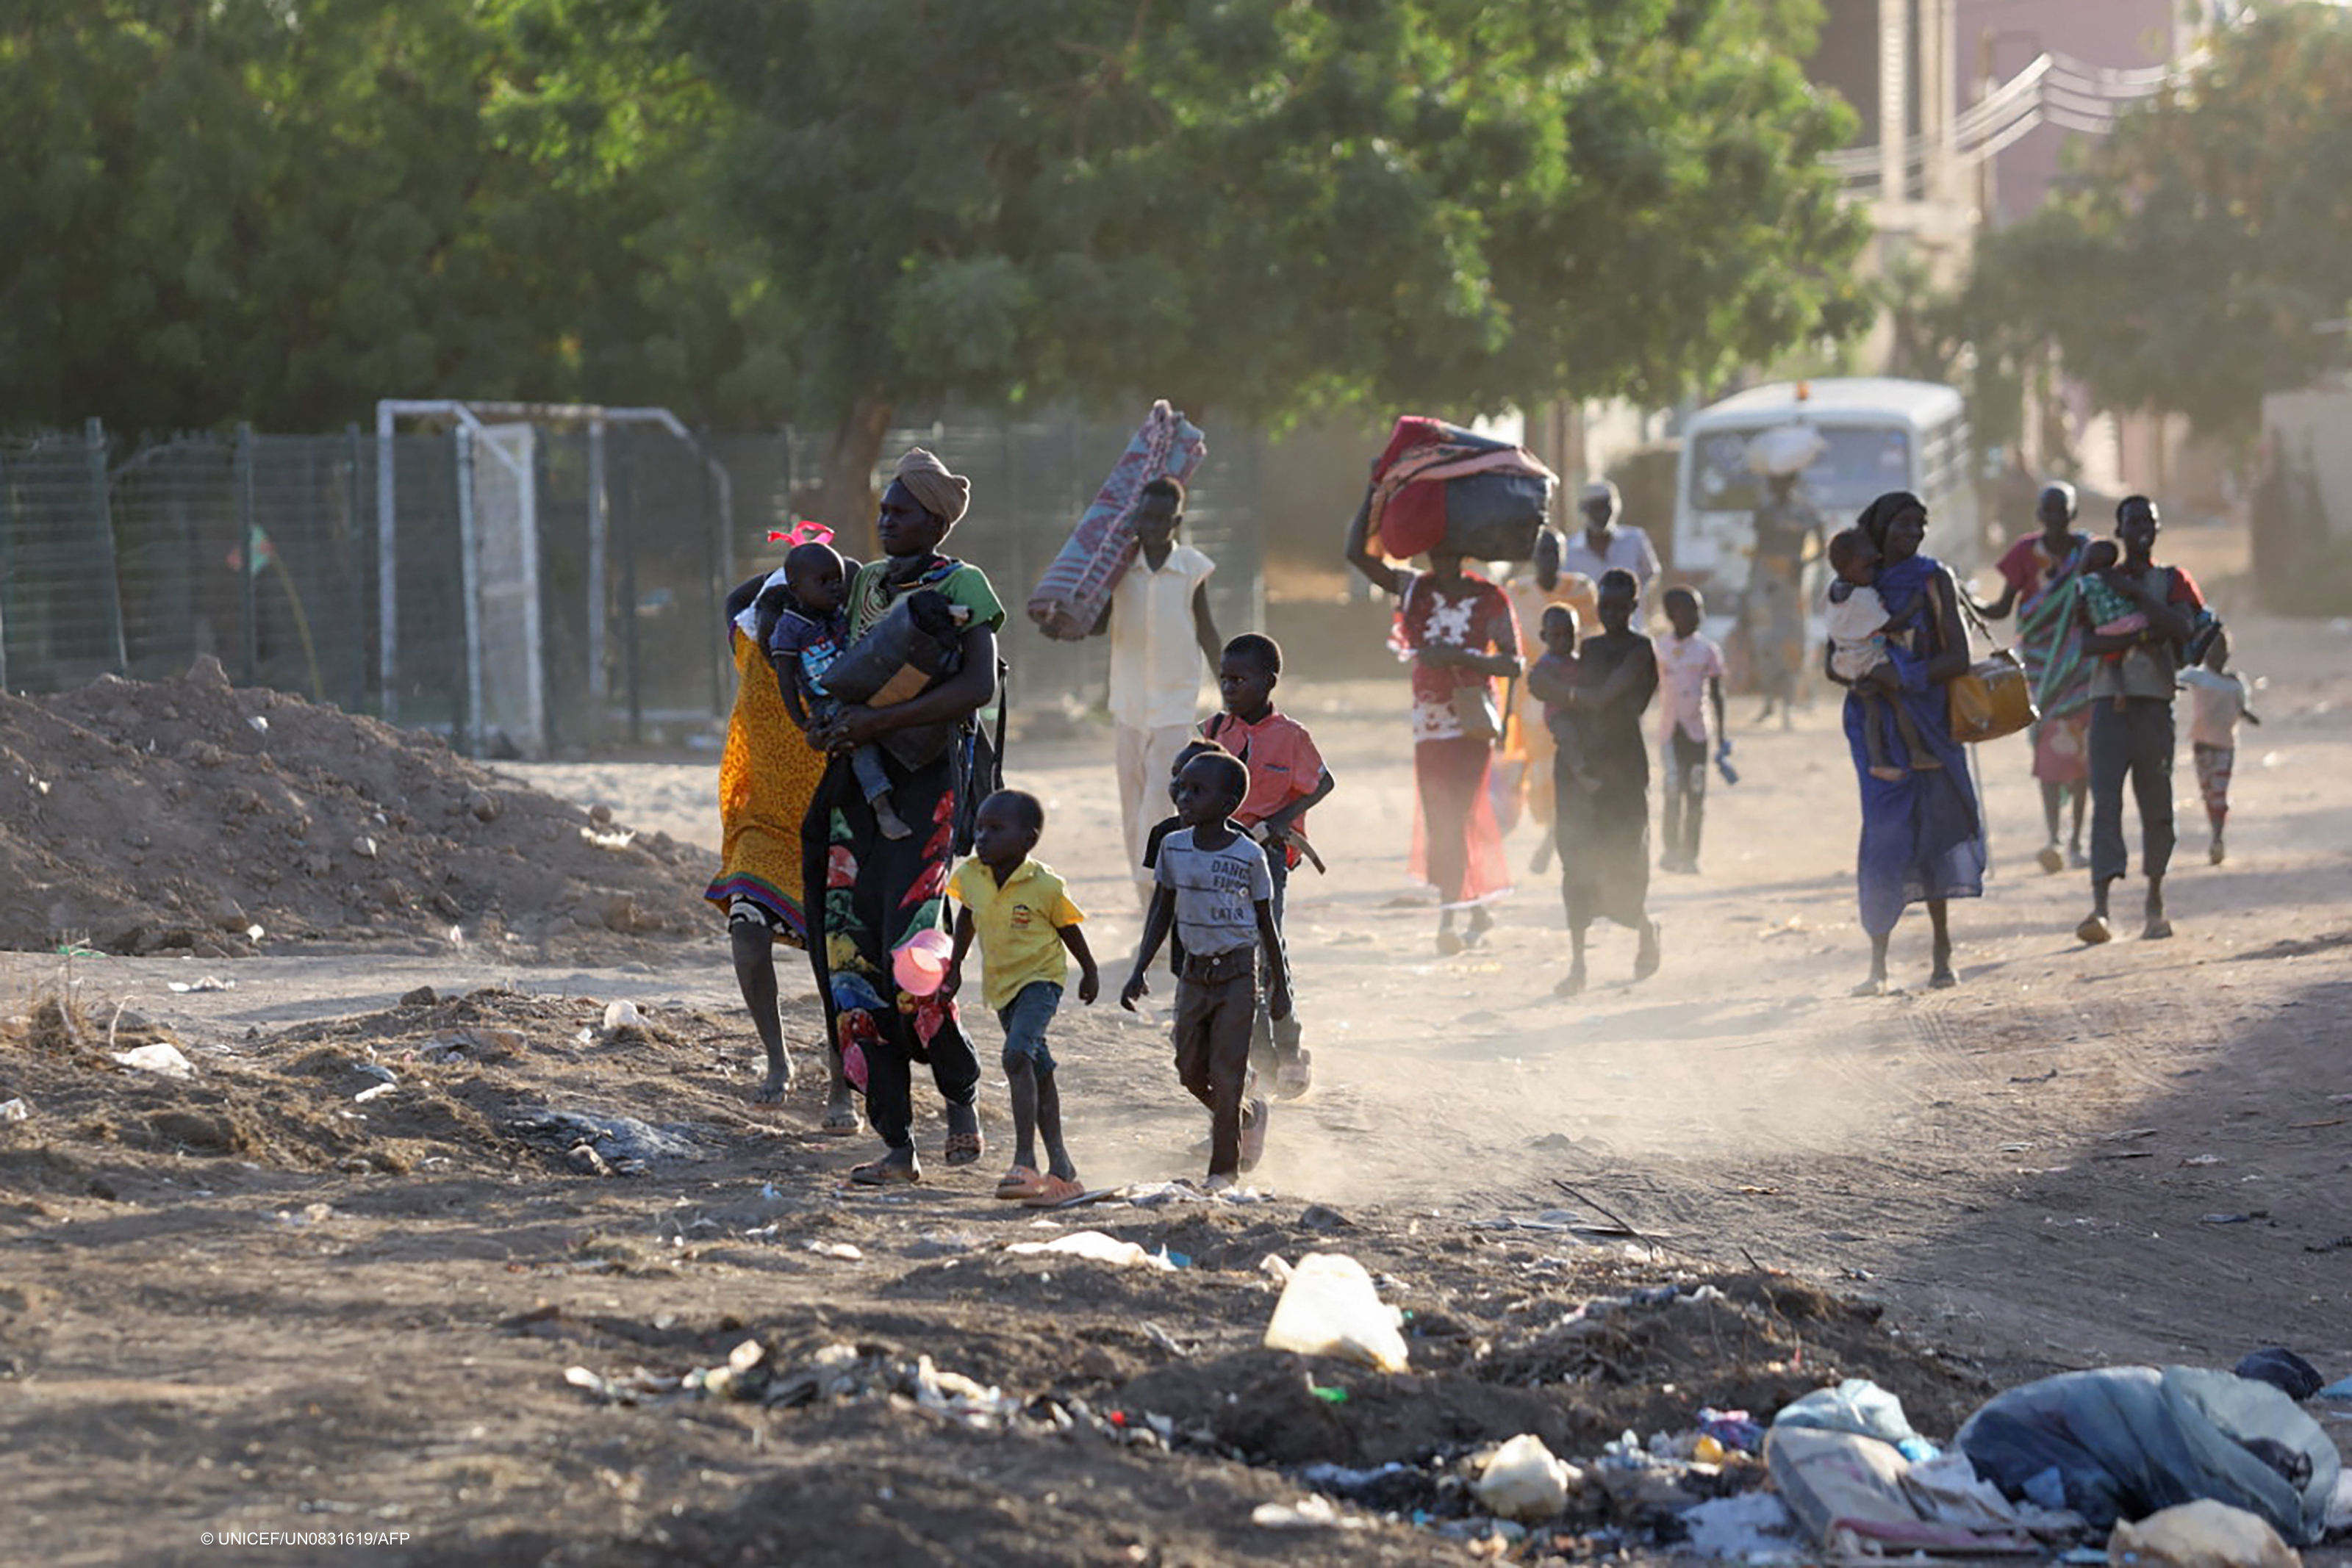
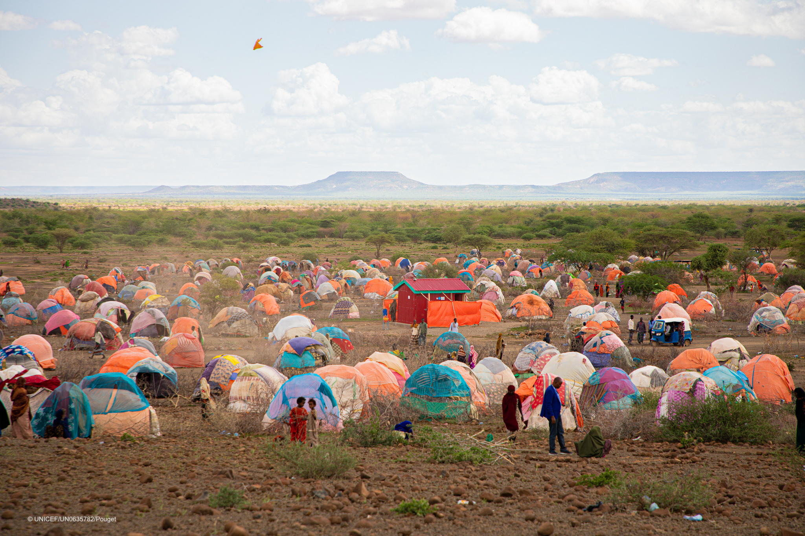
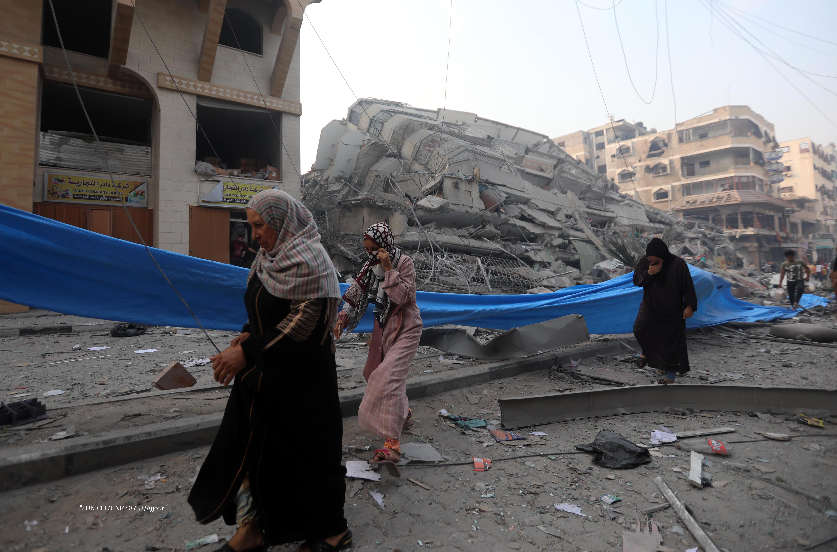

Bilan de l’année /
Year in review
Global Nutrition Landscape – Stefano Fedele, GNCC
19 February
WCA Regional
Meeting
Notes:
As we all are very aware, 2023 was another immensely challenging year that saw an increase in displacement, rise in acute food insecurity and malnutrition that reached very high levels with children, women, and girls suffering a disproportionate burden.
Additionally, the increase in global conflicts put millions in harms way and rising challenges due to climate change forced many to make strategic shifts away from usual ways of working and this will continue into 2024.
Other challenges in 2023 included a funding pitfall where less than 1/3 of the required amount was received. However, as we will undoubtedly continue to face increasing challenges, we need funding so we can provide the life saving assistance so desperately needed now and in the future.

Slide 8
Besoins globaux en 2024 /
2024 Global Needs
PERSONNES DANS LE BESOIN /
PEOPLE IN NEED
299.4M
PERSONNES CIBLEES /
PEOPLE TARGETED
180.5M
REQUIREMENTS (US$)
$46.4B
65.1 million de personnes auront besoin d’une aide humanitaire rien qu’en Afrique de l’Ouest et du Centre / 65.1 million people will need humanitarian assistance in West and Central Africa alone
Facteurs contributifs /
Drivers
Conflit / Conflict
Changement climatique
/ Climage Change
Facteurs économiques
/ Economic factors
Global Nutrition Landscape – Stefano Fedele, GNCC
19 February
WCA Regional
Meeting
Notes:
Globally, almost 300 Million people are and will be in need of humanitarian assistance in 2024, with 180.5 million targeted and $46.4billion required in total humanitarian assistance.
65.1 million people will need humanitarian assistance in West and Central Africa alone. The increase in needs (compared to 2023) are largely driven by the expanding and intensifying crises in Burkina Faso and Niger. $10.9 billion is required in ESA to address the millions in need.
2024 Global priority of needs have been and are driven by three key, overarching determinants:
1) conflict – the world is witness to more devasting conflicts. From the ongoing conflict in Ukraine to the more recent ones in Sudan and SoP, the consequences for civilians has been widespread with 1 in 5 children living in or fleeing from conflict afflicted areas.
2) Climate emergencies are forcing and increasing number of people to flee their homes due to extreme drought and food shortages.
3) economic downturn, including the persistent effect of COVID, in combination with the above, further drive up the humanitarian needs
Acute food insecurity is a reality for 258 million people in 58 countries
Wasting threatens the lives of 45 million children under 5. Of this, 13.6 million are already suffering from severe wasting, placing them at imminent risk of death.
Without concerted international efforts, nutrition insecurity will deteriorate further in 2024 with Burkina Faso, Mali, SoP, South Sudan and Sudan at the highest level of concern.
As the Global Nutrition Cluster, we aim to strenghten national capacity for a coordinated nutrition response before, during, and after emergencies and ensure a response that preserves the nutritional status and saves the most lives. Our collective role is to ensure that this support is provided where it is most needed in a coherent, consistent and predictable manner to maximise its efficiency and effectiveness.

Slide 9
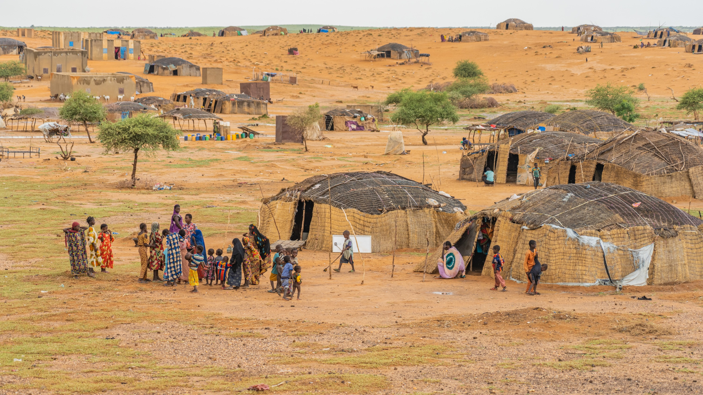
Principaux changements stratégiques
Key strategic changes
Notes:
To address these increasing challenges and needs, we must constantly evolve the ways in which we work and shift priorities to align with the needs of the most affected people.
In particular over the year ahead we aim to have more consistent progress on Localization and Climate Change

Slide 10

Localisation
Localisation
Une réponse locale, menée par des acteurs locaux et appartenant à des acteurs locaux
Locally-driven, locally-led, and locally-owned response
Martha, la conseillère CMAM du GNC, forme de futurs facilitateurs en Somalie à la gestion de la MAS en milieu hospitalier.
Martha the GNC CMAM Advisor is training future facilitators in Somalia on in-patient Management of SAM
Global Nutrition Landscape – Stefano Fedele, GNCC
19 February
WCA Regional
Meeting
Notes:
One is to ensure a more localized approach in the response supporting national and subnational leadership and acknowledging and centering the work of local and national NGOs. Here,
Martha the GNC CMAM Advisor is training future facilitators in Somalia on In-patient Management of SAM. LNAs are the first responders in every emergency and the heart of the response. They can often mobilize resources and networks quickly and have greater access to crisis affected populations. This creates and contributes to a more sustainable, effective and efficient response. .
We need greater clarity on how best we can contribute to the Climate Change agenda, ensuring that response efforts are considered through a climate change lens. The spiraling climate crisis is exposing more and more people to vulnerabilities and increasing needs.

Slide 11
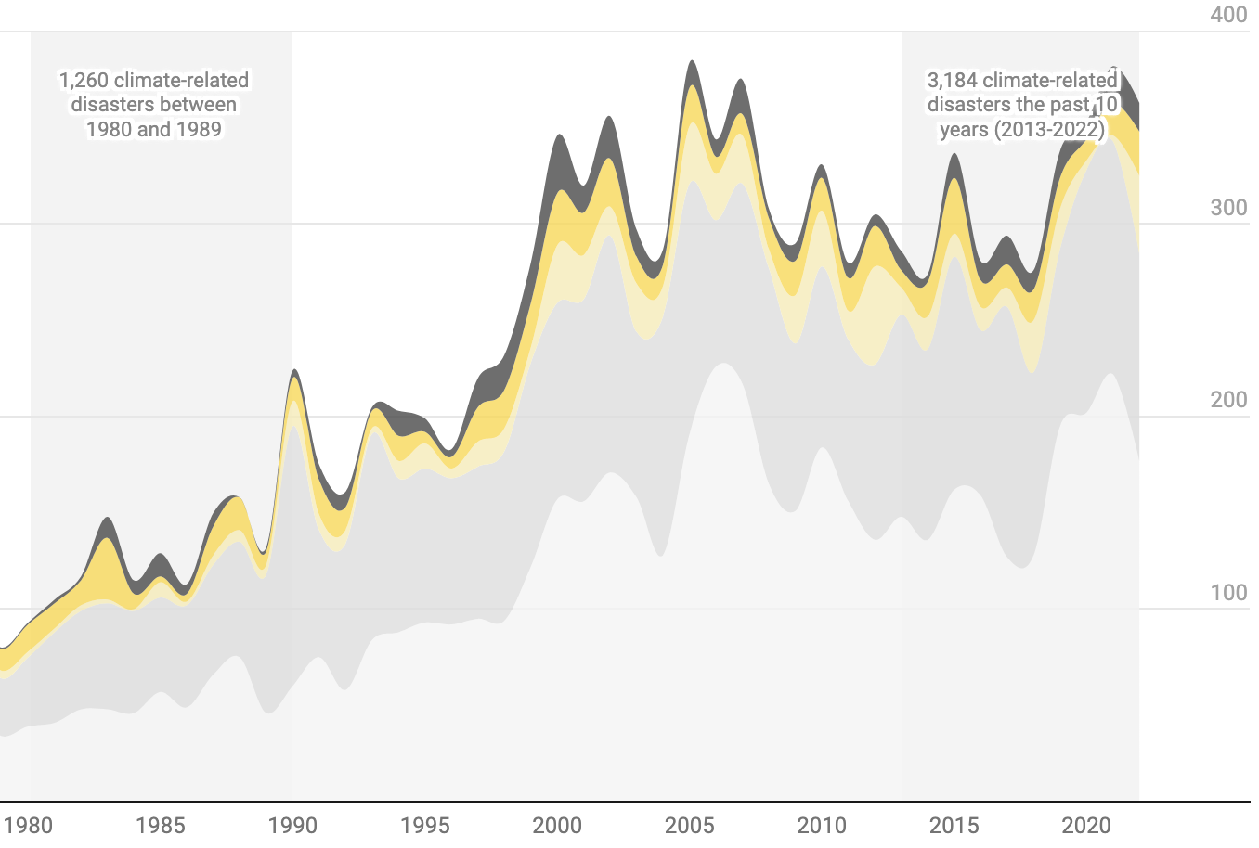
Changement climatique
Climate Change
Les catastrophes liées au climat ont été multipliées par 2,5 au cours de la décennie actuelle par rapport aux années 1980
Climate-related disasters increased by 2.5 times in current decade compared to 1980s
Global Nutrition Landscape – Stefano Fedele, GNCC
19 February
WCA Regional
Meeting
Notes:
One is to ensure a more localized approach in the response supporting national and subnational leadership and acknowledging and centering the work of local and national NGOs. Here,
Martha the GNC CMAM Advisor is training future facilitators in Somalia on In-patient Management of SAM. LNAs are the first responders in every emergency and the heart of the response. They can often mobilize resources and networks quickly and have greater access to crisis affected populations. This creates and contributes to a more sustainable, effective and efficient response. .
We need greater clarity on how best we can contribute to the Climate Change agenda, ensuring that response efforts are considered through a climate change lens. The spiraling climate crisis is exposing more and more people to vulnerabilities and increasing needs.

Slide 12

Nouvelles méthodes de travail de la GNC
GNC New Ways of Working

Slide 13

GLOBAL NUTRITION CLUSTER
SUPPORT
Coordination, Gestion de l’information & NiE
Technique
Formation & Resources
Groupes de travail
Helpdesk virtuel
Roster de Consultants
Bibliothèque Ressources
Renforcement des capacités
Conseillers techniques et RRT déployables
Actualités et événements
WCA Regional
Meeting
Notes:
Au cours de l'année dernière, l'équipe de coordination de la GNC et l'alliance technique de la GNC ont travaillé en étroite collaboration pour s'assurer que le soutien à la coordination, la gestion de l'information et le soutien technique de la NiE pour la mise en œuvre du programme sont plus faciles que jamais à identifier et sont accessibles à tous, par le biais d'une plateforme de soutien de la GNC plus holistique. Nous pensons que cela nous aidera à communiquer notre soutien et nos services plus clairement et à améliorer votre expérience avec nous. Rien ne changera pour vous. Nous continuons à offrir la même assistance, par les mêmes canaux, mais d'une manière plus unifiée et plus claire.
La coordination, la gestion de l'information et l'assistance technique continueront d'être assurées virtuellement par le service d'assistance, par des conseillers techniques déployables et par l'équipe RRT ainsi que par le rooster des consultants, qui compte plus de 235 consultants techniquement agréés, disponibles pour fournir une assistance là où c'est nécessaire et quand c'est nécessaire. Notre site web comprendra désormais toutes les informations et ressources de la GNC, qu'il s'agisse d'informations sur les groupes de travail et le renforcement des capacités, de nouvelles et d'événements ou d'une bibliothèque de ressources élargie.
Nous pensons que cette approche favorisera une plus grande synergie entre nos deux bras de soutien, qui se chevauchent déjà de manière significative. Avec une vision et un objectif communs - fournir une coordination nutritionnelle opportune et complète, une gestion de l'information et un soutien technique en matière de nutrition dans les situations d'urgence - nous pensons pouvoir utiliser nos ressources collectives de manière plus efficace et, en fin de compte, mieux servir les acteurs de la nutrition, tels que vous.

Slide 14
GLOBAL NUTRITION CLUSTER
SUPPORT
Coordination, Information Management & NiE
Technical
Learning & Resources
Working
Groups
Virtual
Helpdesk
Consultant Roster
Resource
Library
Capacity
Strengthening
Deployed
Advisors
News & Events
WCA Regional
Meeting
Notes:
Over the last year the GNC Coordination Team and the GNC Technical Alliance have been working closely to ensure that the provision of support for Coordination, Information Management and technical support for Programme delivery are easier than ever to identify and access by all, through a more holistic GNC support platform. We believe this will help us to communicate our support and services more clearly and improve your experience with us. Nothing will change for you. We are still offering the same support, through the same channels but in a more unified and clear way.
We also believe this approach will foster more synergy between our two arms of support, which already overlap significantly. With one shared vision and purpose – to provide timely and comprehensive nutrition coordination, information management, and Nutrition in Emergencies technical support – we believe we can utilize our collective resources more efficiently and ultimately serve nutrition actors, like you, better.
Scan the QR code at the end of this presentation to visit the GNC site to request any support you need.

Slide 15


ESA Regional
Meeting
merci

Slide 16

La situation nutritionnelle et les priorités de nutrition en urgence dans la région
Simeon Nanama
Conseiller régional nutrition
UNICEF WCARO
Février 2024

Slide 17

Apercu de la situation humanitaire

Slide 18
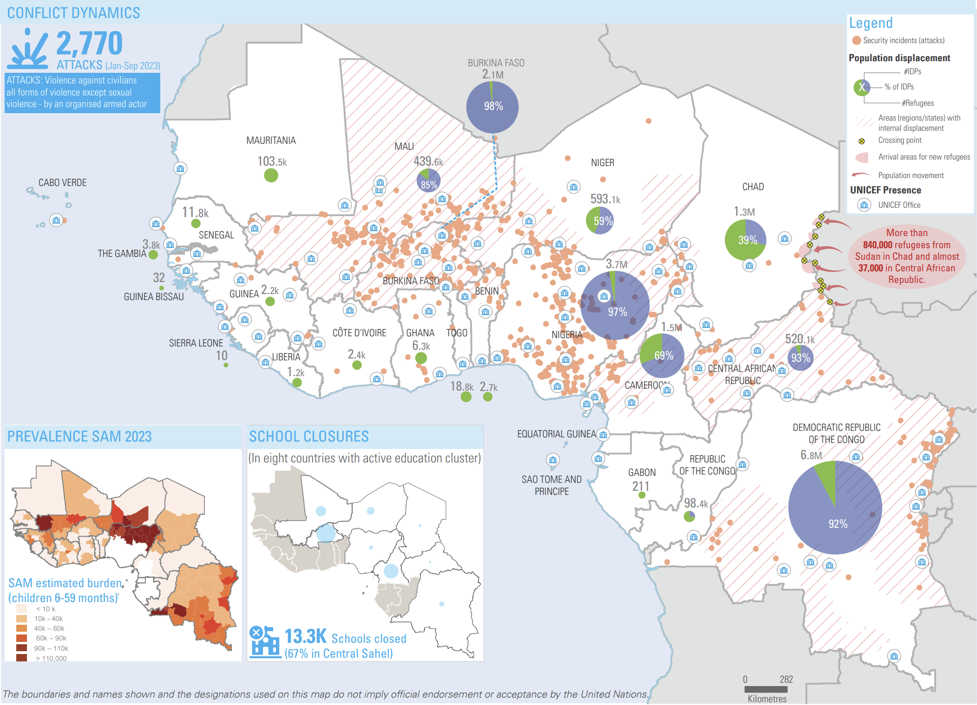
Conflits et déplacements
Augmentation persistante de l’insécurité et des déplacements

Slide 19
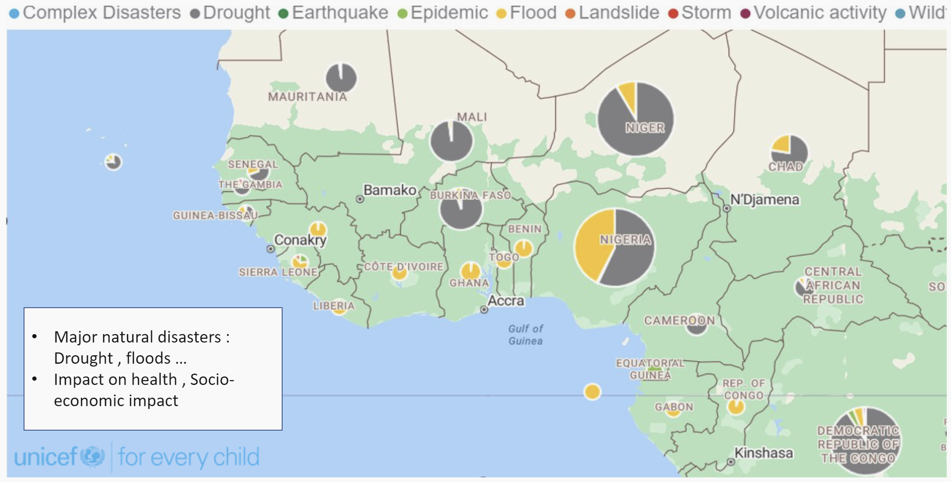
Catastrophes naturelles et épidémies de santé
Les sécheresses sont les plus fréquentes dans les pays du Sahel
Les inondations sont plus fréquentes dans les pays côtiers
Augmentation de la fréquence des épidémies de santé

Slide 20
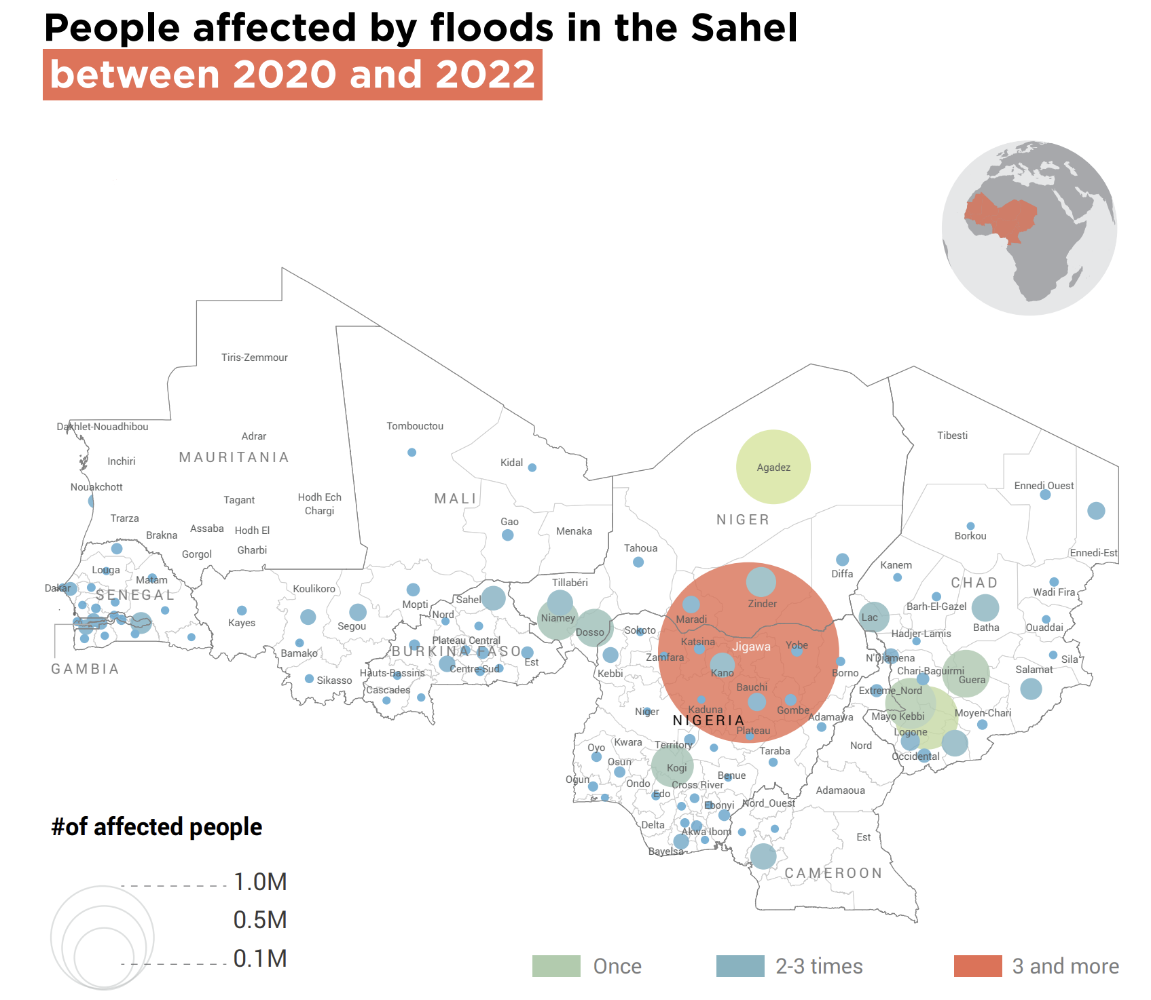
Les inondations au Sahel
Les inondations deviennent plus fréquentes dans les pays Sahel

Slide 21
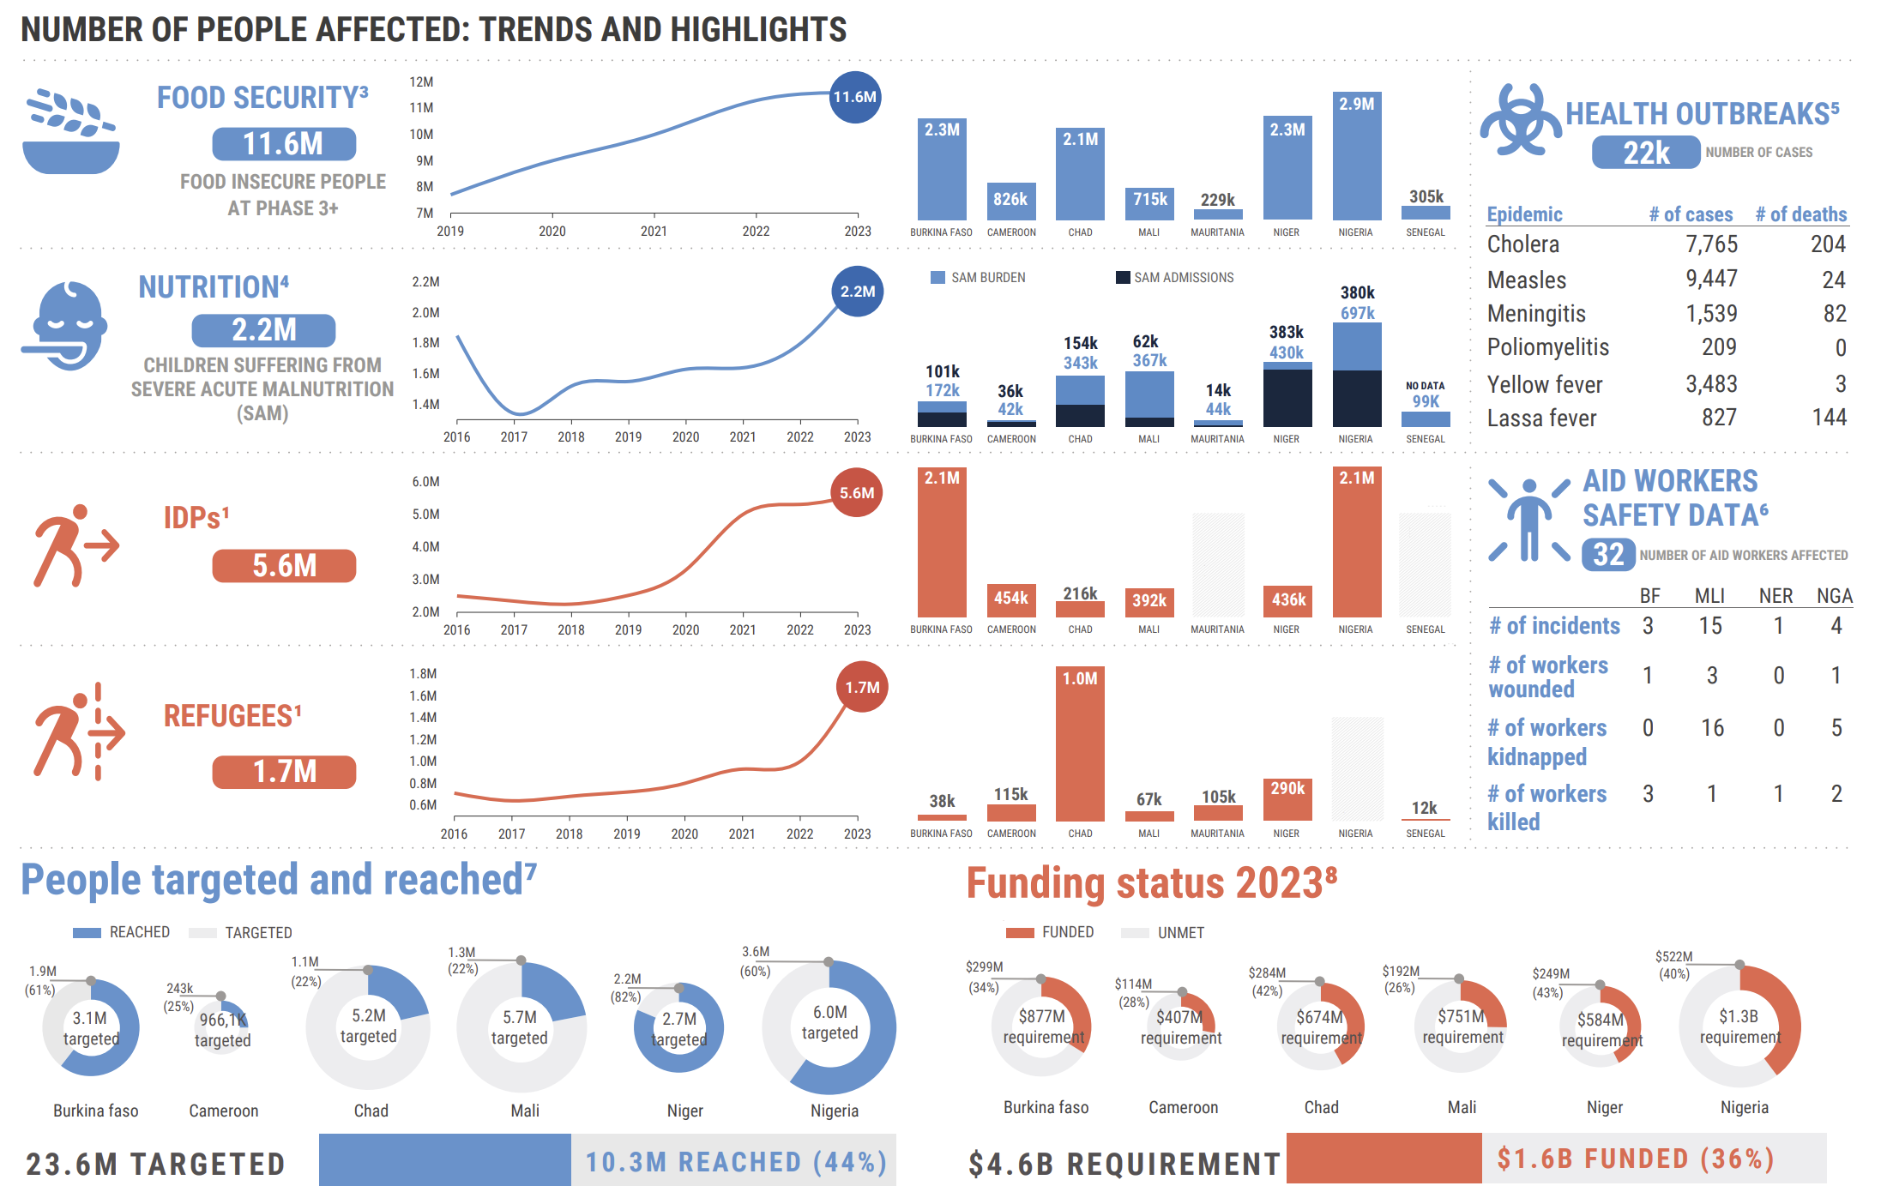

Performance Plan de réponse humanitaire Sahel 2023
Notes:
Not specific for nutrition

Slide 22
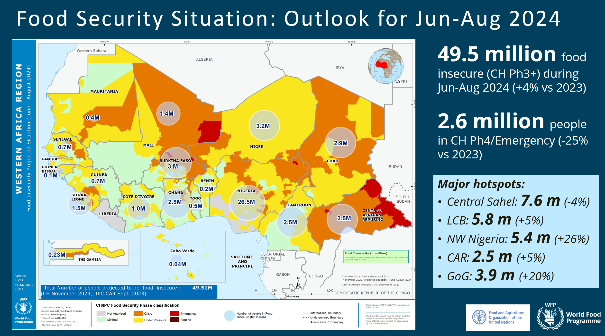
Insécurité alimentaire

Slide 23

Situation nutritionnelle dans la Région

Slide 24
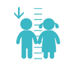
Le nombre d’enfants avec un retard de croissance augmente
31m
Nombre d’enfants avec retard de croissance +41%
Alors qu'elle n'accueille que 15 % des enfants du monde, la région concentre 21 % des cas de retard de croissance dans le monde.
Le retard de croissance est associé à des conséquences significatives et durables pour les enfants et les économies.
22m
40%
32%
Prévalence du retard de croissance -20%
2000
2022
% Stunted U5
# Stunted U5 (millions)
Source: UNICEF, WHO, World Bank Group Joint Child Malnutrition Estimates, 2023.
Notes:
This choice is justified by the magnitude of stunting in the region. While hosting only 11 percent of the world children, the 24 countries of the region are home to 20% of the global stunting burden. Despite a slight decrease in the prevalence of stunting from 40.4% to 32.7% in the last 20 years, the number of stunted children has gradually increased from 22.4 to 29 million in the region. This alarming situation requires urgent action, as poor nutrition in early life has long-lasting consequences for learning and future productivity, and the development of nations.
(Joint malnutrition estimates, March 2021)

Slide 25
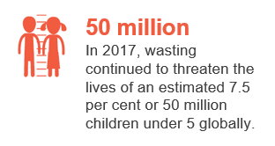
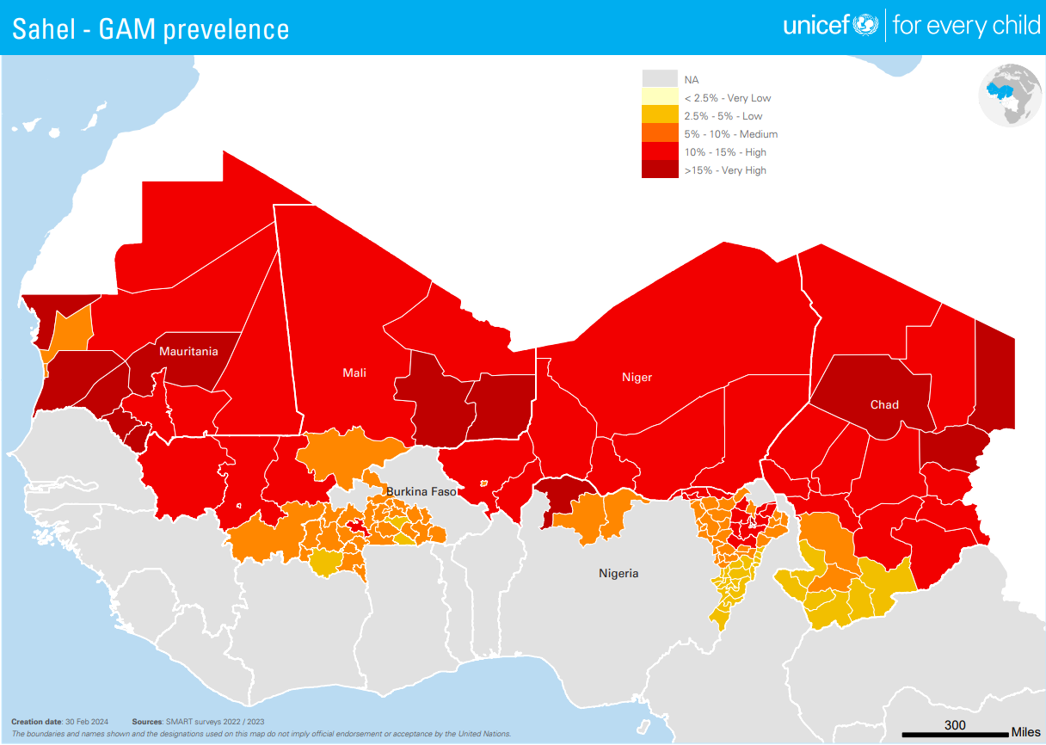
La prévalence de la malnutrition aigue reste alarmante
La malnutrition aigue chez les enfants de moins de 5 ans
La Région répresente ~11% du fardeau mondial de la malnutrition aigue
Notes:
Concurrence wasting-stunting → Increased risk of mortality by 12

Slide 26
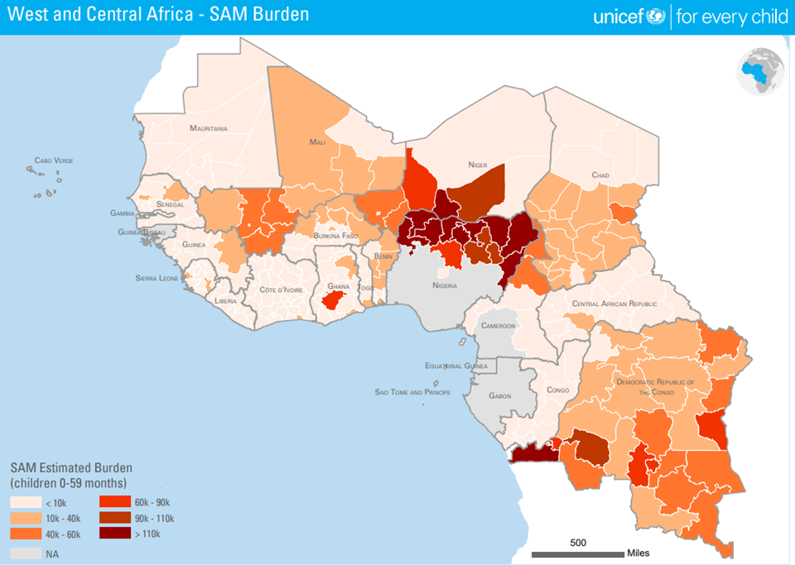
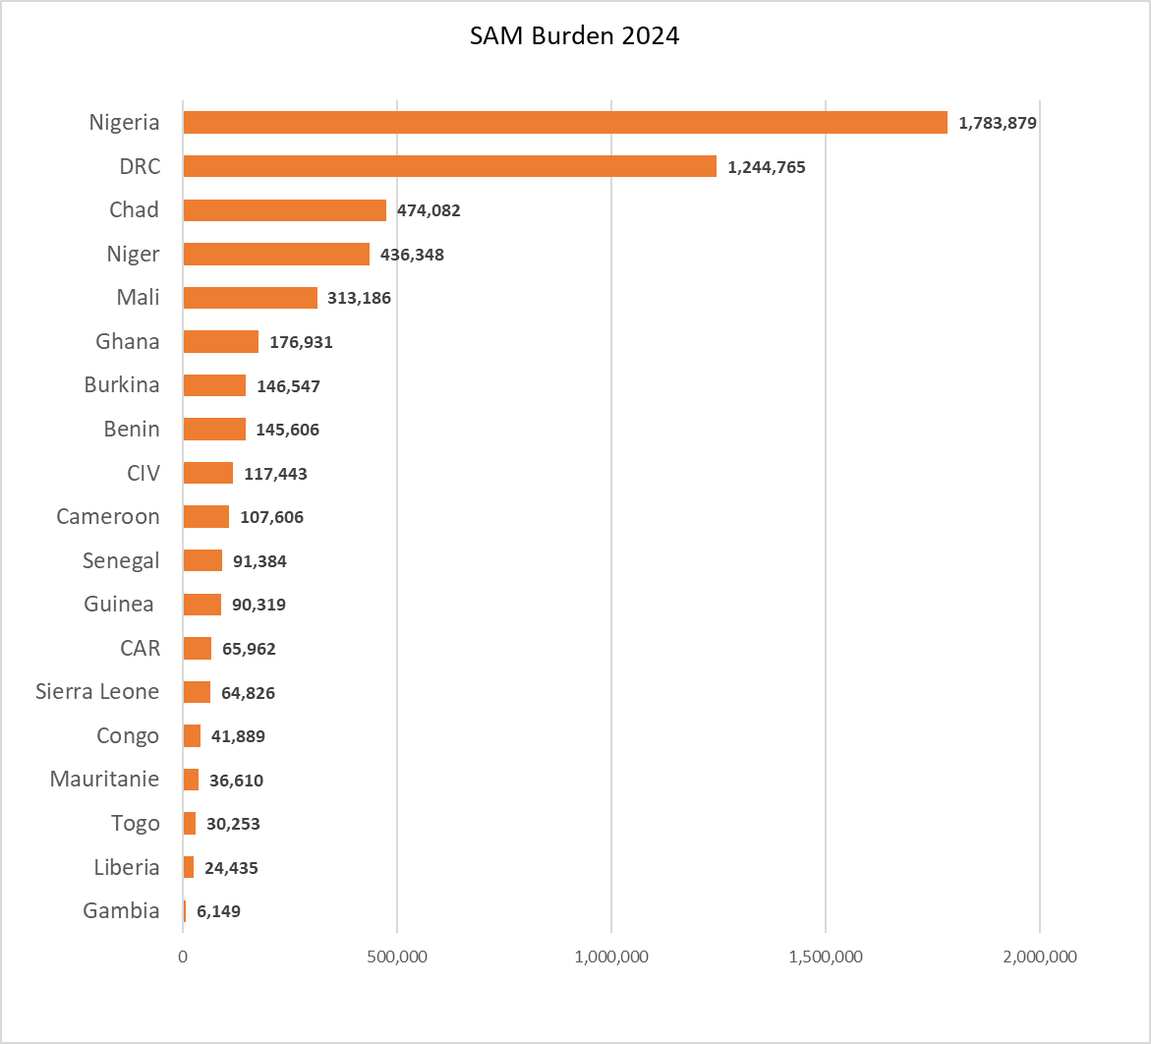
Nombre d’enfants attendus avec la MAS en 2024
Notes:
Concurrence wasting-stunting → Increased risk of mortality by 12

Slide 27
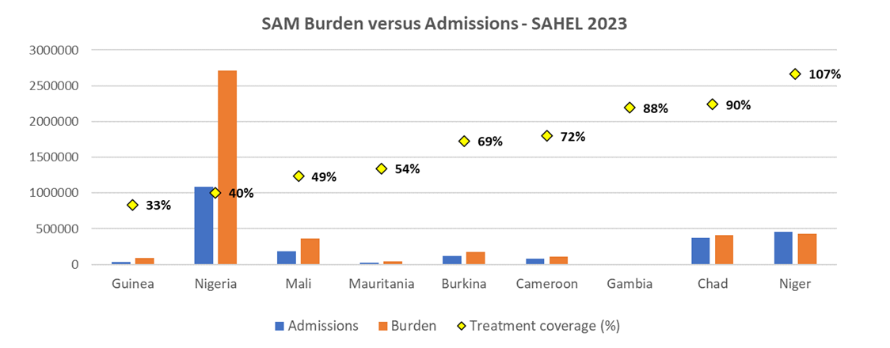
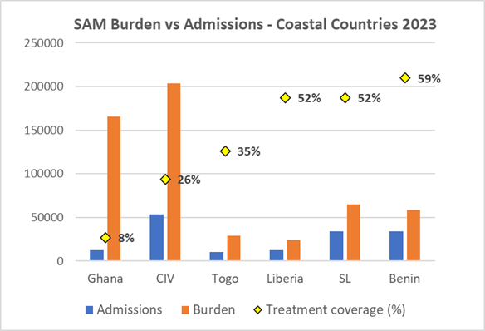
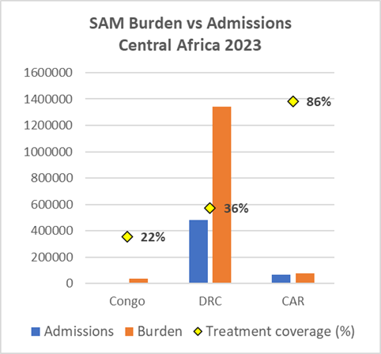
La couverture du traitement de la MAS est limitée par des problèmes de financement et d'accès
Globalement, dans les pays du Sahel, une meilleure couverture du traitement
Il est de plus en plus difficile de sécuriser le financement de l’ATPE, en particulier dans les pays/zones non sahéliens et les pays avec un caseload très élevé (Nigéria et RDC).
L’insécurite affecte l’accès au traitement
Notes:
Concurrence wasting-stunting → Increased risk of mortality by 12

Slide 28
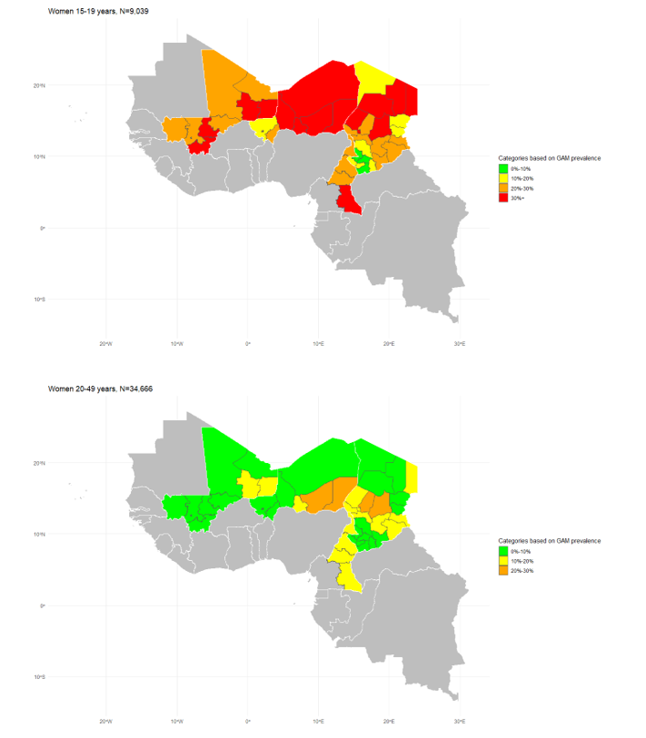
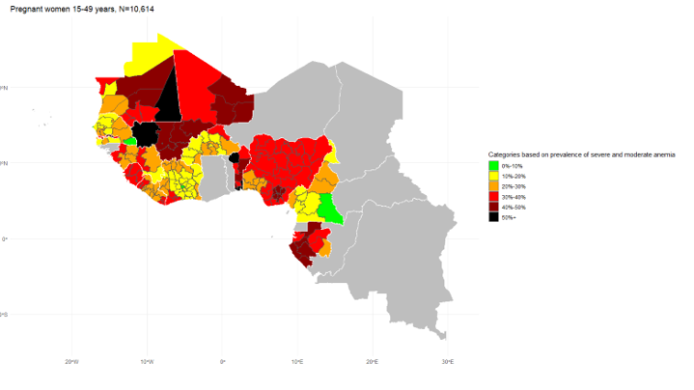
La nutrition maternelle et des adolescentes
Malnutrition aigue sur base de PB <23cm
Anémie sévère et moderée chez les femmes enceintes
Source: WCARO, nutrition section, 2023
Notes:
MUAC: based on latest SMART survey (2022-2023)
Anemia: based on latest DHS data available

Slide 29

Priorités nutrition en urgence

Slide 30
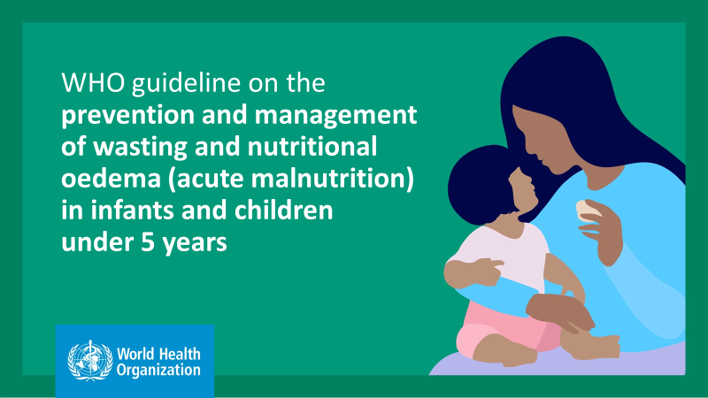

Prévention et prise en charge de la malnutrition aigue
Somalia, Afghanistan and Yemen
Full guidelines
Atelier régional OMS/PAM/UNICEF (Février 2024)
Appui aux pays pour la révision des protocoles
Appui aux pays pour la mise en oeuvre
Suivi de la mise en oeuvre et documentation des lecons apprises
Notes:
Britta
The 15 priority countries have been allocated to three phases.
Implication: Means that these countries are being prioritized for global/regional level support including fundraising efforts, does not mean that country teams cannot move faster than this if they want.
Decision making : determined (with UNCIEF/WFP country teams) to be more ready and more suitable for the transition, based on several factors.
Phase 1: Joint preparation and planning will start in 2023, and programme shifts in 2024. This includes ensuring government agreement and all necessary steps are taken, such as building partner buy-in, identifying target regions, and developing a comprehensive plan for 2024, including costing, funding, development of tools and trainings.
Target areas
Learnings from phase 1 countries will be used to inform transition of other countries.
Phase 2: Detailed consultations with national level partners to start in 2023, with agreement on transition expected end of 2024. Programmatic shifts to start in 2025.
Phase 3: Discussions to start in 2023, programmatic shifts to starts towards the end of 2025 and expansion towards the end of 2026.
Parameters considered for overall readiness and pace for transition:
Operating/programming environment
Government readiness and policy environment
UNICEF and WFP readiness at CO level
System capacity
Supplies and Supply chain readiness
Funding

Slide 31
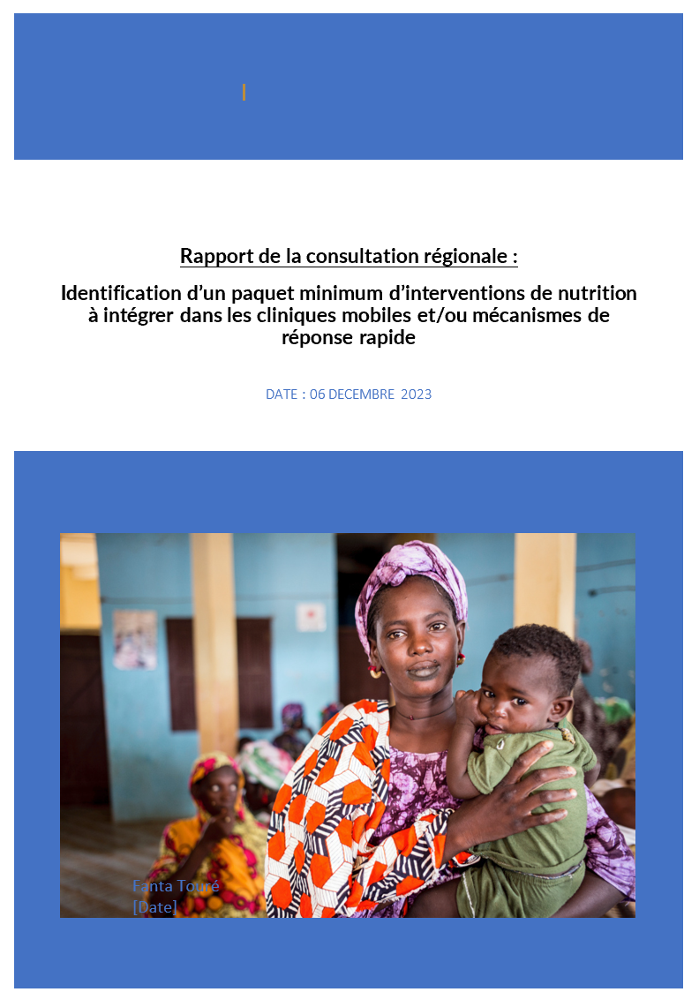
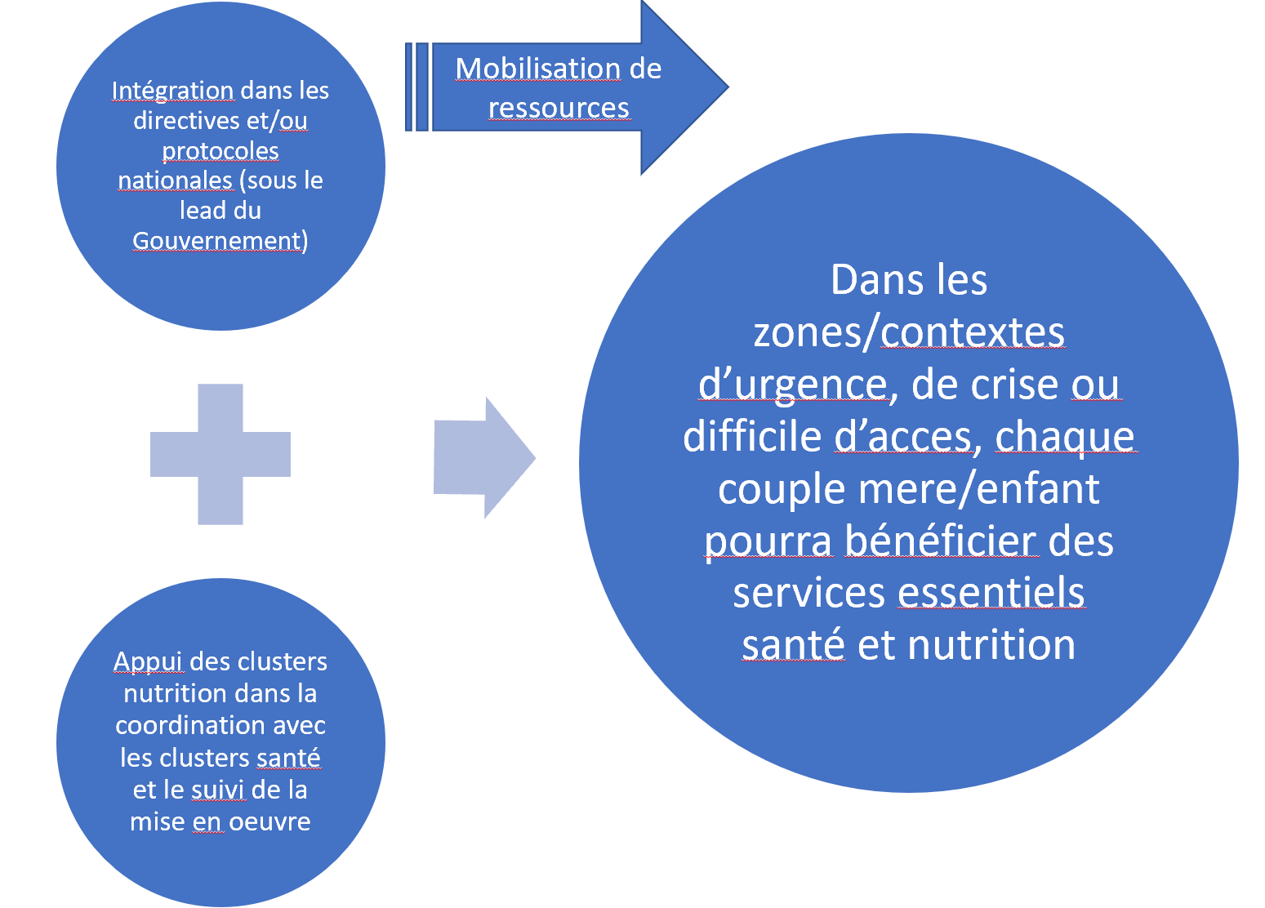
Continuité des services essentiels de nutrition
Prochaines etapes
Somalia, Afghanistan and Yemen
Full guidelines
Notes:
Britta
The 15 priority countries have been allocated to three phases.
Implication: Means that these countries are being prioritized for global/regional level support including fundraising efforts, does not mean that country teams cannot move faster than this if they want.
Decision making : determined (with UNCIEF/WFP country teams) to be more ready and more suitable for the transition, based on several factors.
Phase 1: Joint preparation and planning will start in 2023, and programme shifts in 2024. This includes ensuring government agreement and all necessary steps are taken, such as building partner buy-in, identifying target regions, and developing a comprehensive plan for 2024, including costing, funding, development of tools and trainings.
Target areas
Learnings from phase 1 countries will be used to inform transition of other countries.
Phase 2: Detailed consultations with national level partners to start in 2023, with agreement on transition expected end of 2024. Programmatic shifts to start in 2025.
Phase 3: Discussions to start in 2023, programmatic shifts to starts towards the end of 2025 and expansion towards the end of 2026.
Parameters considered for overall readiness and pace for transition:
Operating/programming environment
Government readiness and policy environment
UNICEF and WFP readiness at CO level
System capacity
Supplies and Supply chain readiness
Funding

Slide 32

Nutrition maternelle en situation d’urgence
Somalia, Afghanistan and Yemen
Analyse régionale des données disponibles sur la malnutrition chez les femmes et les adolescents pour l’identification de zones prioritaires
Tester la mise en oeuvre des directives globales sur la nutrition maternelle en situation d’urgence (à venir)
Identification d’un paquet d’interventions pour la nutrition maternelle et des adolescents en situation d’urgence (sur base des directives globales et lecons apprises – avec le sous-groupe nutrition maternelle et des adolescents)
Full guidelines
Notes:
Britta
The 15 priority countries have been allocated to three phases.
Implication: Means that these countries are being prioritized for global/regional level support including fundraising efforts, does not mean that country teams cannot move faster than this if they want.
Decision making : determined (with UNCIEF/WFP country teams) to be more ready and more suitable for the transition, based on several factors.
Phase 1: Joint preparation and planning will start in 2023, and programme shifts in 2024. This includes ensuring government agreement and all necessary steps are taken, such as building partner buy-in, identifying target regions, and developing a comprehensive plan for 2024, including costing, funding, development of tools and trainings.
Target areas
Learnings from phase 1 countries will be used to inform transition of other countries.
Phase 2: Detailed consultations with national level partners to start in 2023, with agreement on transition expected end of 2024. Programmatic shifts to start in 2025.
Phase 3: Discussions to start in 2023, programmatic shifts to starts towards the end of 2025 and expansion towards the end of 2026.
Parameters considered for overall readiness and pace for transition:
Operating/programming environment
Government readiness and policy environment
UNICEF and WFP readiness at CO level
System capacity
Supplies and Supply chain readiness
Funding

Slide 33

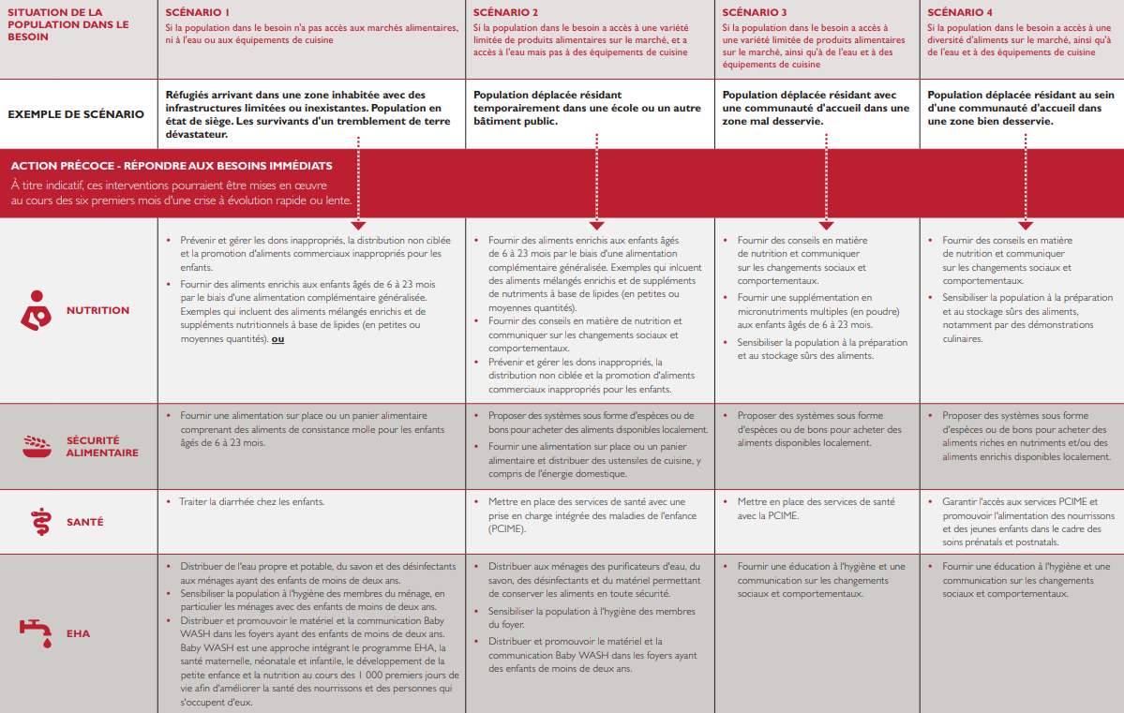
Alimentation de complément en situation d’urgence
Revue des plans de réponse humanitaires pour évaluer l’intégration actuelle
Tester l’outil de décision au niveau des pays
Documentation et partage des bonnes pratiques
Somalia, Afghanistan and Yemen
Full guidelines
Notes:
Britta
The 15 priority countries have been allocated to three phases.
Implication: Means that these countries are being prioritized for global/regional level support including fundraising efforts, does not mean that country teams cannot move faster than this if they want.
Decision making : determined (with UNCIEF/WFP country teams) to be more ready and more suitable for the transition, based on several factors.
Phase 1: Joint preparation and planning will start in 2023, and programme shifts in 2024. This includes ensuring government agreement and all necessary steps are taken, such as building partner buy-in, identifying target regions, and developing a comprehensive plan for 2024, including costing, funding, development of tools and trainings.
Target areas
Learnings from phase 1 countries will be used to inform transition of other countries.
Phase 2: Detailed consultations with national level partners to start in 2023, with agreement on transition expected end of 2024. Programmatic shifts to start in 2025.
Phase 3: Discussions to start in 2023, programmatic shifts to starts towards the end of 2025 and expansion towards the end of 2026.
Parameters considered for overall readiness and pace for transition:
Operating/programming environment
Government readiness and policy environment
UNICEF and WFP readiness at CO level
System capacity
Supplies and Supply chain readiness
Funding

Slide 34

Surveillance nutritionnelle dans les contextes humanitaires
Somalia, Afghanistan and Yemen
Prochaines étapes:
Suivi de la mise en oeuvre des FdR des pays
Déployer la méthodologie SMART+
Tester des approaches innovatives pour la collecte des données dans les zones difficiles d’accès
Full guidelines
Notes:
Britta
The 15 priority countries have been allocated to three phases.
Implication: Means that these countries are being prioritized for global/regional level support including fundraising efforts, does not mean that country teams cannot move faster than this if they want.
Decision making : determined (with UNCIEF/WFP country teams) to be more ready and more suitable for the transition, based on several factors.
Phase 1: Joint preparation and planning will start in 2023, and programme shifts in 2024. This includes ensuring government agreement and all necessary steps are taken, such as building partner buy-in, identifying target regions, and developing a comprehensive plan for 2024, including costing, funding, development of tools and trainings.
Target areas
Learnings from phase 1 countries will be used to inform transition of other countries.
Phase 2: Detailed consultations with national level partners to start in 2023, with agreement on transition expected end of 2024. Programmatic shifts to start in 2025.
Phase 3: Discussions to start in 2023, programmatic shifts to starts towards the end of 2025 and expansion towards the end of 2026.
Parameters considered for overall readiness and pace for transition:
Operating/programming environment
Government readiness and policy environment
UNICEF and WFP readiness at CO level
System capacity
Supplies and Supply chain readiness
Funding

Slide 35
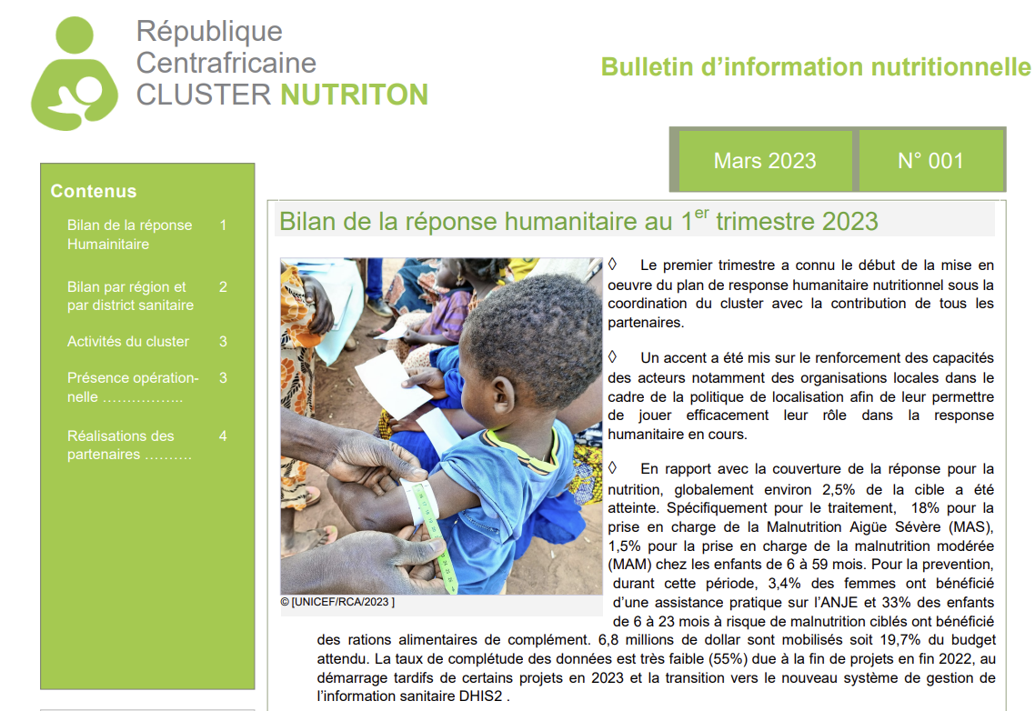


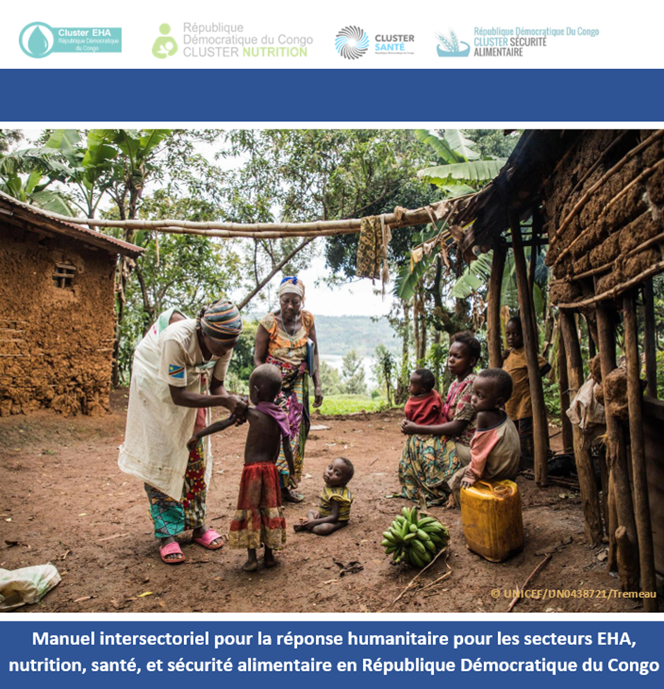
Coordination pour la nutrition en urgence
Niveau pays: clusters nutrition dans 8 pays
Niveau régional: sous-groupe NiE – réunions mensuelles, coordonné par UNICEF et PAM
Contributions aux autres plateformes:
RNWG
OCHA groupe intersecteur
FSNWG
PREGEC/RPCA
Partage d’expériences et de bonnes pratiques:
Réunion GNC/WCARO avec les NCC
Présentations par les pays dans le sous-groupe NiE
Partage des produits entre NCC

Slide 36
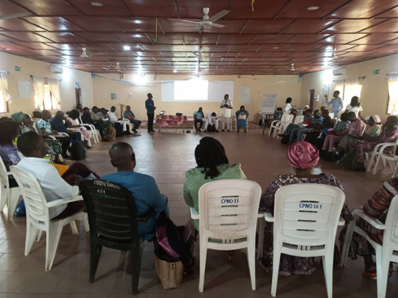


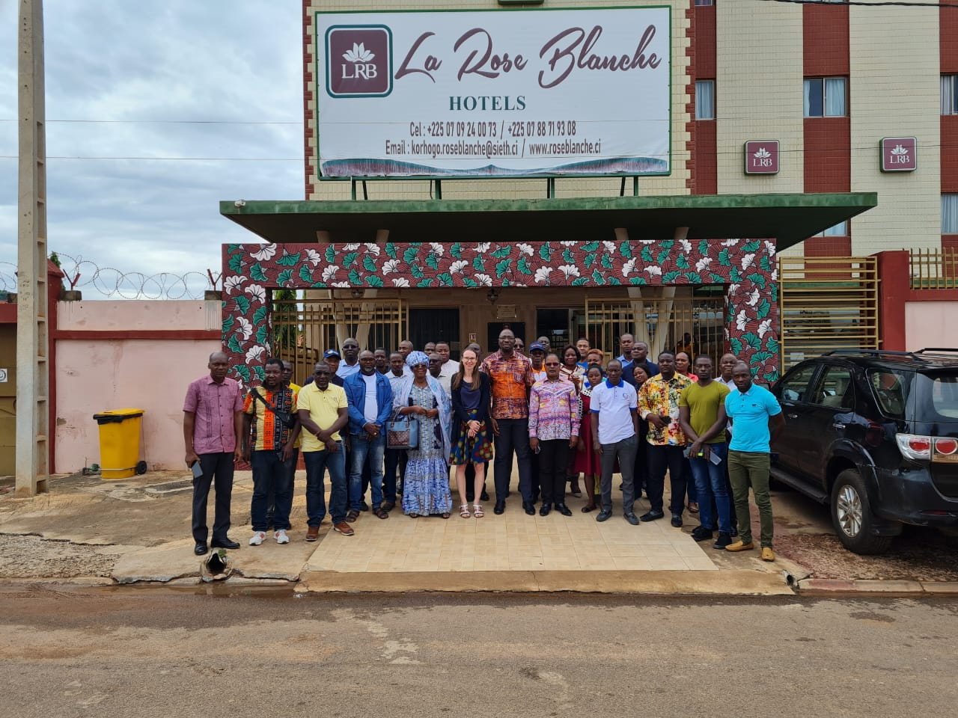

Collaboration WCARO-GNC
Renforcement des capacités pour staffs UNICEF et partenaires sur la coordination pour la nutrition en situation d’urgence
Appui aux pays pour la facilitation des formations sur la nutrition en urgence
Coordination au niveau régional- participation par le GNC dans le sous-groupe NiE
Dissémination des notes conjointes de plaidoyer à travers le site et le bulletin d’information du GNC
Partage des expériences: contribution au webinaire du GNC-TA/Groupe IFE sur ANJE-U et les médias
Formation NiE par UNICEF WCARO – Korhogo,
Cote d’Ivoire
Formation ANJE-U par GNC – Natitingou, Benin

Slide 37


Merci!

Slide 38

pause-café / coffee break

Slide 39
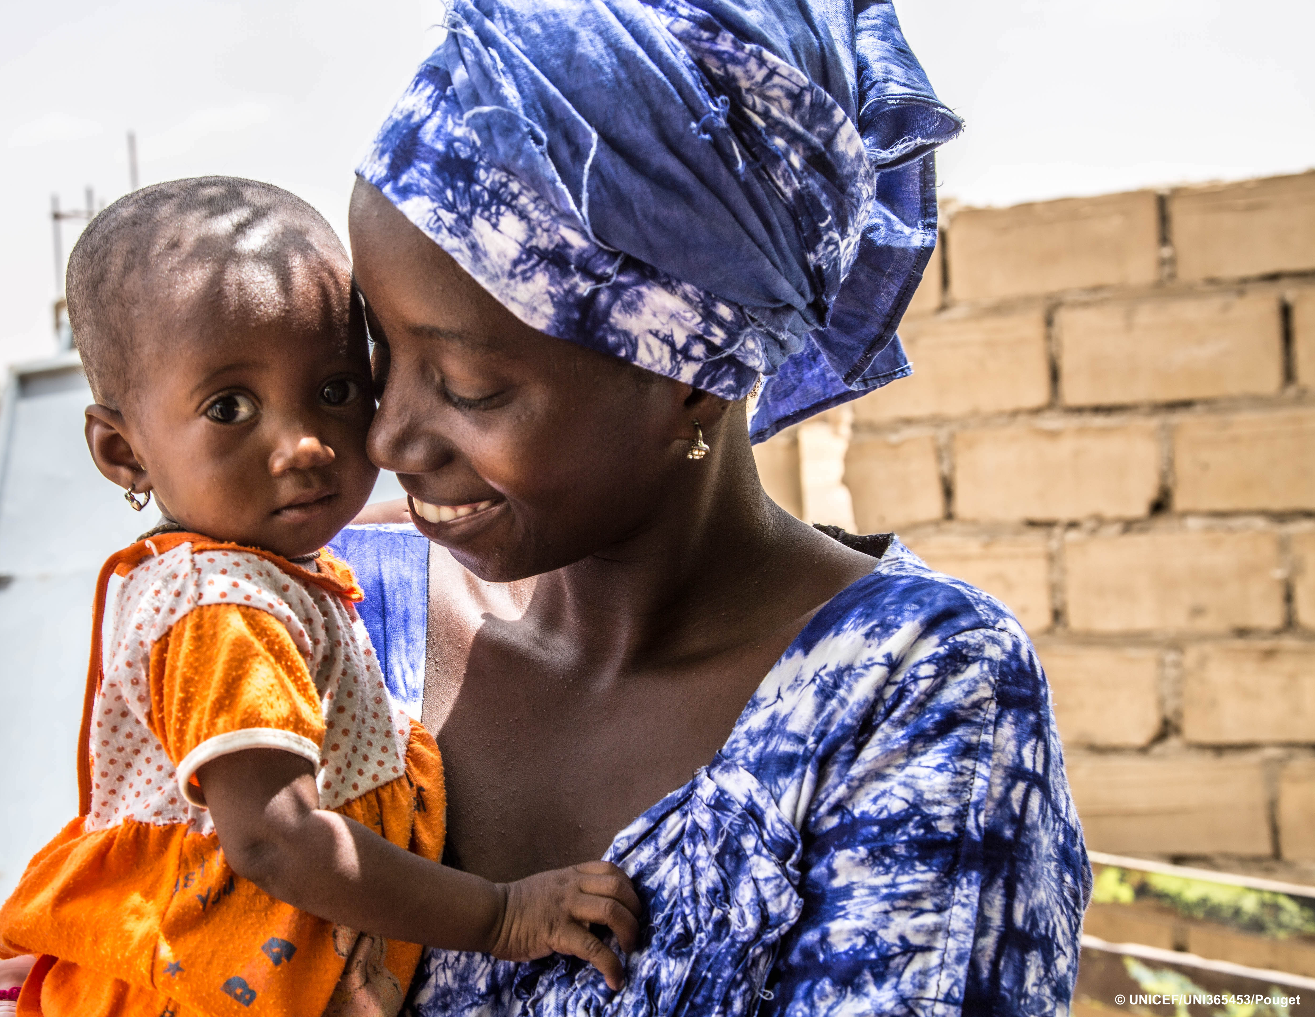
Partie 2 / Part 2
Sessions Thématiques / Thematic sessions
WCA Regional
Meeting

Slide 40



Approche stratégique de l’UNICEF et du PAM
Actions précoces pour lutter contre l’emaciation chez les enfants et les femmes dans un contexte humanitaire, pour 15 pays prioritaires (2024–2026)
Ann Defraye, UNICEF WCARO
Gwenaelle Garnier, WFP HQ
Notes:
Anu
Initially developed for BHA, but seeking further support from other donors

Slide 41

Une nouvelle opportunité
Recommandations de l’OMS – une opportunité de favoriser des changements de programme, sous la direction des Gouvernements
Cibler les plus vulnérables – augmentation des besoins et diminution des ressources
Prevention – renforcer la programmation en lien avec la prise en charge
Processus de partenariat :
  BHA/ UNICEF/ PAM Réunion: Avril 2023
  Planning Stratégique - Juin 2023
  Communication au pays clés - Note Stratégique - Juillet 2023
  En cours: Engagement du gouvernement et des partenaires; planification de la collecte de fonds et de la mise en œuvre
Notes:
Anu
2022-23 – remarkable funding and response for UNICEF and WFP for child wasting
Re-setting the way we have been working
15 priority countries but implications for all GAP and other countries with wasting programming
Will take time to change – and will need support of donor agencies and senior management at WFP/UNICEF

Slide 42
Changements convenus pour les programmes pour les enfants souffrant de malnutrition aigue
Prevention et prise en charge comme un standard pour les mêmes populations
UNICEF et PAM garantiront un ensemble d’actions préventives complémentaires pour les jeunes enfants et les femmes enceintes et allaitantes
UNICEF dirigera le soutien aux gouvernements pour fournir des services permettant aux enfants souffrant de malnutrition aigüe sévère et aux enfants souffrant de malnutrition aigüe modérée présentant un risque plus élevé de mortalité de se rétablir en utilisant des aliments thérapeutiques prêts à l’emploi (ATPE)
Le PAM utilisera une gamme diversifiée d’interventions afin de les autres enfants souffrant de malnutrition aigüe modérée afin de garantir leurs besoins nutritionnels additionnels pour leur rétablissement (ASPE ou aliments locaux riches en micronutriments)
Le PAM dirigera le soutien aux communautés pour garantir l’accès a des aliments familiaux nutritifs au travers de l’aide alimentaire aux ménages vulnérables.
Notes:
Anu
Will go into further detail on prevention and management on following slides.
UNICEF/WFP’s Strategic Approach to supporting government and partners, to move towards new ways of working prevention/management of wasting, that includes aligning to the new WHO guidelines.
So it serves to guide agency teams on how both agencies are going to work together on wasting – in humanitarian contexts – of course, part of this is working closely with government, UN and NGO partners….
RUTF for HRMAM only a supplementation, other portion of diet will need to be met with strong referral/links to other interventions (e.g. cash, SBC, GFA)
Other MAM also need medical assessment and will be provided where possible – health services or community platforms can provide – not be overwhelmed.

Slide 43
Quelques principes clés et méthodes de travail
Alignment with WHO
  Approche contextuelle : cocréée avec le gouvernement
  Priorisation des besoins : IPC, MAG, hotspots, autres facteurs aggravant
  Modalités de transfert : basées par la fonctionnalité du marché et d’autres évaluations
  Sans oublier les populations difficiles à atteindre
  Approches et plateformes multisectorielles
Interventions de prise en charge et de prévention feront partie de l’ensemble standard dans les contextes humanitaires avec insécurité alimentaire
Prise en charge de la malnutrition aigüe :
  UNICEF : les enfants souffrant d’émaciation présentant un risque plus élevé de mortalité (MAS et MAM avec un risqué plus élevé - SFF)
  PAM : Les autres enfants souffrant d’ émaciation (SFF ou aliments locaux riches en nutriments)
Une alimentation nutritionnellement adéquate ou une assistance sociale constitueront la base fondamentale d’une réponse nutritionnelle humanitaire efficace.
Notes:
Anu
Cash/SBC/local foods used where possible, but SNF will be warranted where local foods not available
approaches not clear or evidence based, and investment needed in learning/research etc.
multi-sectoral approach including water, sanitation and hygiene, social protection, health and food systems
In collaboration with other GAP agencies – WHO, FAO, UNHCR – where relevant
Focus on IPC 4-5, and IPC 3 with high GAM rates

Slide 44
EXEMPLE: Possible paquet intégré de services supports par le PAM et l’UNICEF dans un contexte humanitaire
6-23 mois
24-59 mois
FEFA
MAS
Programme de Traitement
(ATPE)
Programme de Traitement
(ATPE)
MAM HR
Programme de Traitement
(ATPE)
Tous les autres MAM
Supplémentation avec mélange d’aliments locaux + PMN
Supplémentation avec mélange d’aliments locaux + PMN
Aliments composes enrichis + huile
Non malnutris dans les ménages en insécurité alimentaire
Cash Top up + PMN
Top up argent + CMV + soins pré et post nataux
Assistance basee sur l’argent pour les menages en insecurite alimentaires
*Les agences surveilleront la proportion de malnutris provenant de ménages consideres en sécurité alimentaire
Non malnutris dans les ménages en sécurité alimentaire
Programme de Prevention
(PMN)
CMV + soins pré et post nataux
CCC / Conseils ANJE
Notes:
Britta

Slide 45
2024 – 2026 Plan de Transition
2026
Afghanistan, Somalie, Yemen
Somalia, Afghanistan and Yemen
Full guidelines
2025
Burkina Faso, Tchad, RDC, Mali, Niger, Ethiopie, Soudan
2024
Haïti, Kenya, Madagascar, Nigeria, Sud Soudan
Notes:
Britta
The 15 priority countries have been allocated to three phases.
Implication: Means that these countries are being prioritized for global/regional level support including fundraising efforts, does not mean that country teams cannot move faster than this if they want.
Decision making : determined (with UNCIEF/WFP country teams) to be more ready and more suitable for the transition, based on several factors.
Phase 1: Joint preparation and planning will start in 2023, and programme shifts in 2024. This includes ensuring government agreement and all necessary steps are taken, such as building partner buy-in, identifying target regions, and developing a comprehensive plan for 2024, including costing, funding, development of tools and trainings.
Target areas
Learnings from phase 1 countries will be used to inform transition of other countries.
Phase 2: Detailed consultations with national level partners to start in 2023, with agreement on transition expected end of 2024. Programmatic shifts to start in 2025.
Phase 3: Discussions to start in 2023, programmatic shifts to starts towards the end of 2025 and expansion towards the end of 2026.
Parameters considered for overall readiness and pace for transition:
Operating/programming environment
Government readiness and policy environment
UNICEF and WFP readiness at CO level
System capacity
Supplies and Supply chain readiness
Funding

Slide 46
Domaines de collaboration entre l’UNICEF et le PAM
Support conjoint aux pays en transition
Information Nutrition – données et analyses (affiner la vulnérabilité, les indicateurs et les personnes dans le besoin)
Suivi de programme, génération d’ évidence et apprentissage (aliments locaux ou faits maison; risques/succès avec la transition; rôle ASC)
Renforcement de la chaine d’approvisionnement (prévision, préparation et réactivité, livraison du dernier kilomètre)
Plaidoyer et mobilisation des ressources
Notes:
Britta
Technical support to country teams: UNICEF and WFP headquarters and regional teams will provide technical support to their country teams with transition planning, implementation and monitoring. UNICEF and WFP country teams will support national and sub-national governments and partners with the transition planning, scale-up, monitoring and reporting.
Nutrition information: UNICEF and WFP will invest in the use of diagnostics tools and analytics to better understand and prioritize their programmes based on nutritional vulnerabilities. This will include Hotspot Analysis and the Nutrition Vulnerability Assessment in Crisis. UNICEF and WFP will support the nutrition and food security clusters in their Humanitarian Needs Overview/Response Plans processes to make necessary adaptations. UNICEF and WFP joint efforts will strengthen engagement in national and global processes such as the IPC and establish networks to ensure that sudden increases in child wasting can be predicted, detected and responded to more effectively.
Programme monitoring and evidence generation: UNICEF and WFP will generate evidence on the programmatic shifts with focus on hard-to-reach areas and will closely monitor implementation and progress of the transition. We will work with partners to design and implement operational research studies to document the effectiveness of programmatic shifts. Operational research priorities will align with gaps highlighted by the WHO Guideline Review Process and the Global Nutrition Cluster and Food Security technical groups.
Supply chain strengthening: UNICEF and WFP will work together on transparent sharing of information about global and national demand and supply of specialized nutritious foods to ensure timely allocation to countries. This will enable optimal production capacity of lipid-based ready to use therapeutic and supplementary foods for those children most in need. In addition, at global and country levels both agencies will work together on optimizing supply chains for lipid-based specialized nutritious foods and improving the tracking of supplies and their programmatic use.
Advocacy: UNICEF and WFP will jointly advocate to donors and partners for support to the programmatic shifts including increased investments on prevention actions in humanitarian settings. Donor advocacy will be supported by the Action Review Panel on Child Wasting, the Global Nutrition Cluster and the Global Food Security Cluster, alongside National Nutrition and Food Security clusters. Both agencies will advocate together for other key sectors that are active in humanitarian settings to increase investment in and attention to child wasting and to ensure efforts of health and immunization, water and sanitation, and social policy and protection converge.

Slide 47

Implications programmatiques
Prise en charge des enfants de 6 à 59 mois atteints de MAM
Leïla Masson,
Nutritioniste régionale, PAM RBD
Ann Defraye,
Nutrition Specialist, UNICEF WCARO

Slide 48
Implication : prise en charge des nourrissons et des enfants de 6 à 59 mois présentant une malnutrition aigüe modérée.
Enfants MAM dans les contextes à haut risque
Enfants MAM à haut risque
Enfants MAM
Notes:
MAM-
Une déclaration de bonne pratique a souligné l'importance des régimes alimentaires disponibles localement pour les enfants souffrant d'émaciation modérée avant de fournir des recommandations spécifiques de prise en charge diététique pour ce groupe.
-Il est recommandé de donner la priorité aux interventions base de SNF, accompagnées de conseils, pour les nourrissons et les enfants âgés de 6 à 59 mois souffrant d'émaciation modérée et de facteurs sociaux et infantiles spécifiques, en raison de leurs effets positifs sur la récupération anthropométrique et d'autres résultats.
-recommande vivement de fournir des aliments spécialement formulés, en plus des aliments maison, à tous les nourrissons et enfants âgés de 6 à 59 mois souffrant d'émaciation modérée dans des contextes à haut risque, tels que ceux qui sont confrontés à des crises humanitaires. Cette recommandation s'appuie sur des données montrant que les aliments spécialement formulés ont des effets positifs sur l'amélioration des résultats anthropométriques et la réduction du risque d'émaciation sévère, tout en mettant l'accent sur la promotion de l'équité en matière de santé pour les enfants vulnérables dans les zones touchées par une crise. Les nouvelles lignes directrices recommandent l'utilisation d'aliments spécialement formulés (pour répondre aux besoins uniques des enfants dans ces contextes difficiles).
- Les nouvelles lignes directrices recommandent l'utilisation de suppléments nutritifs à base de lipides (LNS) pour les enfants âgés de 6 à 59 mois souffrant d'émaciation modérée. Si les LNS ne sont pas disponibles, les aliments mélangés enrichis améliorés sont préférables aux aliments mélangés ordinaires.
-Selon les nouvelles recommandations, les besoins énergétiques des nourrissons et des enfants souffrant d'émaciation modérée sont estimés à 100-130 kcal/kg/jour, les aliments complémentaires contribuant à 40-60 % de l'apport énergétique quotidien. Le critère d'évaluation de la durée du traitement a été fixé à la récupération anthropométrique.

Slide 49

Bilan de santé
Qu’est-ce qui est nouveau ?
  Évaluation et traitement sanitaires et soins psychosociaux pour tous les enfants MAM
Qu’est-ce que cela implique ?
  Les programmes de MAM, quelle que soit la plateforme sur laquelle ils sont mis en œuvre, doivent être liés aux services de santé.
  Personnel de santé/ASC formés et équipés => Budget
Notes:
GPS B12. Tous les nourrissons et les enfants âgés de 6 à 59 mois présentant une émaciation modérée doivent faire l'objet d'une évaluation complète et d'un traitement, dans la mesure du possible, des problèmes médicaux et psychosociaux ayant entraîné ou exacerbé cet épisode d'émaciation.
Cette déclaration de bonne pratique vise à souligner que, bien que la prise en charge alimentaire soit nécessaire, elle n'est généralement pas suffisante sans le traitement des conditions médicales et psychosociales qui entraînent ou exacerbent cet épisode d'amaigrissement modéré.
Tout traitement mis en place doit suivre les principes de la PCIME [54] ou d'autres directives thérapeutiques pertinentes de l'OMS.
Cette évaluation et ce traitement complets pourraient inclure des interventions telles que la vaccination et l'évaluation et le suivi des problèmes médicaux nécessitant des soins de suivi à moyen ou long terme et ayant un lien significatif avec l'état nutritionnel (par exemple, le VIH, la tuberculose, les cardiopathies congénitales, la paralysie cérébrale ou d'autres handicaps).
Parmi les autres interventions importantes figurent le conseil (en matière de santé et de nutrition, notamment en aidant les familles à utiliser les aliments disponibles localement pour prévenir les rechutes) et les soins psychosociaux (par exemple, la thérapie par le jeu).

Slide 50

Quantité de SFF
Qu’est-ce qui est nouveau ?
  Les besoins énergétiques quotidiens totaux nécessaires à la récupération anthropométrique sont estimés à environ 100-130 kcal/kg/jour.
Qu’est-ce que cela implique ?
  Les enfants doivent être pesés à chaque visite pour estimer la quantité de SFF qu’ils doivent recevoir
  Tous les sites de traitement de la MAM, y compris au niveau communautaire, doivent être équipés d’une balance fonctionnelle.

Slide 51








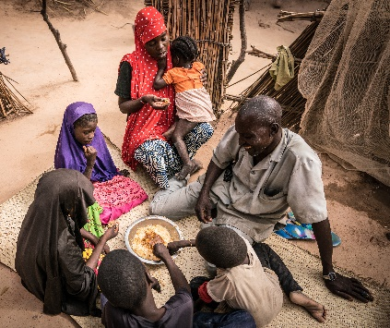















Conseils
Basés sur le contexte - Recherche formative
Liés à la santé et à la nutrition
Font partie de l'approche de changement social et comportemental
Mass media
Système de santé
Gardiens, membres du ménage
Communication à tous les niveaux
Système alimentaire
Communautés
Combinaison d’approches
Familles
  Création de la demande
  Mobilisation communautaire
  Renforcement de capacités
  Com. interpersonnelle / conseil
Individus

Slide 52
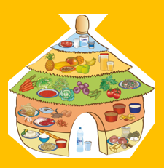
Alimentation familiale riche en nutriments
Qu’est-ce qui est nouveau ?
  Les nourrissons et les enfants âgés de 6 à 59 mois souffrant d'émaciation modérée doivent avoir accès à un régime alimentaire riche en nutriments afin de satisfaire pleinement leurs besoins supplémentaires pour retrouver leur poids et leur taille et pour améliorer leur survie, leur santé et leur développement.
  L'OMS recommande de couvrir 40 à 60 % des besoins de l'enfant souffrant d'émaciation modérée par des SFF - Nous devons nous assurer que les 60 à 40 % restants sont couverts.
Qu’est-ce que cela implique?
  Explorer les solutions locales pour compléter les besoins des enfants MAM :
    Évaluer l’abordabilité et la disponibilité des solutions alimentaires locales pour la supplémentation des enfants et des FEA, en utilisant des outils analytiques pertinents.
  Garantir l'adéquation nutritionnelle de l’assistance aux ménages et la convergence des programmes
  Lien avec les interventions de soutien au système alimentaire :
    Identifier les possibilités d'augmenter la production / la disponibilité de solutions alimentaires nutritives
    Soutenir l'accès aux aliments nutritifs pour tous les ménages ayant des enfants MAM
Notes:
GPS B11. Les nourrissons et les enfants âgés de 6 à 59 mois souffrant d'émaciation modérée (définie par un rapport poids/taille compris entre 2 et 3 z-scores en dessous de la médiane des normes de croissance de l'enfant de l'OMS et/ou une circonférence du milieu et de la partie supérieure du bras égale ou supérieure à 115 mm et inférieure à 125 mm, sans œdème) devraient avoir accès à un régime alimentaire riche en nutriments afin de satisfaire pleinement leurs besoins supplémentaires pour récupérer leur poids et leur taille et pour améliorer leur survie, leur santé et leur développement.
Les aliments riches en nutriments sont ceux qui contiennent beaucoup de nutriments par rapport à leur contenu calorique, c'est-à-dire qu'ils ont une teneur relativement élevée en vitamines, en minéraux, en acides aminés essentiels et en graisses saines. Les aliments d'origine animale, les haricots, les noix et de nombreux fruits et légumes sont des exemples d'aliments riches en nutriments.
Les aliments à forte densité nutritionnelle permettent aux enfants de consommer et d'absorber au maximum les nutriments afin de satisfaire leurs besoins en énergie et en tous les nutriments essentiels. Les aliments d'origine animale sont plus susceptibles de répondre aux besoins en acides aminés et autres nutriments des enfants en convalescence. Les aliments d'origine végétale, en particulier les légumineuses ou une combinaison de céréales et de légumineuses, contiennent également des protéines de haute qualité, bien qu'ils contiennent aussi certains antinutriments tels que des phytates, des tanins ou des inhibiteurs d'enzymes digestives, qui peuvent limiter l'absorption de certains micronutriments, en particulier les minéraux.
Les régimes alimentaires adéquats disponibles localement comprennent les aliments disponibles sur le marché et/ou dans les foyers, généralement consommés par l'enfant, et qui sont adéquats en termes de nutriments.
La récupération anthropométrique chez les nourrissons et les enfants de 6 à 59 mois est définie par un score z de poids par rapport à la taille (WHZ) ou à la longueur (WLZ) égal ou supérieur à 2 écarts-types (ET) en dessous de la médiane des normes de croissance de l'enfant de l'OMS (WHZ ou WLZ ≥ -2) et/ou un MUAC égal ou supérieur à 125 mm (selon que l'enfant a été admis sur la base du WHZ/WLZ ou du MUAC ou des deux), et l'absence d'œdème nutritionnel pendant au moins deux consultations ambulatoires consécutives.
Pour des conseils sur la quantité et la proportion des besoins énergétiques quotidiens pouvant être couverts par une alimentation complémentaire, voir la recommandation B16.
La stimulation psychosociale peut être définie comme l'information sensorielle reçue lors des interactions avec les personnes et la variabilité de l'environnement, qui attire l'attention du jeune enfant et lui fournit des informations ; il s'agit par exemple de parler, de sourire, de pointer du doigt, de permettre et de démontrer, avec ou sans objets. Cela comprend également l'alimentation adaptée, qui fait partie des soins adaptés.
Cette déclaration de bonne pratique est cohérente avec les orientations suivantes de l'OMS :
Note technique de l'OMS : Aliments complémentaires pour la prise en charge de la malnutrition aiguë modérée chez les nourrissons et les enfants âgés de 6 à 59 mois [51].
Actions essentielles de l'OMS en matière de nutrition : Améliorer la santé et la nutrition de la mère, du nouveau-né, du nourrisson et du jeune enfant [53].

Slide 53




Analyse des options programmatiques pour l'utilisation d'aliments locaux dans la gestion de la malnutrition aiguë modérée
Exemple de l'État rural de Borno, Nigeria
Enfant sain 12-23 mois **
Enfant MAM 12-23 mois
83 NGN*
Coût d’un régime alimentaire nutritif à base d’aliments locaux
258 NGN
Coût d'un régime alimentaire nutritif utilisant tous les aliments disponibles localement
464 NGN
Coût d'un régime alimentaire nutritif excluant les abats et les feuilles séchées
13 NGN
Coût d'un régime alimentaire nutritif incluant un RUSF
70 NGN
Coût d'un régime alimentaire nutritif incluant un LNS mq
*NGN = Nigerian Naira (2021)
** Enfant de 12-23 mois recevant également du lait maternal (source: FNG)
Notes:
Couvrir les besoins nutritionnels d’un enfant MAM va au-delà de la couverture des besoins énergétiques.

Slide 54



Burkina Faso, Sahel region - résumé des résultats
Il est beaucoup plus coûteux de répondre aux besoins nutritionnels accrus d'un enfant atteint de MAM, mais les SNF réduisent la charge économique qui pèse sur le ménage.
Enfant sain 2-3 ans
Enfant MAM de 2-3 ans
675
CFA
1211
CFA
105
CFA
221
CFA
250
CFA*
2.7x
4.8x
Coût d'un régime alimentaire nutritif excluant les abats et les feuilles séchées limitant les arachides et les légumes à feuilles vertes à 1x/jour
Coût d’un régime alimentaire nutritif à base d’aliments locaux
Coût d'un régime alimentaire nutritif utilisant tous les aliments disponibles localement
Coût d'un régime alimentaire nutritif incluant un RUSF
Coût d'un régime alimentaire nutritif incluant un LNS sq
*CFA = Franc CFA ouest africain (2023)
Notes:
Questions :
Est-il possible de satisfaire les besoins nutritionnels des enfants MAM en utilisant des aliments locaux dans les zones de subsistance les plus vulnérables du Burkina Faso ?
Quel est le coût minimum pour satisfaire les besoins nutritionnels des enfants MAM et comment se compare-t-il au coût d'un enfant en bonne santé du même âge ?
Comment le coût du régime alimentaire évolue-t-il lorsque des restrictions supplémentaires sont imposées sur certains aliments qui sont plus difficiles à obtenir et à consommer ?
Quels sont les "nutriments limitants" pour les enfants atteints de MAM ?
Quel est l'impact ou l'avantage de l'ajout de SNF, y compris SC+, RUSF, LNS-MQ et LNS-SQ ?
Quels sont les produits locaux (enrichis ou non) disponibles pour la supplémentation des enfants atteints de MAM ? Comment se comparent-ils aux autres SNF en termes de profils nutritionnels et d'impact sur la réduction du coût de l'alimentation des enfants atteints de MAM ?

Slide 55
Aliments spécialement formulés (SFF)
Les enfants MAM à haut risque de mortalité ou de ne pas se rétablir ou dans un contexte à haut risque auront besoin d'un complément à leur alimentation familiale.
D'où la nécessité d'aider les familles à accéder à une alimentation familiale riche en nutriments.
QUELS ENFANTS
Recommendation forte
(B13 and B14)
Enfants présentant des facteurs individuels, des facteurs de risque sociaux et des enfants vivant dans un contexte à haut risque
QUEL SFF
Recommendation conditionnelle
B15
Suppléments nutritionnels à base de lipides (RUTF, RUSF) et aliments mélangés enrichis améliorés (type Supercereal Plus)
COMBIEN
Recommendation conditionnelle
B16
40-60% de 100-130Kcal/kg/jour
Notes:
Les décisions doivent être prises au niveau national pour déterminer quels enfants, quel SFF et quelle quantité en fonction du contexte.

Slide 56
SFFs – comment décider du % ?
Orientation opérationnelles:
TAG
Analyse Hotspot
Adaptations locales
Adapté de Moderate Acute Malnutrition: A decision tool for emergencies. Global Nutrition Cluster, 2017
Risque de détérioration | Analyse | Score | Somme Score | Catégorie de risque et action
Augmentation de la morbidité (diarrhée aqueuse aiguë, rougeole, IRA) | Élevé | 3 |  | Score 7-9 : élevé - 60% des besoins quotidiens doivent provenir d'une alimentation complémentaire (voir le tableau de dosage simplifié 1) Score 4-6 : Moyen - 50% des besoins quotidiens doivent être couverts par une alimentation complémentaire (voir le tableau de dosage simplifié 2) Score ≤ 3 : Faible - 40% des besoins quotidiens doivent provenir d'une alimentation complémentaire (voir le tableau de dosage simplifié 3)
 | Moyen | 2
 | Bas | 1
Insécurité alimentaire | Élevé | 4
 | Moyen haut | 3
 | Moyen bas | 2
 | Bas | 1
Déplacement important de population | Oui | 1
 | Non | 0
Densité de population | Oui | 1
 | Non | 0

Slide 57



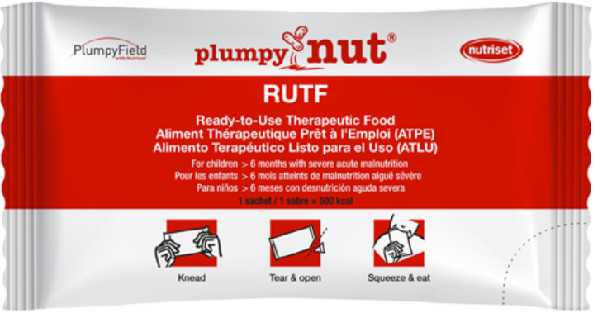



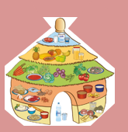
Tous les enfants MAM n’ont pas besoin de SFF
MAM
Dans les contextes à haut risque, tous les enfants MAM devraient être considérés comme devant bénéficier d'un SFF et de conseils.
MAM à haut risque
Other MAM children
Enfants MAM dans
les contextes à
haut risque
Les MAM à haut risque doivent être prioritaires pour bénéficier du SFF et du conseil.

Slide 58
MAM à haut risque : de quels enfants s'agit-il ?
Les enfants qui ont un risque plus élevé de ne pas se remettre d'une MAM
Enfants présentant un risque accru de mortalité
Facteurs individuels de l’enfant
PB 115-119 mm
WAZ <-3SD
Age < 24 mois
Absence de récupération d'une émaciation modérée après avoir reçu d'autres interventions (par ex. conseils seuls)
Avoir rechuté vers MAM
Historique de MAS
Problèmes médicaux nécessitant des soins de suivi à moyen ou long terme avec une association significative avec le statut nutritionnel (par ex. maladie cardiaque congénitale, paralysie cérébrale ou autre handicap, HIV, TB, etc)
Facteurs sociaux
Circonstances personnelles sévères, comme décès de la mère ou santé ou bien-être maternel médiocre
Facteurs nécessitant une mesure et/ou une connaissance/estimation de l'âge de l'enfant
Facteurs pouvant être utilisés pour estimer le nombre de cas d'enfants présentant une MAM à haut risque et ayant besoin d'une supplémentation
Facteurs nécessitant une évaluation individuelle/médicale
Facteurs qui ne peuvent pas être facilement pris en compte pour l'estimation du nombre de cas en raison du manque de données disponibles
Facteurs nécessitant une évaluation de la situation sociale de l'enfant et/ou une évaluation de la santé et de l'état nutritionnel de la mère

Slide 59

MAM à haut risque : comment identifier ces enfants ?
Choix des critères d'identification des enfants présentant un MAM à haut risque :
MUAC 115-119mm et/ou ;
WAZ<-3 SD et/ou ;
Âge <24 mois ;
Et/ou tous les autres facteurs à prendre en compte !
Nécessitera une discussion et un consensus au niveau national

Slide 60

MAM à haut risque : éléments à prendre en compte
Éléments spécifiques au contexte à prendre en considération :
Plateformes existantes utilisées pour la détection précoce et la supplémentation des enfants MAM (établissements de santé, postes de santé, niveau communautaire,...)
Disponibilité de l'équipement (rubans MUAC, balances) et du matériel.
Capacités des ressources humaines à mener des évaluations
Implication en termes de coûts (en particulier pour les produits - de préférence ATPE ou ASPE)
Note : dans un contexte de crise ou d'urgence, tous les enfants atteints de MAM doivent être pris en compte pour la supplémentation.

Slide 61
Estimation du nombre annuel attendu d'enfants présentant une MAM à haut risque et des coûts associés - MÉTHODES
Step 1: Calculer les proportions
Utiliser les données les plus récentes des enquêtes SMART
Sélectionner tous les enfants MAM de 6 à 59 m sur la base du MUAC et/ou du WHZ (définition de l'OMS)
Exclure les œdèmes, des flags de l'OMS, les PB manquants
Step 2: Appliquer au burden MAM
Utiliser les estimations de burden au niveau national et/ou dans les zones prioritaires
Appliquer les proportions respectives au burden
Step 3: Estimer les couts
Utilisation du coût standard de l’ATPE (62 $)
Déterminer le coût du traitement MAS par enfant
Appliquer 75% du coût du traitement MAS comme coût de la MAM par enfant

Slide 62
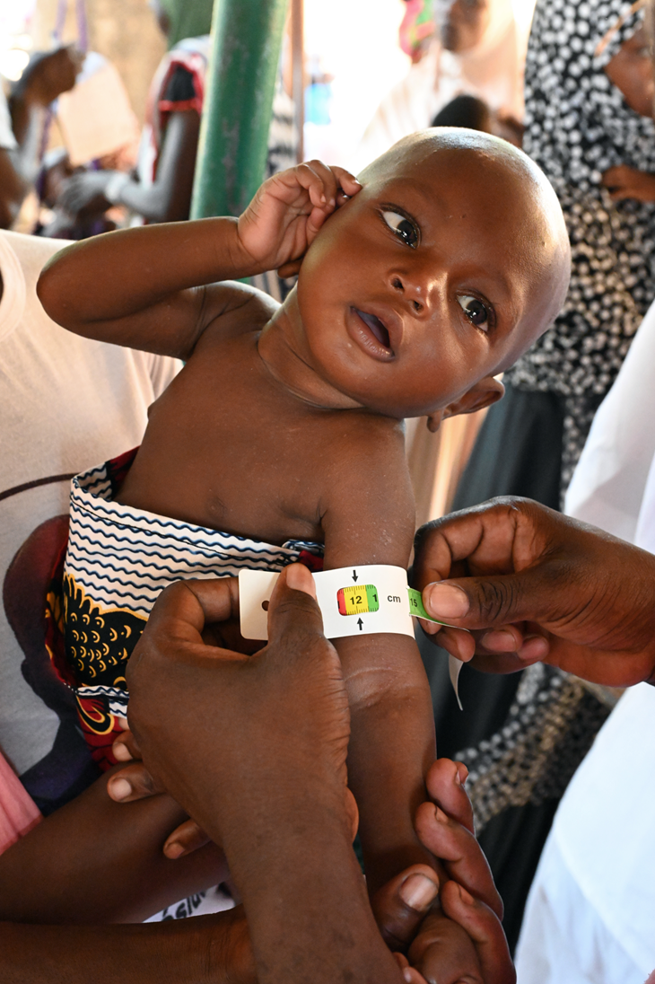
Exemples

Slide 63

Estimation du nombre attendu d’enfants avec la MAM à haut risque et couts associés d
BURKINA FASO
Critères | NIVEAU NATIONAL
Criteria | Nombre d’enfants attendu avec MAM à haut risque | Couts (programme+produit)
(1) MAM+WAZ<-3 | 80,219 | $6,658,178
(2) MAM+115<=MUAC<=119 | 13,370 | $1,109,696
(3) MAM+age <24 months | 217,003 | $18,011,226
(1) & (2) | 5,142 | $426,806
(1) & (3) | 37,024 | $3,073,005
(2) & (3) | 11,313 | $938,974
(1) & (2) & (3) | 4,114 | $341,445

Slide 64

Estimation du nombre attendu d’enfants avec la MAM à haut risque et couts associés d
NIGER
Critères | NIVEAU NATIONAL
Criteria | Nombre attendu d’enfants avec la MAM à haut risque | Couts (programme+produit)
(1) MAM+WAZ<-3 | 570,943 | $31,972,827
(2) MAM+115<=MUAC<=119 | 151,657 | $8,492,782
(3) MAM+age <24 months | 694,350 | $38,883,621
(1) & (2) | 75,828 | $4,246,391
(1) & (3) | 255,735 | $14,321,162
(2) & (3) | 115,973 | $6,494,481
(1) & (2) & (3) | 50,552 | $2,830,927

Slide 65

WCA Regional
Meeting
merci

Slide 66
Approches de programmation adaptées tenant compte des lignes directrices de l'OMS
Ann Defraye
Spécialiste en nutrition, UNICEF WCARO

Slide 67

‘Approches simplifiées’ en relation avec les recommandations de l’OMS (I)
SIMPLIFICATION | RECOMMANDATIONS OMS
PB mère famille | L’efficacité de l’approche PB mère famille comme outil de dépistage n’a pas été priorisé par le groupe d'élaboration des lignes directrices (GDG) comme question à couvrir.
Prise en charge de la malnutrition aigue par les Agents de Sante Communautaire (ASC) | Les ASC peuvent supplémenter les enfants 6-59 mois avec la MAM et faire la prise en charge nutritionnelle des enfants 6-59 mois avec la MAS. Cette intervention peut se faire uniquement si le Gouvernement ou les partenaires de mise en oeuvre peuvent assurer une formation et supervision adéquate des ASC et avec des ressources dediées. La supplementation et la prise en charge nutritionnelle est recommandée sur base des besoins en kcal/kg/jour, par consequent les ASC doivent etre en mesure de peser l’enfant.

Slide 68
‘Approches simplifiées’ en relation avec les recommandations de l’OMS (II)
SIMPLIFICATION | RECOMMANDATIONS OMS
Fréquence reduite des visites de suivi | La fréquence réduite des visites de suivi n’a pas été priorisé par le groupe d'élaboration des lignes directrices (GDG) comme question à couvrir.
Programmation sur base du PB et oedèmes uniquement | Pour les nourrissons de moins de 6 mois présentant un risque de faible croissance et de développement, le PB peut être utilisé pour l'admission en hospitalisation ou en ambulatoire; cependant, le PB ne peut pas être utilisé pour évaluer la progression ou pour décider sur la sortie des soins. Pour les nourrissons et les enfants âgés de 6 à 59 mois souffrant de malnutrition aiguë, le PB peut être utilisé comme seul critère anthropométrique, en plus d'une évaluation médicale et de l'appétit, pour admettre un enfant en hospitalisation ou en ambulatoire ; cependant, le PB ne peut pas être utilisé pour décider de la quantité de supplémentation nutritionnelle pour la MAM ou du traitement nutritionnel pour la MAS. Pour le dosage et l’évaluation de la progression, le poids doit etre utilisé ensemble avec l’évaluation médicale.

Slide 69
‘Approches simplifiées’ en relation avec les recommandations de l’OMS (III)
SIMPLIFICATION | RECOMMANDATIONS OMS
Utilisation d’un seul produit | Si des aliments nutritifs specialisés sont utilisés pour la supplémentation d’un enfant avec MAM, les produits recommandés sont: De préférence: aliments prets à l’emploi (ASPE/ATPE) Si pas disponible, des aliments mélangés enrichis avec sucre, huile et/ou lait ajouté
 | L’ ATPE doit être utilisé pour le traitement nutritionnel des enfants avec MAS (d’autres produits ne doivent pas être utilisés à cette fin).
Dosage réduit | Pour les enfants agés de 6-59 mois avec MAS, la quantité de l’ATPE doit fournir: 150-185 kcal/kg/jour jusqu'à la récupération anthropométrique et la résolution de l'œdème nutritionnel; OU 150-185 kcal/kg/day jusqu'à ce que l'enfant ne soit plus gravement émacié et ne présente plus d'œdème nutritionnel. À ce stade, la quantité peut être réduite pour fournir 100-130 kcal/ kg/jour, jusqu'à la récupération anthropométrique.

Slide 70
Quand convient-il d'adapter les protocoles standard?
Dans des circonstances exceptionnelles, et dans le cadre d'une réponse à une situation d'urgence aiguë limitée dans le temps, une adaptation des protocoles standard peut être nécessaire et sera appliqué dans les contextes d'urgence uniquement ;
Toutefois, lorsque les situations d'urgence se prolongent, il est recommandé de revenir aux normes dès que possible;
La production de preuves et la recherche sur tous les aspects de la prévention et de la prise en charge de la malnutrition aiguë restent d'une grande importance.

Slide 71
WCA Regional
Meeting
merci

Slide 72

Déjeuner
Notes:
Laura – 10 minutes

Slide 73

Preparedness, Anticipatory Actions, NiE and the Climate crisis
Préparation aux urgences, Actions Anticipatoires, Nutrition en situation d’urgence et crise climatique.
Cécile Basquin (GNC) et Géraldine Bellocq (GNC)
Gwenaelle Garnier (WFP)
Diane Holland (GNC) et Ann Defraye (UNICEF)
Douala - 19 Février 2024
Notes:
Cecile

Slide 74
overall objectives objectifs généraux
To provide an overview of mechanisms and initiatives used to reduce the impact of crisis
To hear/learn country experience
To identify actions that can be taken collectively to make progress & need for support from regional and global levels
Fournir un aperçu des mécanismes et des initiatives utilisés pour réduire l’impact de la crise
Apprendre des expériences des pays
Identifier les actions qui peuvent être prises collectivement pour réaliser des progrès et les eventuels besoins d’appui des niveaux régional et global
ERP, AAs, NiE and Climate crisis
Date: 19/02/2024
WCA Regional
Meeting
Notes:
Cecile

Slide 75
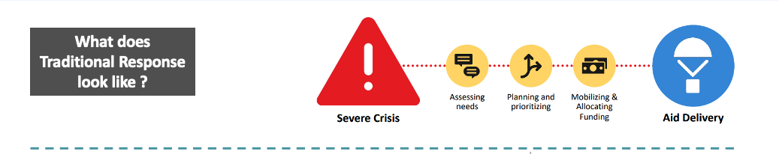
Shifting away from reactive humanitarian crisis management
Ce à quoi ressemble une réponse classique
Comment passer d’une gestion réactive des crises à davantage de prévention, d’actions précoces / de mise en oeuvre précoce de la réponse ?
How can we shift from reactive crisis management to prevention, early actions and response?
Abandonner une gestion réactive des crises
ERP, AAs and Climate crisis
Date: 19/02/2024
WCA Regional
Meeting
Notes:
Cecile
Dans le monde d'aujourd'hui, les communautés sont confrontées à des crises humanitaires de plus en plus fréquentes et graves. Les conséquences de la crise climatique exacerbent les vulnérabilités nutritionnelles. L'ampleur des besoins ne fera donc que croître.
L’Agenda 2030 pour le développement durable et le Cadre de Sendai pour la réduction des risques de catastrophe ont souligné la nécessité de passer d’une gestion réactive des crises à la prévention et à des actions précoces.
Comment pouvons-nous nous éloigner de l’approche traditionnelle pour garantir que les réponses d’urgence nutritionnelle sont mises en œuvre rapidement/intensifiées en temps opportun ?
Scheme source: Adapted from the framework for UNICEF’s Anticipatory Actions, June 2023

Slide 76
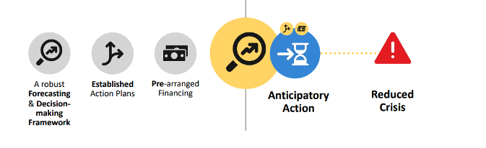
Towards more timely and effective response
What does preparedness, and anticipated actions look like?
-
A quoi ressemblent la préparation aux urgences et les actions anticipatoires?
Disaster risk reduction,
prevention & mitigation
ERP planning & Anticipatory Actions
Preparedness
Vers une réponse plus rapide et plus efficace
ERP, AAs and Climate crisis
Date: 19/02/2024
WCA Regional
Meeting
Notes:
Cecile
Il faut s'appuyer sur des stratégies de développement/à long terme qui contribuent à augmenter la résilience nationale et locale aux catastrophes.
Le système humanitaire a utilisé une approche plus proactive en matière de préparation et de réponse, l'IASC a développé de solides directives PRU pour augmenter la vitesse et le volume de l'assistance critique fournie immédiatement après le début d'une urgence humanitaire.
Plus récemment, avec l'initiative d'actions anticipatoires, la priorité a été accordée à la mise en œuvre d'un ensemble d'interventions avant les chocs qui sont prévisibles afin de prévenir et d'atténuer leur impact. L'initiative AAs est basée sur des déclencheurs basés sur des modalités de financement préalablement convenues pour la mise en œuvre des AAs une fois que les déclencheurs atteignent les seuils.
Tous ces mécanismes permettent d'agir sur les risques au lieu de réagir uniquement aux besoins. Une telle approche réduit les besoins humanitaires, contribuant ainsi à protéger les acquis de développement durement acquis et à renforcer la résilience » (OCHA, 2022).
Adapted from the framework for UNICEF’s Anticipatory Actions, June 2023

Slide 77
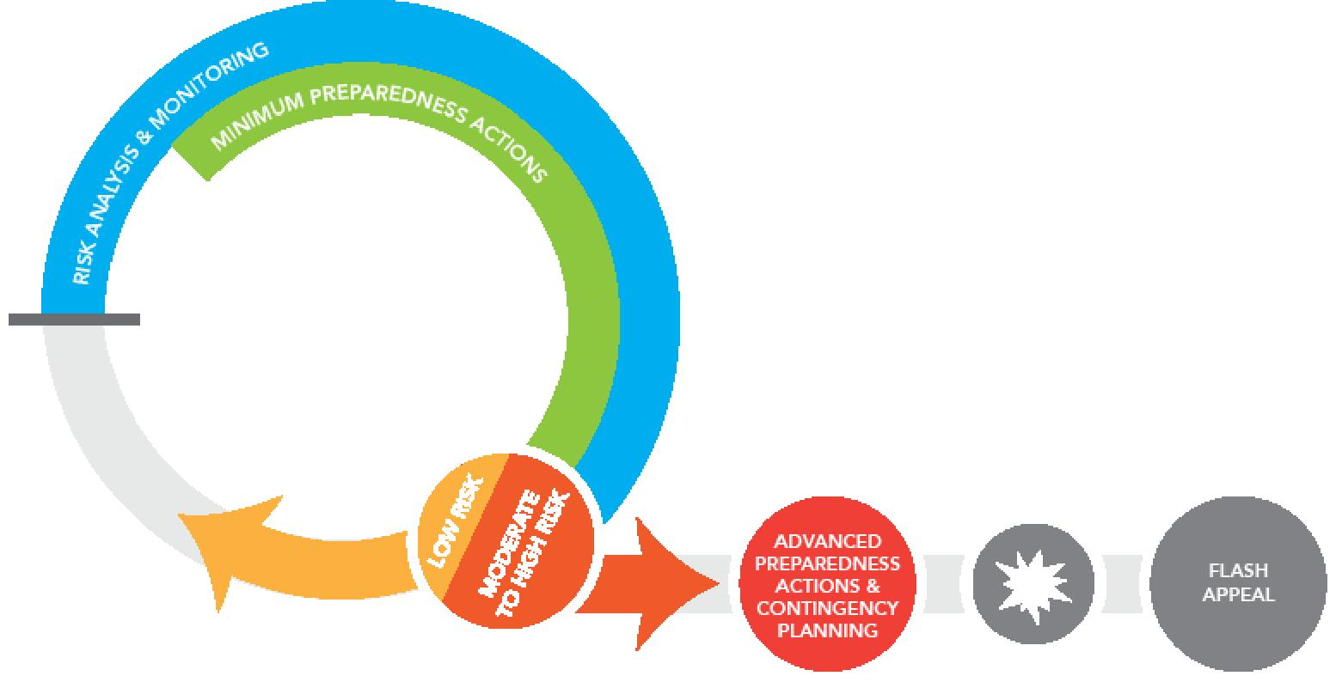
Emergency Response Preparedness (ERP)
Préparation de la réponse aux urgences (PRU)
La stratégie du GNC met fortement l’accent sur la PRU pour améliorer les capacités des clusters/secteurs Nutrition non seulement à répondre, mais aussi à mieux se préparer aux situations d’urgence
Renforcer les capacités de préparation des clusters/secteurs Nutrition, standardiser et systématiser l’approche PRU
Les directives PRU du IASC ont été agrémentées d’une approche étape par étape plus détaillée
The GNC strategy includes a strong focus on ERP to improve Nutrition Clusters/sectors’ capacities not only to respond but to become better prepared for emergencies
To strengthen Nutrition Clusters/sectors’ Preparedness capacities, and to standardize and systematize the ERP approach
The IASC ERP guidance was expanded into a step-by-step approach
ERP
Date: 19/02/2024
WCA Regional
Meeting
Notes:
Cecile
Stratégie GNC et Objectifs clés de l’approche étape par étape de l’ERP GNC
Identifier les principaux aléas, effectuer une analyse des risques de catastrophe, prévoir un scénario de crise, estimer les besoins des groupes vulnérables
Cartographier les capacités existantes
Entreprendre l'analyse et la conception de la réponse (pour une réponse immédiate), anticiper les obstacles qui pourraient ralentir et entraver la mise en œuvre en temps opportun de la réponse humanitaire, identifier les interventions prioritaires,
Planifier les dispositions opérationnelles nécessaires pour intensifier/mettre à l’echelle ou initier la mise en œuvre rapidement
Définir les actions de préparation
Développer un plan ERP multirisque

Slide 78
ERP key messages messages clés PRU
  La preparation aux urgences a des avantages avérés.
  La PRU est un processus continu et dynamique.
  La planification de la préparation aux ugences n’est pas un processus isolé.
  S’appuyer sur ce qui a déjà marché, et utiliser la PRU pour surmonter les défis des réponses précédentes.
  La PRU spécifique à la nutrition doit compléter et s’aligner sur les plans nationaux.
  Utiliser les analyses de risques existantes pour élaborer un scénario de crise.
  L’approche PRU doit être collaborative.
  Preparedness has proven benefits.
  ERP is a continuous and dynamic process.
  ERP planning is not a standalone process.
  Build on what you have and use ERP to overcome challenges from previous responses.
  The Nutrition specific ERP plan must complement and align to national plans.
  Use existing risk analyses to develop a crisis scenario.
  The ERP approach must be collaborative.
  For more information, please see the GNC ERP step by step guide (available in English, Spanish and French) -
  Pour plus d'informations, veuillez consulter le guide étape par étape du GNC sur le PRU (disponible en anglais, espagnol et français): https://www.nutritioncluster.net/resources/erp-step-step-guide
ERP, AAs and Climate crisis
Date: 19/02/2024
WCA Regional
Meeting
Notes:
Cecile et Geraldine – à deux voix
La préparation aux urgences a des avantages avérés. Investir dans l'ERP permet de gagner du temps et de l'argent dans la réponse humanitaire. Le temps gagné dans la mise en œuvre de la réponse est essentiel dans les situations d'urgence, car la rapidité de la mise en œuvre de la réponse a des conséquences directes sur les vies sauvées.
L'ERP est un processus continu et dynamique. Le plan d'intervention d'urgence doit être mis à jour et adapté pour tenir compte des risques émergents, de l'évolution des dangers et de l'évolution de la situation nutritionnelle. Il s'agit également d'un processus progressif, ce qui signifie que plus les actions de préparation sont nombreuses, plus le niveau de préparation atteint est élevé.
La planification de la préparation aux urgences n'est pas un processus isolé. Les éléments de la planification de la préparation aux urgences doivent être intégrés dans toutes les phases du CPH et devenir un état d'esprit dans les activités quotidiennes du cluster/secteur Nutrition.
S'appuyer sur ce qui a déjà marché, et utiliser le PRU pour surmonter les défis des réponses précédentes. Dans les pays ayant un HRP et qui sont confrontés à des crises récurrentes, il est important de développer une approche ERP pour augmenter rapidement le niveau de réponse et apporter une réponse d'urgence au cas où des besoins supplémentaires surviendraient (au-delà du HNO/HRP). Dans les pays ayant des crises récurrentes, ce qui a déjà bien fonctionné doit être conservé et intégré dans le PRU. Ainsi on se concentrera sur la recherche de solutions et d'actions de préparation pour remédier à ce qui n'a pas fonctionné.
Le PRU spécifique à la nutrition doit compléter et s'aligner sur les plans nationaux. Les informations provenant des plans spécifiques des organisations existantes peuvent être utilisées et alimenter un plan d'urgence multisectoriel.
Utiliser les analyses de risques existantes pour élaborer un scénario de crise. Dans la plupart des pays, l'identification des dangers et l'analyse des risques existent déjà et, en tant que cluster/secteur Nutrition, elles peuvent être utilisées pour élaborer un scénario de crise sous l'angle de la nutrition.
L'approche PRU doit être collaborative. La planification conjointe du PRU renforce la collaboration et contribue à créer des alliances et des partenariats plus solides qui joueront un rôle déterminant par la suite pour une mise à l'échelle et une mise en œuvre efficace en temps voulu.
Preparedness has proven benefits. Investing in ERP saves time and money in the humanitarian response. Time saved in response implementation is critical in emergencies since the speed of response implementation has direct implications on lives saved.
ERP is a continuous and dynamic process. The ERP plan needs to be maintained and adapted to reflect emerging risks, evolving hazards, and the changing Nutrition situation. It is also an incremental process, meaning the more preparedness actions taken, the stronger the level of Preparedness achieved.
ERP planning is not a standalone process. Elements of preparedness planning must be mainstreamed in all phases of the HPC and become an adopted mindset in the regular day to day workstreams of the Nutrition cluster.
Build on what you have and use ERP to overcome challenges from previous responses. In HRP countries that are facing recurring crisis, it is important to develop an ERP approach to scale up rapidly and bring a surge response in case additional needs arise (beyond the HNO/HRP). In those cases, what worked well for a quick response should be kept and integrated in the ERP. Then put the focus on finding solutions and preparedness actions to overcome what did not work.
The Nutrition specific ERP plan must complement and align to national plans. Information from existing organization specific plans can be use and and feed into a multi-sectoral ERP plan.
Use existing risk analyses to develop a crisis scenario. In most countries, hazard identification and risk analysis already exists and as a Nutrition cluster/sector, these can be used to build crisis scenario with a nutrition lens.
The ERP approach must be collaborative. Joint ERP planning reinforces collaboration and contributes to build stronger alliances and partnerships that will be instrumental later on for timely scale up / effective implementation.

Slide 79
Emergency Response Preparedness (ERP)
Préparation de la réponse aux urgences (PRU)
Remaining challenges
ERP tends to be seen as a single / one time activity
Nutrition specific contingency plan do not result in early response implementation
Few countries have a comprehensive Nutrition ERP plan that guides preparedness and early response
Preparedness actions tend to rely on availability of supplies only
Défis à relever
La PRU tend à être considérée comme une activité unique / ponctuelle
Les plans d'urgence spécifiques à la nutrition n'aboutissent pas à la mise en œuvre d'une réponse rapide.
Peu de pays disposent d'un plan d'urgence nutrition qui guide concrètement la préparation et l'intervention précoce.
Les actions de PRU ont tendance à s'appuyer uniquement sur la disponibilité des intrants.
ERP
Date: 19/02/2024
WCA Regional
Meeting
Notes:
Geraldine

Slide 80
Nutrition ERP status Statut de la PRU pour la Nutritoin
Questionnaire online for expression of interest sent out in September 2023 – Questionnaire en ligne pour une expression d’intérêt envoyé en septembre 2023
Support from regional and global level – soutien du niveau régional et global:
https://ta.nutritioncluster.net/request-support
Focal point on ERP within the GNC, working in coordination with RO – point focal PRU au sein du GNC, qui travaille en coordination avec le BR
 | Existing ERP plan and needs for revision – PRU existants et besoin de révision | Need for ERP orientation to partners – Besoin d’une orientation des partenaires au PRU | Need for ERP blended training – Besoin d’une formation hybride en PRU
CAR | Non | Oui, TRIM1 2024 | Oui, TRIM1 2024
Burkina Faso | Non | Oui, TRIM4 2023 | Oui, TRIM4 2023
Mali | Non | Oui, TRIM4 2023 | Oui, TRIM1 2024
RDC | Non | Oui, TRIM4 2023 | Oui, TRIM1 2024
Tchad | Non | Oui, TRIM4 2023 | Oui, TRIM4 2023
Niger | Oui | Oui, TRIM4 2023 | Oui, TRIM1 2024
ERP
Date: 19/02/2024
WCA Regional
Meeting
Notes:
Geraldine
Où en sommes-nous aujourd'hui ? Partager une vue d'ensemble de la situation de la région en matière de PRU du point de vue du GNC.
Where do we stand now? Share an overview of where do we stand in the region on ERP from a GNC perspective

Slide 81
Country experience on erp approach
Expérience pays sur l’approche PRU
Q&A:
What is the status of your Nutrition ERP?
Why are we not so advanced on ERP as we should be?
What opportunities do you see for making progress on ERP in the future?
Who needs to be involved? Who can be your best allies?
What can you commit to advance ERP at your level in the 2024?
Q&R:
Quel est le status de vôtre PRU?
Pourquoi ne sommes-nous pas aussi avancés que nous le devrions en matière de PRU?
Quelles sont les possibilités de progresser dans le domaine de la PRU à l'avenir?
Qui doit être impliqué ? Qui peuvent être vos meilleurs alliés?
Que pouvez-vous faire pour faire progresser la PRU à votre niveau en 2024?
ERP
Date: 19/02/2024
WCA Regional
Meeting
Notes:
Geraldine anime, Cecile complète les discussions
Il s'agit d'une séance de questions-réponses
Demander au public ainsi qu'à des collègues nationaux sélectionnés qui ont reçu les questions à l'avance:
Pourquoi est-il si difficile de se préparer à une catastrophe ?
Quel est l'état d'avancement du processus d'ERP nutritionnel dans votre pays ?
Avez-vous cartographié les capacités de réponse existantes (partenaires ? Personnel formé ? orientations et protocoles nécessaires ? Cartographie des stocks d'approvisionnement ?)?
Vos dispositions opérationnelles ont-elles été anticipées ? (pour la coordination, la gestion de l'information, l'évaluation et la fourniture d'une réponse) ?
Disposez-vous d'un plan de réponse nutritionnelle précoce pour la phase initiale d'une crise ?
Disposez-vous d'un plan de travail pour les actions de préparation ?
Disposez-vous d'un plan d'urgence nutritionnel multirisque ?
This is for a Q&A session
Asking the audience as well as selected country colleagues who received the questions in advance
Why is is so hard to be prepared for disaster?
What is the status of your Nutrition ERP process in your country?
Have mapped you existing response capacities (partners? Trained personnel? necessary guidance and protocols? Supply stock mapping?)?
Are your operational arrangements anticipated? (for coordination, IM, assessment and response provision)?
Do you have an early nutrition response plan for the initial phase of a crisis
Do you have a preparedness actions workplan?
Do you have a multi-risk Nutrition ERP plan?

Slide 82

WCA Regional
Meeting
Thank you merci !

Slide 83

IMAGE TO BE REPLACED AS NEEDED
Actions Anticipatoires et Nutrition
Gwenaelle Garnier (PAM siège) et Leila Masson (PAM BR)
19 Février 2024

Slide 84
Session outline
Définition et caractéristiques clés
Aperçu global
Actions Anticipatoires et Nutrition
Expérience Regionale

Slide 85


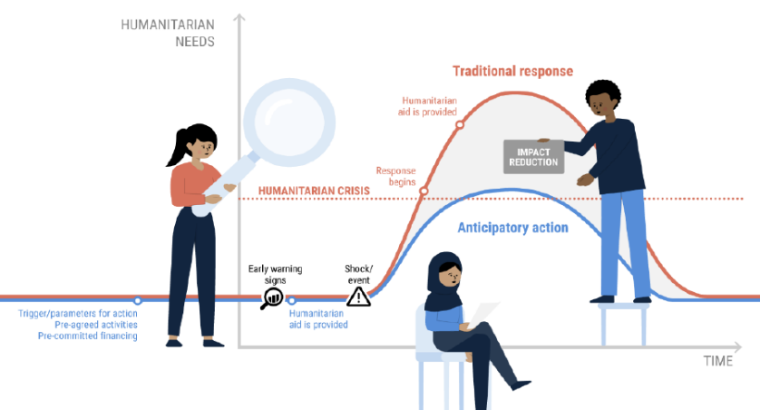




Qu’est-ce qu’une action ANTICIPATOIRE ?
Action Anticipatoire (AA) est définit comme “actions prédéfinies sont entreprises en amont des risques prévus afin d’atténuer ou de prévenir les pertes et les dommages avant qu’ils ne se produisent”.
Caractéristiques clés
Limitées dans le temps
Intentions Protectrices & Atténuatives
Seuils prédéfinis & informes par les risques
Approche sans regrets
Financements arrange a l’avance
Notes:
Déclencheurs/paramètres d’actions : développer base sur les prévisions de risques a surveiller et déterminer quand intervenir.
Interventions prédéfinies : Set d’activites planifiées basées sur les menaces identifies et développées considérant les risques et les impacts sur les personnes.
Financements arranges a l’avance: des fonds engages a la phase de planification et prêts a être débourser pour faciliter la mise en œuvre des activités dans un temps imparti.
.​

Slide 86








Understanding the concept - FRAMEWORK
Preparedness, Anticipatory Action and Response
In anticipation of the crisis …
… after the crisis
Early warning
PP & CP
Readiness
Anticipated actions
Crisis impact / shocks
Needs assessment & Response
Preparedness & Contingency Plan
Anticipatory/Early Actions
Early Response
Crisis
Response
ESA Regional
Meeting
Notes:
Plans de Contingence, Preparation and AA
Se référer aux activités de préparation de réponse aux urgences (Surveiller et analyser les risques, développer des plans de contingence, conduire des exercices de simulation et pré-positionner des stocks), qui ne tombent pas sous la réponse humanitaire.
AA se situe entre la préparation de réponse et la réponse, dans une fenêtre d’opportunite entre l’alerte précoce (ou un autre déclencheur d’action) et le début de la crise.
Reponse Precoce, Reponse Humanitaire et Action Anticipatoires
Reponse : pas de mécanisme déclencheur, mais mise en œuvre aux prémices de la l’urgence
Réponse Traditionelle : basée sur l’evaluation de besoins (processus long)

Slide 87
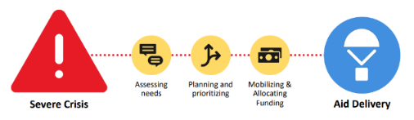
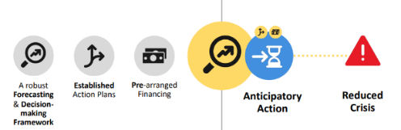
Comprendre le concept – Comment est-ce diffèrent ?
Les actions anticipatoires sont différentes d’une réponse humanitaire traditionnelle en trois points :
Timing: avant plutôt qu’après un choc ou, au minimum, avant la manifestation des besoins humanitaire.
Cible : personnes dont les vies sont imminemment a risque plutôt que les personnes déjà dans un besoin accru.
Objectif : d’atténuer l’impact du choc pour réduire la crise et son impact humanitaire plutôt que repondre a une crise évoluée et a ses conséquences humanitaires
A quoi ressemble une Réponse Traditionnelle ?
A quoi ressemble des actions anticipatoires ?
Notes:
La préparation de réponse aux urgences :
Système d’alerte précoce en place, impact base sur la prévision, les déclencheurs et la surveillance
Set d’activites pour atténuer les risques identifies, les bénéficiaires a cibler (base sur le contexte) et être prêt (pré-positionnement)
Les fonds: l’argent doit être prêt a être débourser

Slide 88

Comprendre le concept – Résultats et IMPACTS
Efficace : économies substantielles de temps et d’argent en agissant avant les urgences.
Une manière digne d’aider les personnes : renforcer la dignité des personnes tout en les protégeant d’une nouvelle exposition aux chocs.
Approche Nexus : contribuer au triple lien avec les interventions humanitaires qui se situent à l’intersection de la paix et de l’action climatique.
Photo credit: WFP

Slide 89
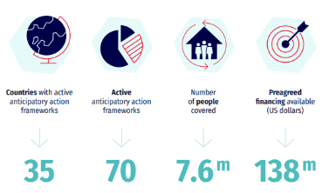
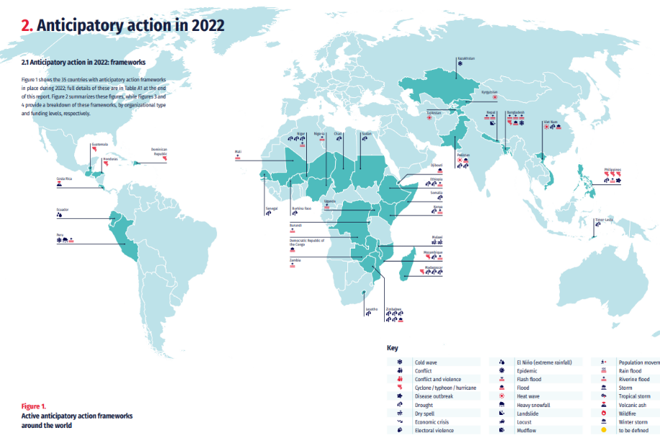
Action anticipatoire – Apercu global 2022
Cadre d’actions anticipatoires actives autour du monde
4.7 million people
covered by AA Plans
Source: Anticipation Hub, Anticipatory actions in 2022: A global overview
Notes:
Active AA framework en 2022 activer

Slide 90
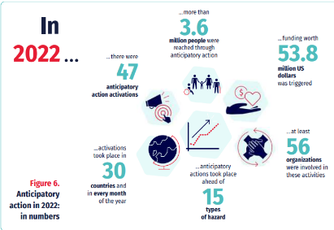
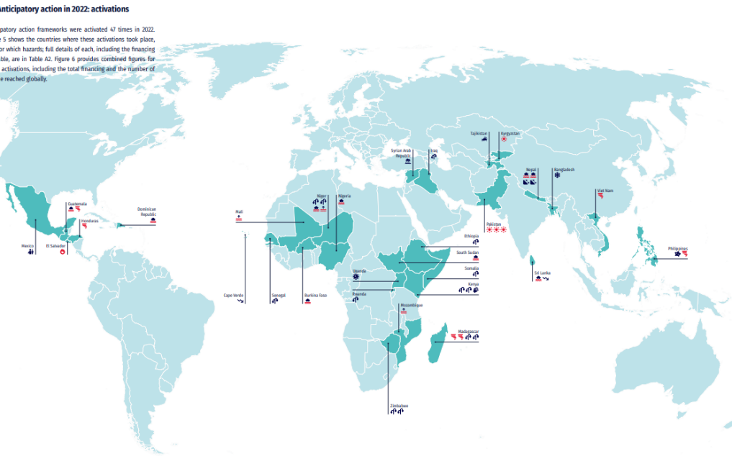
Anticipatory action – Global overview 2022
Anticipatory action frameworks activated in 2022
Source: Anticipation Hub, Anticipatory actions in 2022: A global overview
Notes:
Activation of framework one or the other

Slide 91
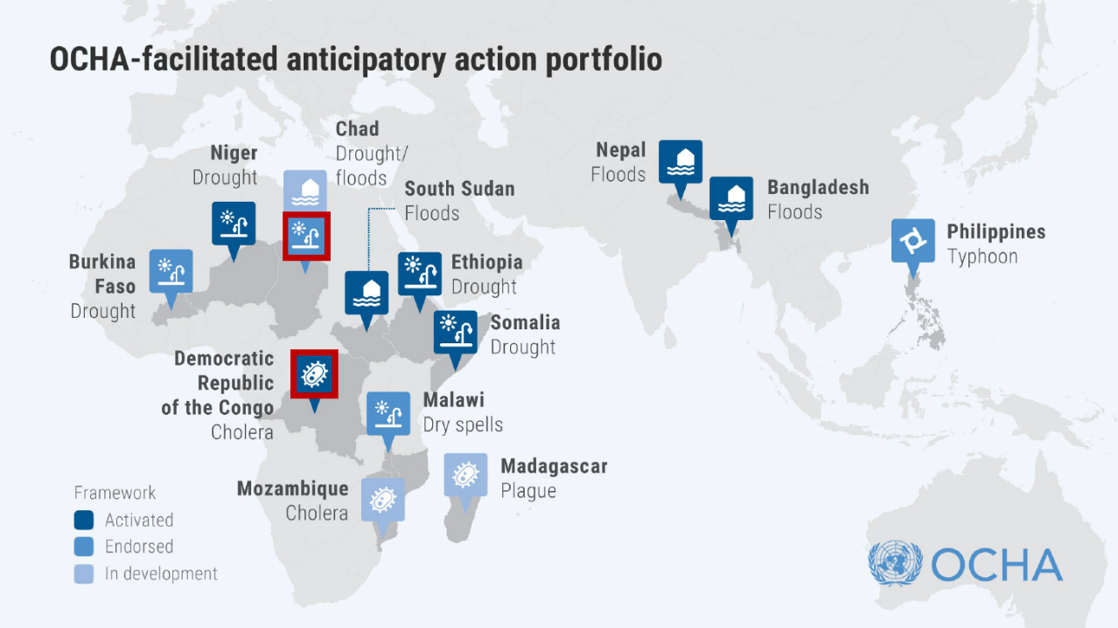
*As of March 2023
Source: https://www.unocha.org/our-work/humanitarian-financing/anticipatory-action
Notes:
As of December 2022
Total frameworks : 12 + South Sudan (Early Action)
UNICEF engagement: 11 frameworks, and Mozambique which is in development/discussion
Sectoral engagement: WASH, Health and Nutrition, Child protection, Education

Slide 92

Pourquoi actions anticipatoires & Nutrition?
1
Changement climatique est l’un des principaux facteurs de l’insécurité alimentaire et de la malnutrition, et des urgences complexes.
Exposition a des pluies excessives, des températures extrêmes, des inondations et sècheresses sont des facteurs de risques pour la malnutrition aigüe et chronique
2
3
Des chocs climatiques toujours plus nombreux et plus intenses, des besoins humanitaires accrus et des réponses coûteuses
4
Nécessité de passer d'un système humanitaire réactif à un système plus prospectif
5

Slide 93








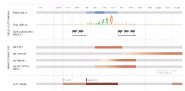
Intégrer la NUTRITION au sein du système des actions anticipatoires
EVALUER LES RISQUES ET LES IMPACTS
DECIDER QUAND AGIR EN DEVELOPPANT DES DECLENCHEURS DE PREVISION MECHANISM
ETABLIR UNE CHRONOLOGIE DE LA CRISE
2
1
Afin d’etablir une analyse des risques et des impacts ainsi que la chronologie de la crise, posez-vous les questions suivantes :
Est-ce que ce type de hasard a un potentiel impact sur la nutrition et l’alimentation ? Direct ou indirect ? Est-ce que le hasard impacterait les déterminants de la malnutrition qui peuvent être surveilles ? Est-il pris en compte dans la chronologie de la crise établit pour le plan d’AA ?
Quand peut-on attendre l’impact sur l’alimentation et la nutrition d’arriver et a quelle sévérité doit-on s’attendre ?
Qui est affecté ? Est-ce que les plus vulnérables nutritionnellement sont-ils les plus à risques (incluant les problèmes de nutrition existant exacerbes) Est-ce reflétés dans l’analyse ?
Cote approvisionnement : Avons-nous évaluée la disponibilité et l’acces physique a une alimentation nutritive et a des services de santé et de nutrition de base (incluant pour les plus a risque)? Comment le hasard les impacte?
Déclencheurs et seuils à développer avec des données/situation nutritionnelles, et le cout et la disponibilité d’alimentation nutritionnelle en tête – “impact base sur les déclencheurs”
Notes:
Évaluer les risques et les impacts : pour mieux comprendre l'impact potentiel des événements météorologiques extrêmes sur les personnes souffrant d'insécurité alimentaire et nutritionnelle, y compris les groupes nutritionnellement vulnérables, pour éclairer la conception et le ciblage des mesures d'atténuation anticipées.
Décider quand agir en développant des mécanismes de déclenchement : en collaboration avec les acteurs nationaux de la gestion des catastrophes pour déterminer l'ampleur d'un événement météorologique extrême pouvant entraîner des impacts élevés, modérés et faibles.

Slide 94




Integrating NUTRITION into THE ANTICIPATORY ACTION SYSTEM
DEVELOPPER LES ACTIONS ANTICIPATOIRES
CONCEPTUALISER PSO
SURVEILLER LES PREVISIONS, AGIR ET MESURER L’IMPACT!
Choix du type d’actions est très fortement dépendant du type de chocs : apparition rapide ou lente
Evaluer le besoin d’actions spécifiques nutrition ? Est-ce déjà couvert par d’autres partenaires ? Est-ce qu’une chronologie claire est définie ?
Assurez –vous que les messages d’alerte précoce intègrent des messages sur la nutrition, une alimentation saine, hygiène, et tirer parti des plateformes communautaires existantes et des activités de CCC afin d’atteindre les donneurs de soins et les autres membres de la communauté.
Considérer de fournir des paquets d’activités pour la prévention de la malnutrition (e.g.;. Top-up d’argent couples a l’assistance alimentaire / au travers des systèmes de protection sociale; pré-positionnement de produits nutritionnels / marche temporaire de nourriture fraiche; ….)
Maximiser les résultats en matière d’alimentation et de nutrition d’autres actions (ex : cultures riches en nutriments, résistantes a la sècheresse / a maturation précoces)
Considérer d’inclure des indicateurs sensibles a la nutrition dans le cadre de suivi et évaluation et ajouter des questions relatives aux résultats en matière d’alimentation et de nutrition dans la revue après actions / l’ évaluation d’impacts
Notes:
Développer des actions d'anticipation : sur la base de consultations multipartites, d'évaluations des risques et des évaluations historiques post-catastrophe, identifier les actions à risque élevé, modéré et faible qui peuvent être mises en œuvre dans la fenêtre entre les prévisions et les événements météorologiques extrêmes.
Concevoir des PSO : les PSO décrivent les actions, ainsi que les acteurs, les coûts, les seuils, les déclencheurs et les fonds prédéterminés à mobiliser en prévision d'un événement météorologique extrême. Les PSO doivent être alignées sur les plans nationaux de gestion des risques de catastrophe et validées avec les acteurs clés par le biais de simulations.
Surveiller les prévisions, agir et mesurer l'impact : En réponse à un déclencheur de niveau élevé, moyen ou faible, coordonner avec les principales parties prenantes pour mettre en œuvre des actions d'anticipation conformément aux PSO. Analyser l'impact, assimiler les leçons apprises et générer les preuves nécessaires pour passer à l'échelle

Slide 95





SYSTEME AA a action rapide - inondations
RECOLTE
WFP – Anticipatory Action: The Basics

Slide 96

Exemple: aa pour reduire l’impact de la secheresse au Tchad
Impact significatif de la sécheresse sur l’économie et les moyens de vie des populations
Démontrer comment l'action humanitaire collective anticipatoire à travers un paquet d’activités multisectorielles réduit l’impact humanitaire de la sécheresse sur les personnes exposées
En cas de sécheresse grave, les besoins humanitaires surviennent souvent plus tôt que d'habitude et avec une plus grande intensité.
Paquet multisectoriel : sécurité alimentaire et moyens d’existence ; eau, assainissement et hygiène ; nutrition ; protection ; santé.
Notes:
Le changement climatique est l’une des menaces les plus graves qui pèsent sur le Tchad, avec des impacts significatifs sur l’économie et les moyens de vie des populations
Calendrier de la crise : Pour ce pilote, les partenaires ont établi une chronologie de crise pour répondre à la question : Comment une grave sécheresse modifie-t-elle l'intensité et le timing des besoins humanitaires au Tchad à travers les bénéficiaires des partenaires de ce pilote ? Deux choses deviennent évidentes. Premièrement, en cas de sécheresse grave, les besoins humanitaires surviennent souvent plus tôt que d'habitude et avec une plus grande intensité. Deuxièmement, trois fenêtres d'opportunité se présentent : deux fenêtres visant la protection des moyens d’existence en agriculture et
pastoralisme et une fenêtre visant principalement à réduire les impacts humanitaires précoces.

Slide 97
Exemple: aa pour reduire l’impact de la secheresse au Tchad
Trois fenêtres d'opportunité : deux fenêtres visant la protection des moyens d’existence en agriculture et pastoralisme et une fenêtre visant principalement à réduire les impacts humanitaires précoces
Modèle déclencheur
Seuil de 42.5% de probabilité que la précipitation totale pendant la période juillet-aout septembre sera inférieure à la moyenne.
Déclenchement des activités de la fenêtre 1
Mars ou avril
Prévision de précipitation
Déclenchement des activités de la fenêtre 2
Mai ou juin
Seuil d’au moins 80% d’anomalie
Déclenchement des activités de la fenêtre 3
Observation de la biomasse
Septembre
Sécurité alimentaire et moyens d’existence
Eau, assainissement et hygiène
Nutrition
Protection
Santé
Notes:
Le modèle déclencheur adopté pour la prise de décision dans le cadre de ce pilote a été développé en partenariat avec la FAO, la Direction des Ressources en Eau et de la Météorologie (DREM) au sein du ministère de l’Environnement et de l’eau, le Centre de données humanitaires d’OCHA (CDH) et l’Université de Columbia. Le pilote a trois « fenêtres » de déclenchement pour trois paquets d’interventions anticipatoires :
• Les activités dans la « fenêtre 1 » sont déclenchées si la prévision de l’IRI publiées en mars ou avril atteint un seuil de 42.5% de probabilité que la précipitation totale pendant la période juillet-aout septembre sera inferieure a la moyenne.
• Les activités dans la « fenêtre 2 » sont déclenchées si la prévision de l’IRI publiées en mai ou juin atteint un seuil de 42.5% de probabilité que la précipitation totale pendant la période juillet-aout septembre sera inferieure a la moyenne.
• Les activités dans la « fenêtre 3 » sont déclenchées si l’analyse de données d’observation de la biomasse publiées en septembre atteint un seuil d’au moins 80% d’anomalie.
Cinq agences des Nations Unies ont identifié des actions anticipatoires dans cinq secteurs : sécurité alimentaire et moyens d’existence ; eau, assainissement et hygiène ; nutrition ; protection ; santé.

Slide 98

Lutter contre la secheresse – Tchad

Slide 99



ESA Regional
Meeting
mERCI

Slide 100

IMAGE TO BE REPLACED AS NEEDED
Nutrition en urgence et la crise climatique
Diane Holland (GNC)
Ann Defraye (UNICEF WCARO)
19 Fevrier 2024
Notes:
Les deux objectifs de cette présentation sont de
Partager une compréhension commune du nutrition en urgence dans le contexte de la crise climatique aux niveaux mondial et régional, et également
Discuter les efforts aux niveau régionaux et mondiaux
Nous attendons également avec impatience la séance du groupe de travail
Pour entendre et apprendre votre expérience en nutrition en urgence dans le contexte de crise climatique, et aussi
D'identifier les actions prioritaires pour aller de l’avant
Je reconnais qu'il s'agit d'une session brève et que certaines terminologies et approches peuvent différer selon les pays et les agences. Nous nous efforcerons donc de clarifier les endroits où elles sont disponibles, et je reconnais également qu'une partie de la raison d'être de cette session est d'identifier les moyens de rassembler diverses perspectives autour de cette question cruciale.

Slide 101
Chevauchement des dangers, des chocs et des contraintes climatiques et
Environnementaux et l’évolution de la crise nutritionnelle
Dangers, chocs et stress liés au climat et à l’environnement
Prévalence des enfants de moins de 5 ans qui ne grandissent pas bien (retard de croissance, émaciation ou surpoids), 2018
Sensitivity and adaptive capacity
Seasonality, shocks, long term stressors
Figures from The Climate Crisis is a Child Rights Crisis:: Introducing the Children’s Climate Risk Index. New York: United Nations Children’s Fund (UNICEF), 2021.
Figures from UNICEF (2019). The State of the World’s Children 2019. Children, Food and Nutrition: Growing well in a changing world. UNICEF, New York.
Session Title: NIE and the Climate Crisis
Date: 19 Feb 2024
ESA Regional
Meeting
Notes:
Le changement climatique a modifié notre paysage humanitaire.
Nous sommes confrontés à des dangers, des chocs et des stress climatiques et environnementaux qui se chevauchent. L’analyse de 2021 de l’UNICEF a exploré comment 8 risques, dangers et stress liés au climat différents étaient liés les uns aux autres. La carte de gauche montre le chevauchement de la répartition de ces risques à l’intérieur et entre les pays.
Nous sommes également confrontés à des défis nutritionnels qui se chevauchent. En 2019, l’UNICEF a introduit un nouvel indicateur de « croissance bien-estimative des enfants, par exemple des enfants qui ne souffrent pas de retard de croissance, d’émaciation, de surpoids ou d’une combinaison de retard de croissance, de retard de croissance et de surpoids, ou de retard de croissance et d’émaciation ».
À l’époque, « à l’échelle mondiale, au moins un enfant sur trois de moins de 5 ans ne grandissait pas bien – il souffrait d’un retard de croissance, d’émaciation ou de surpoids et, dans certains cas, souffrait d’une combinaison de deux de ces formes de malnutrition ».
Les enfants ne sont pas les seuls touchés. « L’UNICEF suit l’état nutritionnel des adolescentes et des femmes enceintes et allaitantes dans les pays les plus touchés de la Corne de l’Afrique, du Sahel central et d’autres pays en crise. Nous constatons que le nombre estimé d’adolescentes et d’adolescentes enceintes et allaitantes souffrant de malnutrition aiguë a augmenté de 25 % entre 2020 (5,5 millions) et 2022 (6,9 millions).

Slide 102

Augmentation des risques et des impacts :
malnutrition, déplacement, morbidité et mortalité
ESA Regional
Meeting
Notes:
Ces crises qui se chevauchent se traduisent par :
Augmentation de la fréquence, de la gravité et de la durée des situations d’urgence liées au climat
Environ 1 milliard d’enfants (50 %) dans le monde, vivant dans des pays extrêmement exposés aux impacts du changement climatique
On estime à 250 000 le nombre de décès prématurés supplémentaires dus chaque année à la malnutrition, au paludisme, à la diarrhée et au stress thermiqueremature deaths per year from malnutrition, malaria, diarrhoea and heat stress
On estime à 30 millions le nombre de personnes déplacées à l’intérieur du pays chaque année en raison d’événements liés au climat
3 milliards de personnes qui n’ont pas les moyens d’avoir une alimentation saine et 1,5 milliard de personnes qui ne peuvent pas satisfaire leurs besoins nutritionnels de base
Pour cette session, nous proposons d’adopter une perspective de crise climatique (par opposition au changement climatique), en nous concentrant spécifiquement sur :
Lorsque la variabilité climatique a une incidence sur le risque nutritionnel (par exemple, la saisonnalité des pluies et les saisons de la faim)
Chocs climatiques et météorologiques, comme les inondations, les sécheresses, les chaleurs extrêmes et les cyclones,
Les facteurs de stress à long terme (par exemple, les changements de température, les précipitations, l’élévation du niveau de la mer) qui, en fin de compte, ont un impact sur les communautés et leur capacité à se nourrir de manière durable.
Image de https://www.ipcc.ch/report/ar5/wg2/

Slide 103
Une architecture collective pour faire face aux crises climatiques et nutritionnelles, même si des lacunes restent à combler
Opportunités de renforcement au niveau national
La nutrition et le climat se chevauchent uniquement
dans :
2 % des contributions déterminées au niveau national
16% des plans d'action nationaux
1% de l'aide publique au développement
Architecture de la gouvernance climatique
Convention-cadre des Nations Unies sur les changements climatiques (CCNUCC)
Accord de Paris sur le climat
Contributions déterminées au niveau national (NDC)
Programmes d'action nationaux d'adaptation (PANA) et plans nationaux d'adaptation (PAN)
Conférence des Parties (COP)
Groupe d'experts intergouvernemental sur l'évolution du climat (GIEC)
Objectifs de développement durable (ODD)
ESA Regional
Meeting
Notes:
Il existe un certain nombre d’engagements et de plateformes mondiales pour faire face à la crise climatique. Dans le même temps, les progrès sont lents au niveau national.
L'Initiative sur l'action climatique et la nutrition (I-CAN) a entrepris une analyse du degré auquel la nutrition et le climat sont actuellement liés dans ces discussions, ce qui met en évidence des lacunes critiques :
seulement 2 % des contributions déterminées au niveau national (CDN) et 16 % des plans d'action nationaux (PAN) incluent des plans distincts visant à mobiliser des ressources pour une action reliant le climat et la nutrition, tandis que 60 % des CDN et 21 % des PAN n'établissent pas de lien entre la nutrition. et le climat.(I-CAN).
Seulement 1 % du financement de l’aide publique au développement consacré au climat en 2019-2021 mentionne explicitement la nutrition. (ICAN)
REFERENCE TEXT- NOT TO SPEAK TO IN THE PRESENTATION
« La Convention-cadre des Nations Unies sur les changements climatiques (CCNUCC) est le principal mécanisme international et intergouvernemental de lutte contre le changement climatique. La Convention a actuellement été ratifiée par 197 pays. "
« L'Accord de Paris sur le climat, adopté en 2015, a inauguré une nouvelle ère dans la réponse au changement climatique et constitue le premier accord au monde largement soutenu.1 L'accord vise à maintenir l'augmentation mondiale de la température au cours de ce siècle à moins de 2 °C au-dessus niveaux préindustriels et de poursuivre les efforts pour limiter encore davantage cette température, à 1,5°C. L'accord identifie le droit à la santé comme étant au cœur de l'action climatique nationale et reconnaît la valeur sociale, économique et environnementale des actions volontaires d'atténuation, ainsi que leurs co-bénéfices pour l'adaptation, la santé et le développement durable. "
« Au cœur de l’Accord de Paris se trouvent les contributions déterminées au niveau national (CDN). Les CDN présentent des plans nationaux visant à réduire les émissions de gaz à effet de serre (GES) pour atteindre les objectifs de l'Accord de Paris sur le climat de 2015 et sont renouvelées tous les cinq ans. Ils reflètent les adaptations auto-définies par les pays aux impacts du changement climatique, tout en améliorant leur résilience au changement climatique.
Dans le cadre de la CCNUCC, les pays ont également élaboré des programmes d'action nationaux d'adaptation (NAPA) intersectoriels et, plus récemment, des plans nationaux d'adaptation (PAN en francais, NAP en anglais), qui permettent aux pays d'identifier les actions prioritaires pour s'adapter au changement climatique. Si les NAPA et les NAP identifient généralement la santé, l’agriculture et la sécurité alimentaire comme secteurs prioritaires, ils ne prennent souvent pas en compte les aspects nutritionnels.
« La Conférence des Parties (COP) est l'organe décisionnel suprême de la Convention, au sein de laquelle sont représentés tous les États parties à la Convention. "
« Le IPCC GIEC est un organisme scientifique indépendant fondé par l’Organisation météorologique mondiale et le Programme des Nations Unies pour l’environnement. Il examine et évalue régulièrement les informations scientifiques, techniques et socio-économiques les plus récentes liées au changement climatique. Les résultats et les données du GIEC sont utilisés par l’ONU comme base pour prendre des décisions scientifiques sur le changement climatique. "
« Bien que la CCNUCC soit le principal forum international pour coordonner l'action contre le changement climatique, les objectifs de développement durable (ODD) incluent également des engagements liés au climat. "

Slide 104

Une approche systémique pour faire face aux crises climatiques et nutritionnelles
ESA Regional
Meeting
From FAO. 2023. Climate action and nutrition – Pathways to impact. Rome. https://doi.org/10.4060/cc8415en
Notes:
Un analyse réalisé en 2023 par la FAO sur les liens entre l'action climatique et la nutrition nous apprend que
« ... un examen attentif des systèmes qui ont un impact sur la nutrition peut fournir des orientations importantes pour répondre conjointement au changement climatique et à la malnutrition, d'une manière qui va au-delà de la seule analyse des impacts sur les systèmes agroalimentaires.
◗ Quatre systèmes clés reliant le climat et la nutrition sont : l'agroalimentaire, l'eau, la protection sociale et la santé.
◗ Dans tous les systèmes, il existe de nombreuses options pour aborder conjointement le climat et la nutrition. Les efforts devraient se concentrer sur l’élargissement de ces réponses, tout en générant davantage de preuves pour identifier les moyens d’obtenir un impact maximal.
◗ Prendre des mesures dans ces quatre systèmes pour relever les défis liés au climat et à la nutrition contribuera à réduire les inégalités globales entre les sexes, à améliorer les moyens de subsistance et l’accès des femmes à l’eau et à l’assainissement, et à renforcer la protection sociale et les services de santé pour les femmes.
Dans le même temps, les bases factuelles sur les moyens de travailler avec d’autres systèmes pour faire face aux risques nutritionnels dans le contexte de la crise climatique varient.

Slide 105





La nutrition et les chocs climatiques en Afrique de l'Ouest et centrale
en 2021, les inondations ont touché 1,4 million de personnes dans 15 pays d'Afrique de l'Ouest et d'Afrique centrale
tendance significative vers des conditions plus humides avec des précipitations plus intenses mais moins nombreux
1,4 million d'enfants supplémentaires souffriront d'un retard de croissance sévère d'ici 2050 si le réchauffement climatique est de 2,1°C.
l'augmentation de la température au Sahel devrait être 1,5 fois plus élevée que dans le reste du monde
17 des 30 pays du monde où le risque de changement climatique est le plus élevé pour les enfants se trouvent en Afrique de l'Ouest et en Afrique centrale
ESA Regional
Meeting

Slide 106




Une opportunité d'amplifier ...
des décennies d'expérience en matière de chocs climatiques
les engagements organisationnels et collectifs en faveur de la nutrition et de la crise climatique
Notes:
This is a moment of opportunity to amplify decades of collective experience addressing climate shocks and risks- predictable and unpredictable- through development of ways of preparing for and responding to emergencies through the humanitarian planning cycle.
This is also a moment of opportunity to amplify organizational and collective commitments for NIE and the climate crisis – including policy briefs, technical guidance, research across GNC partner agencies and governments

Slide 107

Actions au niveau régional: analyse, alertes et plaidoyer
Dispositif régional de prévention et de gestion des crises alimentaires (PREGEC)/Reseau pour la Prevention des Crises Alimentaires (RPCA): appui au CILSS pour l'intégration de la nutrition, l'analyse de la situation nutritionnelle, le plaidoyer et la communication
Session Title: NIE and the Climate Crisis
Date: 30 Jan 2024
ESA Regional
Meeting

Slide 108


Actions au niveau régional: approches programmatiques
Sahel programme de résilience pluriannuel :
Appui à la diversification de la production et la transformation des aliments locaux pour un régime alimentaire sain et diversifié + protection de la biodiversité et mitigation des effets climatiques
Initiative "premiers aliments" pour addresser les besoins spécifiques des enfants 6-23 mois
L'adaptation au climat des services de santé
Programmes de protection sociale sensibles à la nutrition
Engagement des jeunes
Session Title: NIE and the Climate Crisis
Date: 30 Jan 2024
ESA Regional
Meeting

Slide 109

Action du GNC : Janvier-Juin 2024
Une analyse: nutrition en urgence dans le contexte de la crise climatique
Exposé de position
études de cas
matériel de communication
Conversation amplifiée
Identification des actions prioritaires
Un positionnement, une légitimité et des ressources améliorés
Besoins des utilisateurs
Groupe de travail du GNC sur la crise climatique
ESA Regional
Meeting
Notes:
Main points- this builds off of the work that we collectively have been doing, and regional work that is underway
Aims to identify where we can align collectively in addition to what individual agencies are doing
This will be an iterative process- data collection, desk review, KIIs, and discussions
Resulting in position paper case studies and communication materials
Aim to discuss position paper at GNC meeting at end of March
And as a result of this work, amplify the GNC’s conversation to date on NIE and climate crisis, have prioritized collective action, and support for improved positioning (partnerships, comparative advantage), legitimacy and resourcing
And that this is being facilitated through the GNC Climate and Nutrition WG- co leads Andi and Domi-
How to engage:
Share your experience and needs
Participate in upcoming surveys
Keep informed about the Climate Crisis and NIE Working Group

Slide 110
ESA Regional
Meeting
merci

Slide 111
pause-café / coffee break

Slide 112
group work travail de groupes
Group repartition
Répartition des groupes
Themes | Tables | Facilitators
ERP / PRU | 1 | Geraldine
 | 2
AAs | 3 | Gwen
 | 4
Climate crisis | 5 | Ann
 | 6
Group work
Date: 19/02/2024
WCA Regional
Meeting

Slide 113
group work travail de groupes
Objectifs
Passer en revue les bonnes pratiques, refléchir aux défis et aux nouvelles idées/opportunités pour avancer sur la PRU, les AAs et les implications de la crise climatique sur le secteur.
Formuler des actions à mener collectivement pour progresser
Identifier les domaines qui peuvent nécessiter un appui des niveaux régional et/ou global
Objectives
To reflect on best practices, challenges and new ideas/opportunities to move forward on ERP, AAs, and Climate crisis implications
To formulate actions to be taken collectively to make progress
To identify areas that may require support from regional and global levels
Group work
Date: 19/02/2024
WCA Regional
Meeting

Slide 114
group work travail de groupes
Instructions pour le réflexion
Approche rose, bourgeon, épine : Les participants partagent et échangent sur l'une des 3 thématiques en relation avec :
  Une rose : un moment fort, un succès, une petite victoire ou quelque chose de positif
  Une épine - un défi dans ce domaine où un soutien est nécessaire
  Un bourgeon - de nouvelles idées qui ont emergées ou des activités qui démarrent et que vous avez hâte de développer prochainement.
Chaque groupe identifie un modérateur et un porte-parole
Les preneurs de notes désignés utilisent le caneva pour capturer les réflexions et discussions
Résumer les résultats des discussions du groupe en 3 points maximum
Instructions
Rose, bud, thorn reflection: Participants share and exchange on one of the 3 themes in relation to:
  A rose - a highlight, success, small win or something positive
  A thorn - a challenge in this area where support is needed
  A bud - new ideas that have blossomed or activities that are beginning and you look forward to developing in the near term.
Each group identify a moderator and a spokesperson
Assigned notetakers use the template to capture reflections
To summarize group’s discussion outcomes in 3 bullet points max
Group work
Date: 19/02/2024
WCA Regional
Meeting

Slide 115
collective actions actions conjointes
Guiding questions
    What are the biggest challenges you currently face in moving ahead?
    What are the most impactful opportunities you see to move forward in the coming year?
    What would help you from the country level? From the regional level to move forward?
    What would help you from the global level? From the GNC (toolkits? case studies? advocacy notes? trainings?)
Pour guider la reflexion
    Quels sont les plus grands défis auquels vous êtes actuellement confrontés pour advancer ?
    Quelles sont les opportunités les plus marquantes que vous voyez pour aller de l’avant au cours de l’année à venir ?
    Qu’est-ce qui vous aiderait au niveau national ? Besoin d’appui du niveau régional pour avancer ?
    Qu’est-ce qui vous aiderait de la part du niveau mondial ? Du GNC (boîtes à outils ? études de cas ? notes de plaidoyer ? formations ?)
Group work
Date: 19/02/2024
WCA Regional
Meeting

Slide 116
ESA Regional
Meeting
Merci
À demain

