Slide 1


ROSA / EAP Regional
Meeting
nutritioncluster.net
ROSA & EAP Regional Nutrition Consultation Meeting
Virtual
13 March 2024

Slide 2
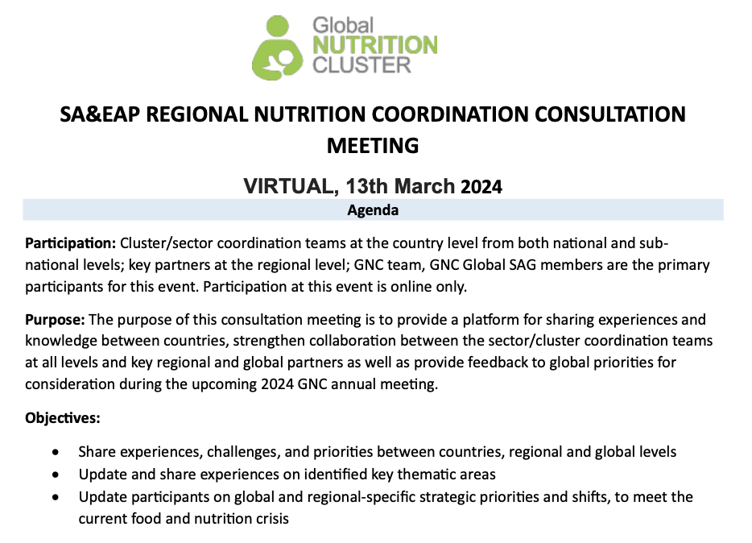
AGENDA

Slide 3

OPENING REMARKS

Slide 4
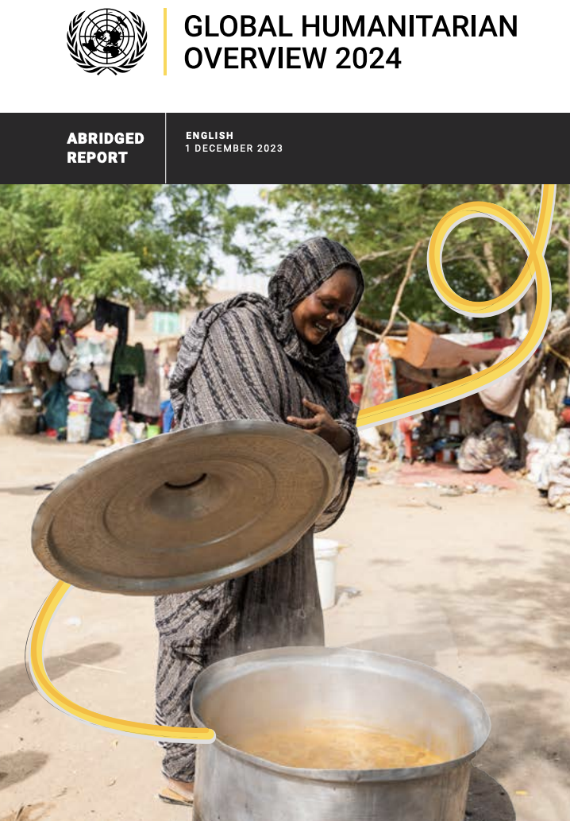

Global Nutrition Landscape
Stevano Fedele
Global Nutrition Cluster Coordinator
Notes:
Introduce yourself (again)
The 2024 Global Humanitarian Overview is produced yearly and is a coordinated and comprehensive plan to address the growing humanitarian needs of people affected by crises globally. Each year we witness a growing number of affected people due to impacts from climate change to conflict, pandemics to epidemics.
The GHO assesses and analyzes those needs to help guide humanitarian response efforts. It helps in the coordination of respone efforts by providing a common understanding of the crisis including the funding needed to adequately address humanitarian needs. All of which are criticial components in our work in nutrition in emergencies.
In addition to identifiying the needs, the GHO also identifies ways forward and what we must implement at all levels into our response efforts.

Slide 5
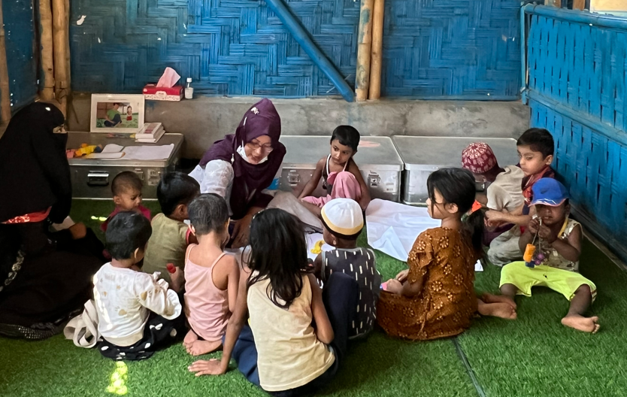


GBV Safety Audit
for Nutrition Facilities
A mixed-method assessment report
Nutrition Sector & GBV Sub-Sector; Cox’s Bazar, Bangladesh
13 March 2024

Slide 6


Key Objectives
Identify and understand GBV risks related to the Nutrition sector and their key contributing factors
Identify field-driven recommendations to address identified GBV needs and gaps
Allow the Nutrition Sector to self-assess the status of GBV risk mitigation programme integration and identify priority areas for action
Provide evidence-based to support advocacy initiatives.
EAP Regional
Meeting
Notes:
Besides; the analysis will provide an evidence base to support advocacy initiatives with the donors, clusters and partners for stronger inter-sectoral GBV prevention and risk mitigation.
"Provide an evidence base to support advocacy initiatives with the donors, clusters and partners for stronger inter-sectoral GBV prevention and risk mitigation"

Slide 7
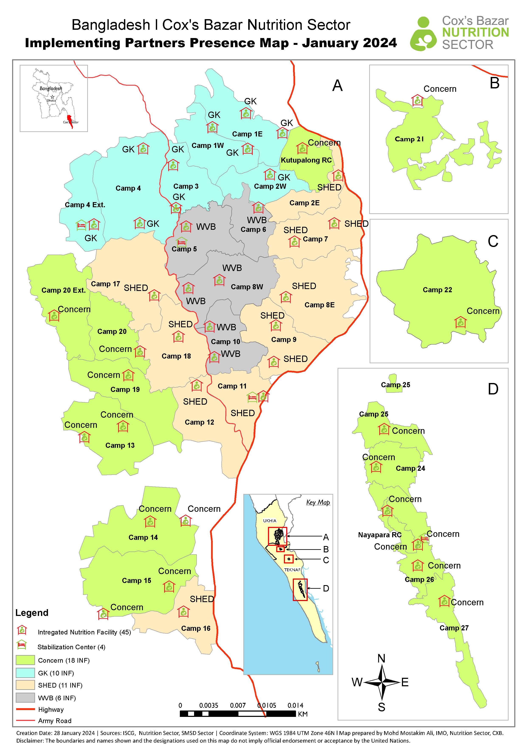
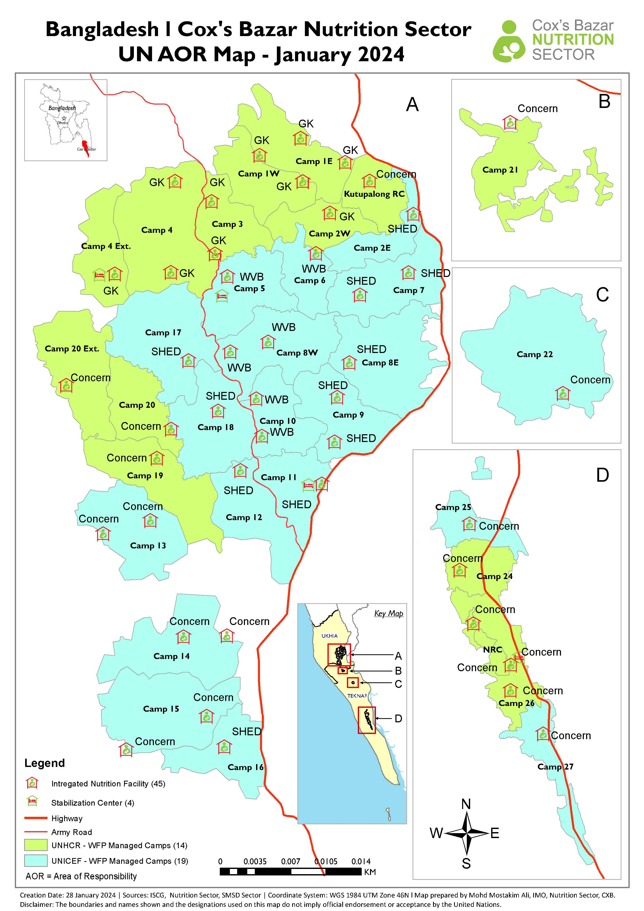


IP Presence
UN AOR

Slide 8
Research Questions
Methodology
Reflection checklist
Observational checklist
Consultation questionnaire: qualitative and quantitative data collection were used for the analysis
  A total of 35 FGDs
  9 key informant interviews
GBV risk assessment (44 Nutrition Sector facilities)
a. Safety and accessibility
b. Access to nutrition in the household
c. Participation of communities
2. Minimum standards for GBV risk mitigation (44 Nutrition Sector facilities)
a. Facility standards
b. GBV referral pathways
c. Complaints and feedback mechanisms
3. Recommended actions
What “recommended actions” can frontliners working in the Nutrition Sector facilities provide for the enhancement of GBV risk mitigation?
EAP Regional
Meeting

Slide 9
Key Findings
97.7% of the nutrition facilities are safe and equally accessible
  100% of nutrition sites reported having no safety concerns
100% of nutrition sites have a private consultation/counselling room
100% of nutrition sites – no requests for payment/favours to gain access to nutrition services
13.6% of facilities assessed do not have adequate toilets and are not separated by gender
80% of nutrition facility staff stated that sexual reproductive health and rights (SRHR) messages are not incorporated into nutrition outreach
EAP Regional
Meeting

Slide 10
Key Findings continued
Complaints and feedback mechanism (CFM) in place in all nutrition facilities
11.4% of nutrition facilities did not have any GBV referral pathways/hotlines displayed inside the nutrition facility
All nutrition personnel and community volunteers are trained on the Code of Conduct
Female staff represents more than 50% in all nutrition sites. However, only 1/3 of them are in leadership positions
Husbands/men decide what to eat in 75% of households (HH)
Wives/women and girls are reported to be least prioritized to eat in HH (80% of responses)
EAP Regional
Meeting

Slide 11
Recommendations
Empowering women to pursue leadership roles
Increase the number of GBV & PSEA awareness-raising sessions at nutrition sites and outreach programmes
Continue to display GBV referral pathways and hotlines within nutrition facilities and at the community level
To ensure all facilities have toilets separated (proper partition) by gender
Maintain and establish separate waiting areas for women and men within the nutrition sites, where possible
EAP Regional
Meeting
Notes:
In conclusion, the survey confirmed that the nutrition programmes' safety and accessibility are excellent. The participation of female staff and volunteers in the provision of nutrition services is outstanding as well. To encourage diversity and gender equality, however, there needs to be a greater representation of women in leadership positions.

Slide 12


EAP Regional
Meeting
Thank you

Slide 13
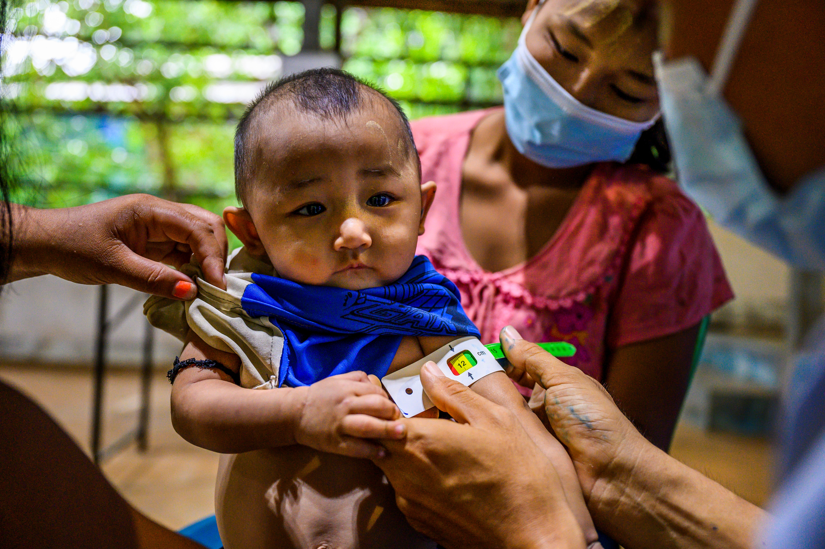
CVA and Related Opportunities to Expand Programming Options in Restricted Humanitarian Spaces
Mabasa Farawo – Myanmar Nutrition Cluster Coordinator
13th March 2024

Slide 14
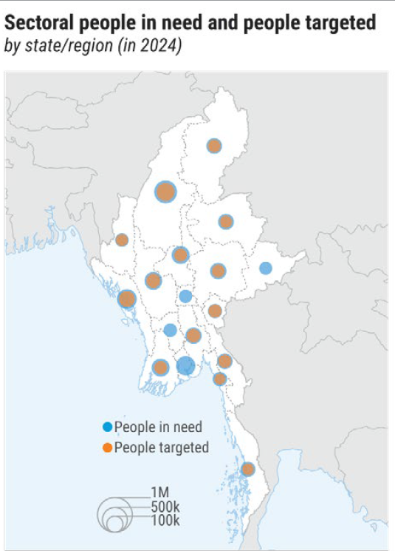
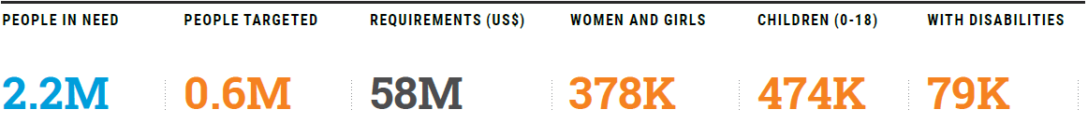
Background – Nutrition Situation, Myanmar
The Nutrition Cluster was established in August 2021
Many lives have been affected due to the post coup crisis, Covid19
Resultantly, a dire nutrition situation in the country ensued
The burden of acute malnutrition is rising, and the situation has worsened due to conflict
Myanmar Humanitarian Needs and Response Plan (HNRP) showing increasing needs
ROSA / EAP Regional
Meeting

Slide 15
Trends - SAM and MAM Admissions 2020 - 2023
Trends of SAM and MAM increasing - more than 80% are in Rakhine
Limited response capabilities
Nutrition Cluster Exploring innovative approaches
Cash Voucher Assistance initiated
ROSA / EAP Regional
Meeting

Slide 16
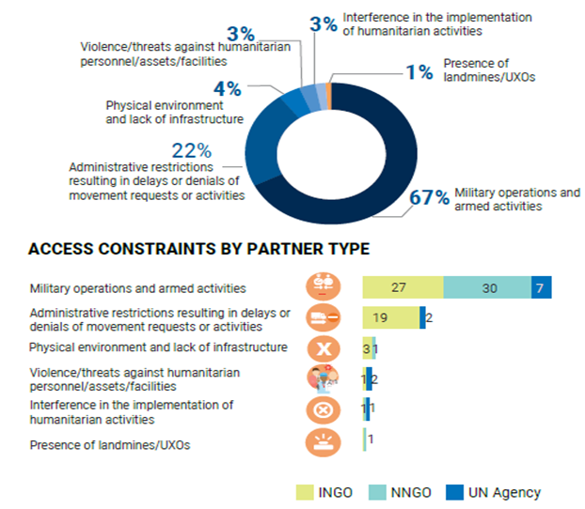
Nutrition Programme Implementation Impediments**
Access constraints are a big hindrance to responding to the growing humanitarian needs in Myanmar
Many impediments hinder partners from responding to needs as shown by access constraints established above
ROSA / EAP Regional
Meeting

Slide 17
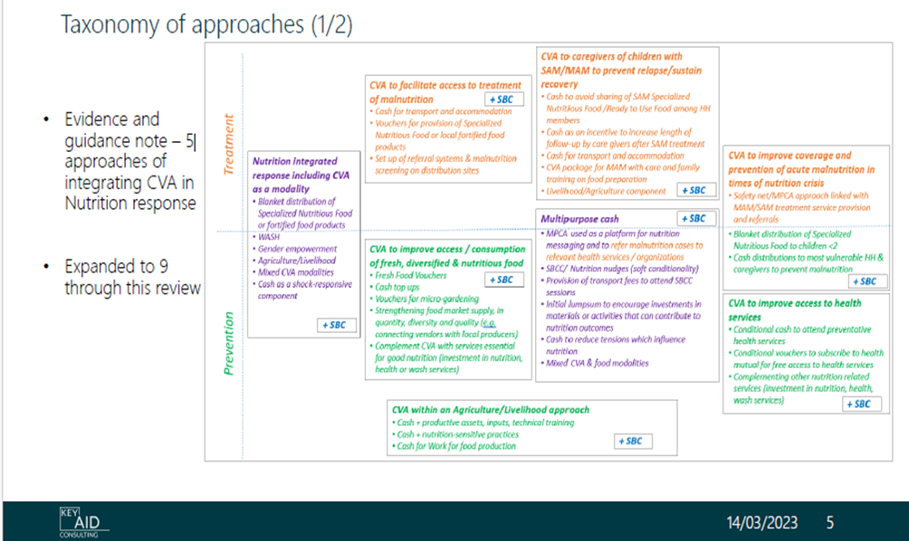
CVA Initiative in Myanmar, Progress
Continuous Cluster support to at least 5 partners
Advocacy strengthened
NB: Partners received 2% of the $10million MHF
Interventions to follow generic options according to the CVA Guidelines for Myanmar
ROSA / EAP Regional
Meeting

Slide 18
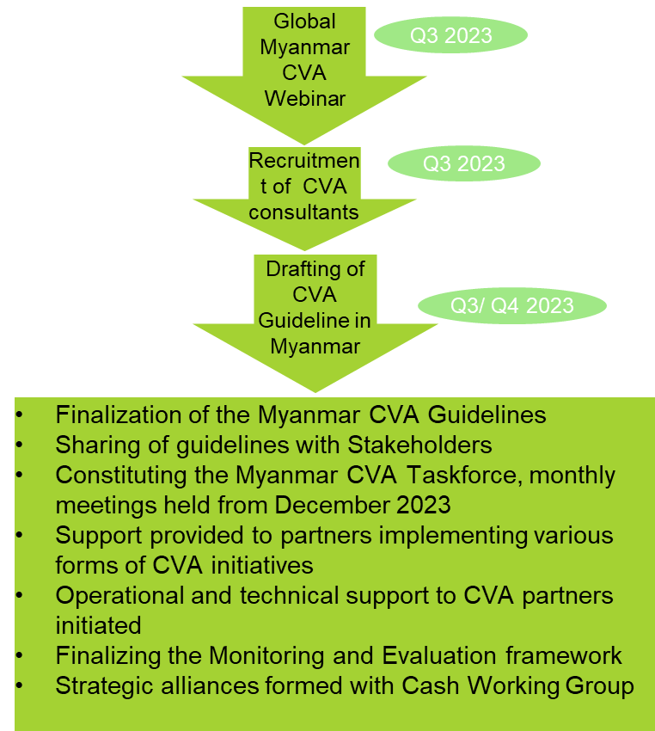
Progress After the Webinar on CVA for Myanmar
Myanmar CVA for Nutrition Drafted and shared with Partners
Taskforce created
ROSA / EAP Regional
Meeting

Slide 19
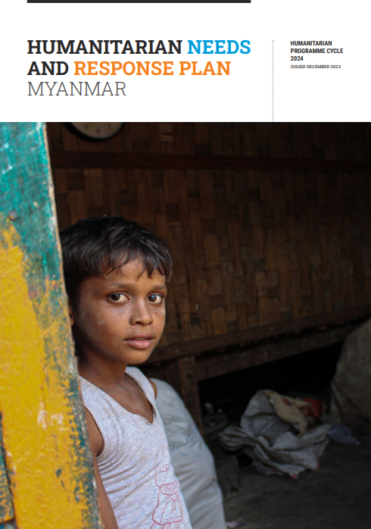
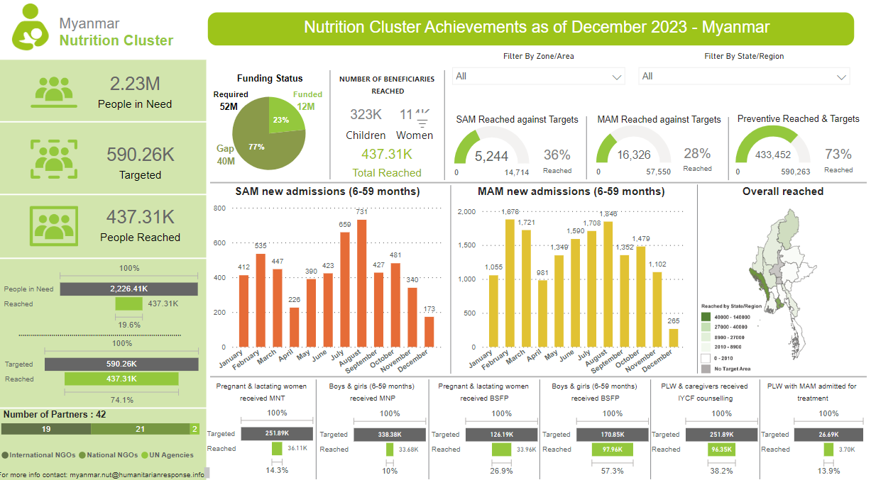
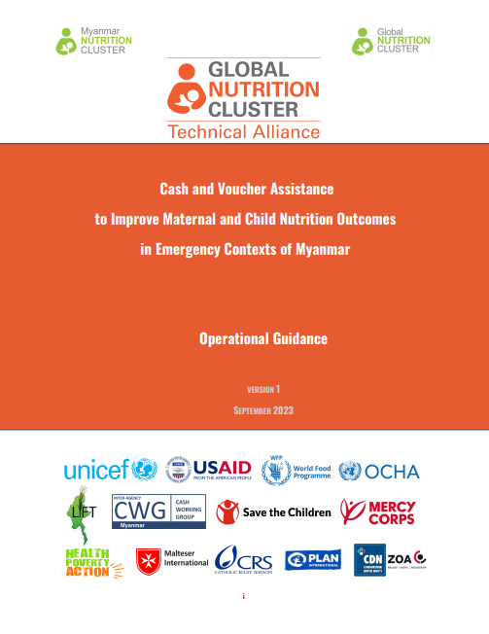



Links to Some Referral Documents
ROSA / EAP Regional
Meeting

Slide 20

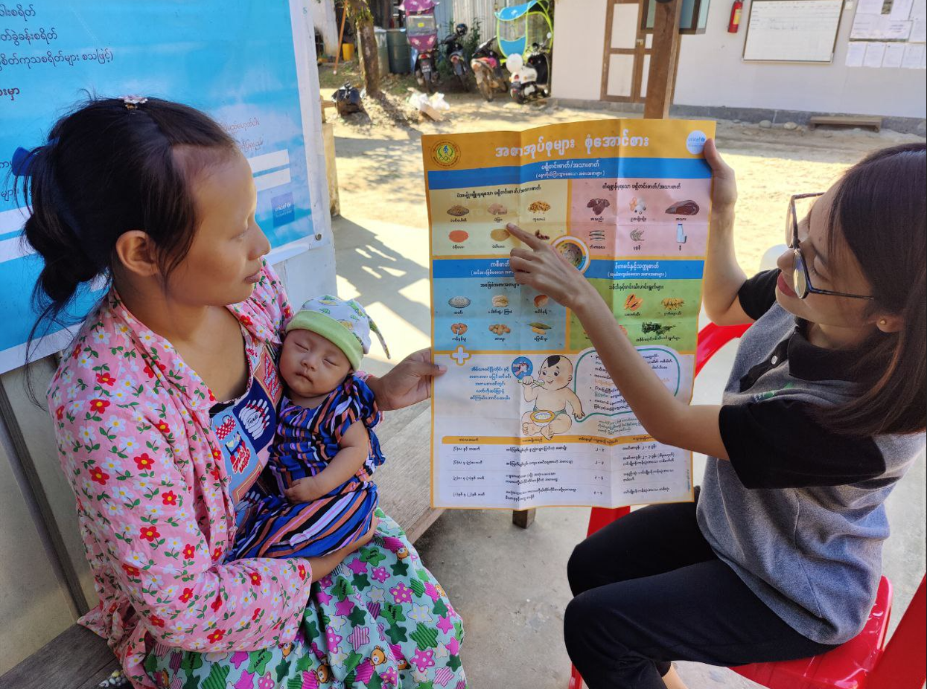
ROSA / EAP Regional
Meeting
Thank you
@UNICEF/2022/Ayeyarwardy

Slide 21

Localisation
Denis Kioko Matheka
Martha Nakakanda
Alexa Humphreys

Slide 22
What is localisation?
There is no single definition and interpretations of the term “localisation” vary across stakeholders and contexts
GNC Anti-racism & Localisation Working Group:
“Localisation is based on the recognition of an imbalance of power between international actors and the communities that they serve. Localisation is a restorative process involving recognition, respect, appreciation, and investment in local and national humanitarian capacities, leadership, and local and national resources. The aim is to replace this imbalance with locally-driven, locally-led, and locally-owned response to better and more sustainably meet the needs of affected populations"
- Inspired by The Grand Bargain, Arbie Baguios, and Oxfam
The Grand Bargain frames localisation as being:
“as local as possible, as international as necessary”
Signatories have pledged to increase cash programming, strengthen the humanitarian-development nexus, promote greater participation of affected persons in decision-making, and provide more support to national and local responders.
ROSA/EAP
Regional Meeting
Session Title: Localisation
Date: 13 March 2024
Notes:
The first question you may have is, what is localisation?
There is no globally agreed upon definition of the term "Localisation"
The Grand Bargain focused on some characteristics but did not issue a clear definition
To help the GNC understand localisation for our work, the Anti-racism & Localisation Working Group developed the following understanding of localisation.
However, we also acknowledge that the term localisation is top-down in nature and will likely be replaced in the future.

Slide 23
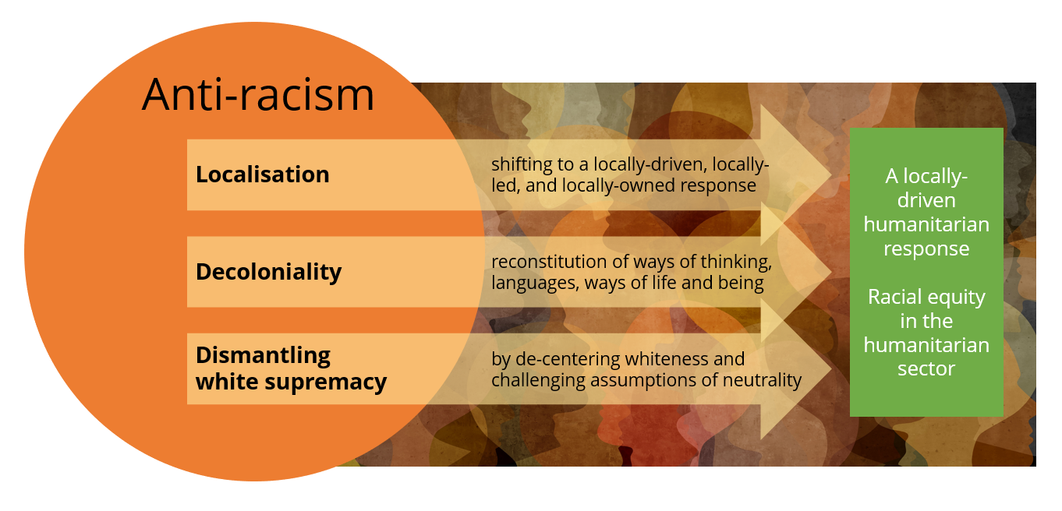
How the GNC connects Anti-racism and Localisation
ROSA/EAP
Regional Meeting
Session Title: Localisation
Date: 13 March 2024
Notes:
Further, this working group believes that when localisation is implemented as a restorative process, it contributes to anti-racism efforts and the ultimate vision of racial equity in the humanitarian sector. Furthermore, the working group acknowledges that critiques of the Localisation Agenda highlight that racism in the sector has not been sufficiently addressed. Therefore, localisation contributes to anti-racism efforts, but localisation alone is not sufficient for transformative change. Combining anti-racism with localisation provides a more comprehensive manner to meet our main objective while meaningfully confronting racism and power imbalances as manifested in our work.

Slide 24
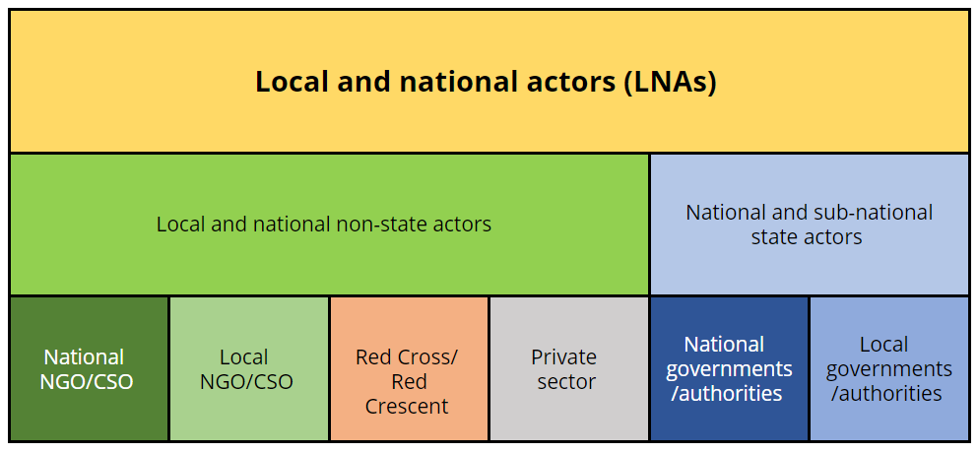
Who is a local or national actor?
These are generally the types of actors that are considered local or national, depending on the context
ROSA/EAP
Regional Meeting
Session Title: Localisation
Date: 13 March 2024
Notes:
The second question you may have is, who is a local or national actor?
The question of who is ‘local’ is debated within the sector, and the official Inter-Agency Standing Committee (IASC) definition is highly contested by many home-grown organisations across the Global South because it allows for international actors to “localize” their operations. Generally speaking, and without getting lost in definitions, these are the types of actors that are considered local or national in our sector, however, these are context specific and should always be discussed with in-country actors.

Slide 25
Learning from our colleagues
How are you promoting localisation in your context?
CODE:
XXXX XXXX
ROSA/EAP
Regional Meeting
Session Title: Localisation
Date: 13 March 2024

Slide 26



Support and resources for localisation
Newly established Localisation Helpdesk
Inter-Agency Toolkit on Localisation in Humanitarian Coordination
The GNC is partnering with various actors to provide on demand organizational capacity strengthening opportunities for LNAs (funding dependent)
Coming soon Localisation
e-learning module targeting cluster coordination groups
ROSA/EAP
Regional Meeting
Session Title: Localisation
Date: 13 March 2024

Slide 27
ROSA/EAP
Regional Meeting
ধন্যবাদ
TERIMA KASIH
​تشکر
Salamat
धन्यवाद​
Dhanyabād
감사합니다
Thank you
Denis Kioko Matheka
dmatheka@unicef.org
Martha Nakakande
mnakakande@internationalmedicalcorps.org
Alexa Humphreys
ahumphreys@actionagainsthunger.ca

Slide 28


Advancing a
Humanitarian – Development - Peace
Nexus approach to nutrition

Slide 29
Introduction
MENA Regional
Meeting

Slide 30
Session objectives
Sharing country experiences in advancing a Nexus approach to nutrition
Identifying common constraints and exploring how they can be overcome
Discussing the role of the Nutrition Cluster at country, regional & global levels
MENA Regional
Meeting

Slide 31
Session plan
Definitions (5 mins)
Yemen (10 mins)
Reactions & sharing of experiences by participants (15 mins)
MENA Regional
Meeting

Slide 32
What is a HDP Nexus approach?
Collective outcomes: Reduce needs, risks and vulnerabilities – prevent, prepare and respond to malnutrition – sustainably.
A collaborative and coherent way of working between humanitarian, development and peace actors
Drawing on respective comparative advantages
Convergence of HDP actions on the same at-risk populations
MENA Regional
Meeting

Slide 33
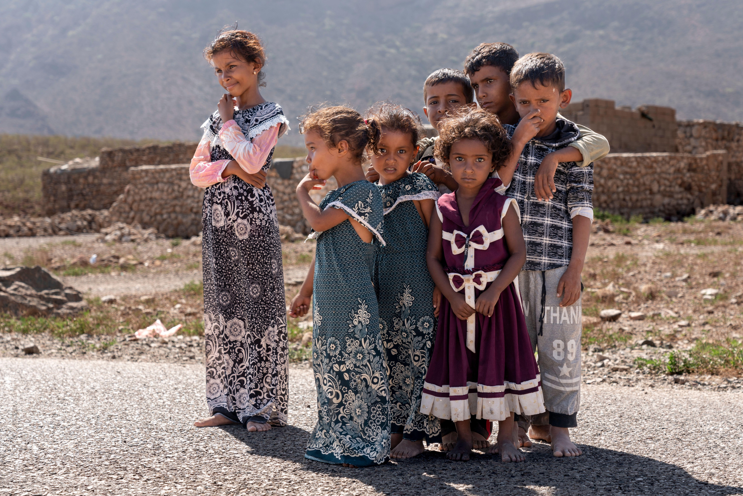
Yemen
A case study

Slide 34
What is happening to advance a Nexus approach to nutrition in Yemen?
Joint spaces bringing together humanitarian, development and peacebuilding actors
High level Steering Committee chaired by Vice Minister of Planning
An overall multisectoral technical team.
Technical Working Groups on NIS, financing, advocacy
The SUN Yemen Secretariat
The Yemen Multisectoral Nutrition Action Plan (MSNAP) - overarching strategic framework for all HDP nutrition actions.
Development of National Guidelines on a HDP Nexus approach to nutrition
The Nutrition Cluster is increasingly involved to ensure integration of HRP nutrition actions into MSNAP and ensure a coordinated approach in implementation, monitoring etc
MENA Regional
Meeting
Notes:
= the national mechanism responsible for coordinating all HDP nutrition actions across sectors and throughout the country.
with representation from Line Ministries (across the political divide), donors, UN, Yemeni and international NGOs.
Currently being updated up to 2030. Integrates nutrition relevant interventions implemented by the Nutrition &other Clusters from the HRP.
– present the consensus of all HDP actors on how they collaborate to coherently & sustainably reduce all forms of malnutrition.
provides space for international partners to coordinate and align their support in SUN Yemen processes.

Slide 35
Achievements to date. Factors contributing to progress.
Increased recognition amongst national and international actors of:
Role of SUN Yemen structures in coordinating HDP actions.
Ability of the SUN Yemen Secretariat to bridge the political divide.
The MSNAP as the overarching strategic plan.
Nutrition is providing a focus for bridging political divides
Increased recognition that progress can be made at a technical level
Nutrition is providing a focus for increased collaboration and trust between HDP actors
Key enabling factor: Intensive engagement by the SUN Yemen Secretariat with senior management of international partners - building trust and confidence in its ability to withstand political interference.
MENA Regional
Meeting
Notes:
by encouraging dialogue and trust building at a technical level.
and local systems can be supported and strengthened whilst ¨maintaining distance¨ from de facto political authorities.
(Line Ministries, Clusters, UN agencies, donors etc) – setting an example for a wider HDP Nexus approach.
(e.g. UN RC/HC, Heads of UN & donor agencies) in order to raise awareness of its role and to

Slide 36
Key constraints and solutions.
Despite achievements a lot remains to be done to turn commitments to a Nexus approach into action and improved nutrition outcomes.
Constraints
Progress has been constrained by a lack clarity and understanding about national nutrition governance mechanisms
Emphasis is on fulfilling agency specific mandates
Lack of awareness of opportunities for ¨development¨_ interventions & systems strengthening
What is needed?
Better political economy analysis to identify existing national and local actors
On-going engagement with partners
Advocacy in donor capitals to raise awareness of opportunities to support and strengthen nationally led technical processes
MENA Regional
Meeting
Notes:
& the way in which it was trying to work across the political divide and across the country in order to facilitate and coordinate multisectoral nutrition actions.
Solutions
& systems & analyse their existing and potential roles and interests, their commitment to ensuring services reach the most vulnerable and how they can be supported to play their role and withstand political pressures.
with senior managers and technical specialists to encourage proactive participation and collaboration across the Nexus.
and scale up multisectoral development actions alongside humanitarian assistance.

Slide 37
What further support can the Nutrition Cluster provide?
National Nutrition Cluster
Share information on plans & implementation under the HRP
Support identification and targeting of non-HRP interventions under the MSNAP particularly on prevention and systems strengthening
Support strengthening of national Nutrition Information System building on Cluster information systems
Mobilise other Clusters to engage and also do above
Support from regional and global GNC
Help countries capture and share learnings
Advice to National Nutrition Clusters on how to contribute to a Nexus approach whilst maintaining focus on core mandate
Engagement with other Clusters at global and regional levels to agree a joined up approach to help advance the Nexus at country level
MENA Regional
Meeting

Slide 38
Plenary discussion

Slide 39
Questions for discussion
Who has experiences to share from your country?
What is the role of Nutrition Cluster at country level in advancing a Nexus approach to nutrition?
What support do National Nutrition Clusters need from regional and global levels?
MENA Regional
Meeting

Slide 40
Final reflections
Notes:
I’ve been asked to provide a general overview on the HDP Nexus and global experiences. I want to set the scene by giving you a sense of how the overall work on the Nexus has been proceeding at the country level and in Ethiopia. The following presentations in the training will provide deeper dives into the issue of the HDP Nexus in nutrition – examples, challenges, etc. Collaboration for the reduction of humanitarian needs and vulnerabilities across on the most pressing issues faced by a given country, requires a multi-stakeholder, multi-actor and a systems approach, something that we are working on here in Ethiopia. That means that all actors and sectors must contribute to the development and operationalization of the approach. That is why this initiative on Nexus and Nutrition by MoH is so welcome and important.

Slide 41
Some (not all) takeaways
Do not silo a Nexus initiative. It is not a type of programme requiring separate structures and processes.
It is an approach & a way of working to be integrated into existing coordination, planning and implementation mechanisms.
Ensure a Nexus approach to nutrition is integrated into wider Nexus initiatives.
Localization is fundamental to a Nexus approach.
Be proactive in identifying local and national actors that are committed to lead & deliver multisectoral actions across the Nexus
MENA Regional
Meeting

Slide 42


Thank you

Slide 43
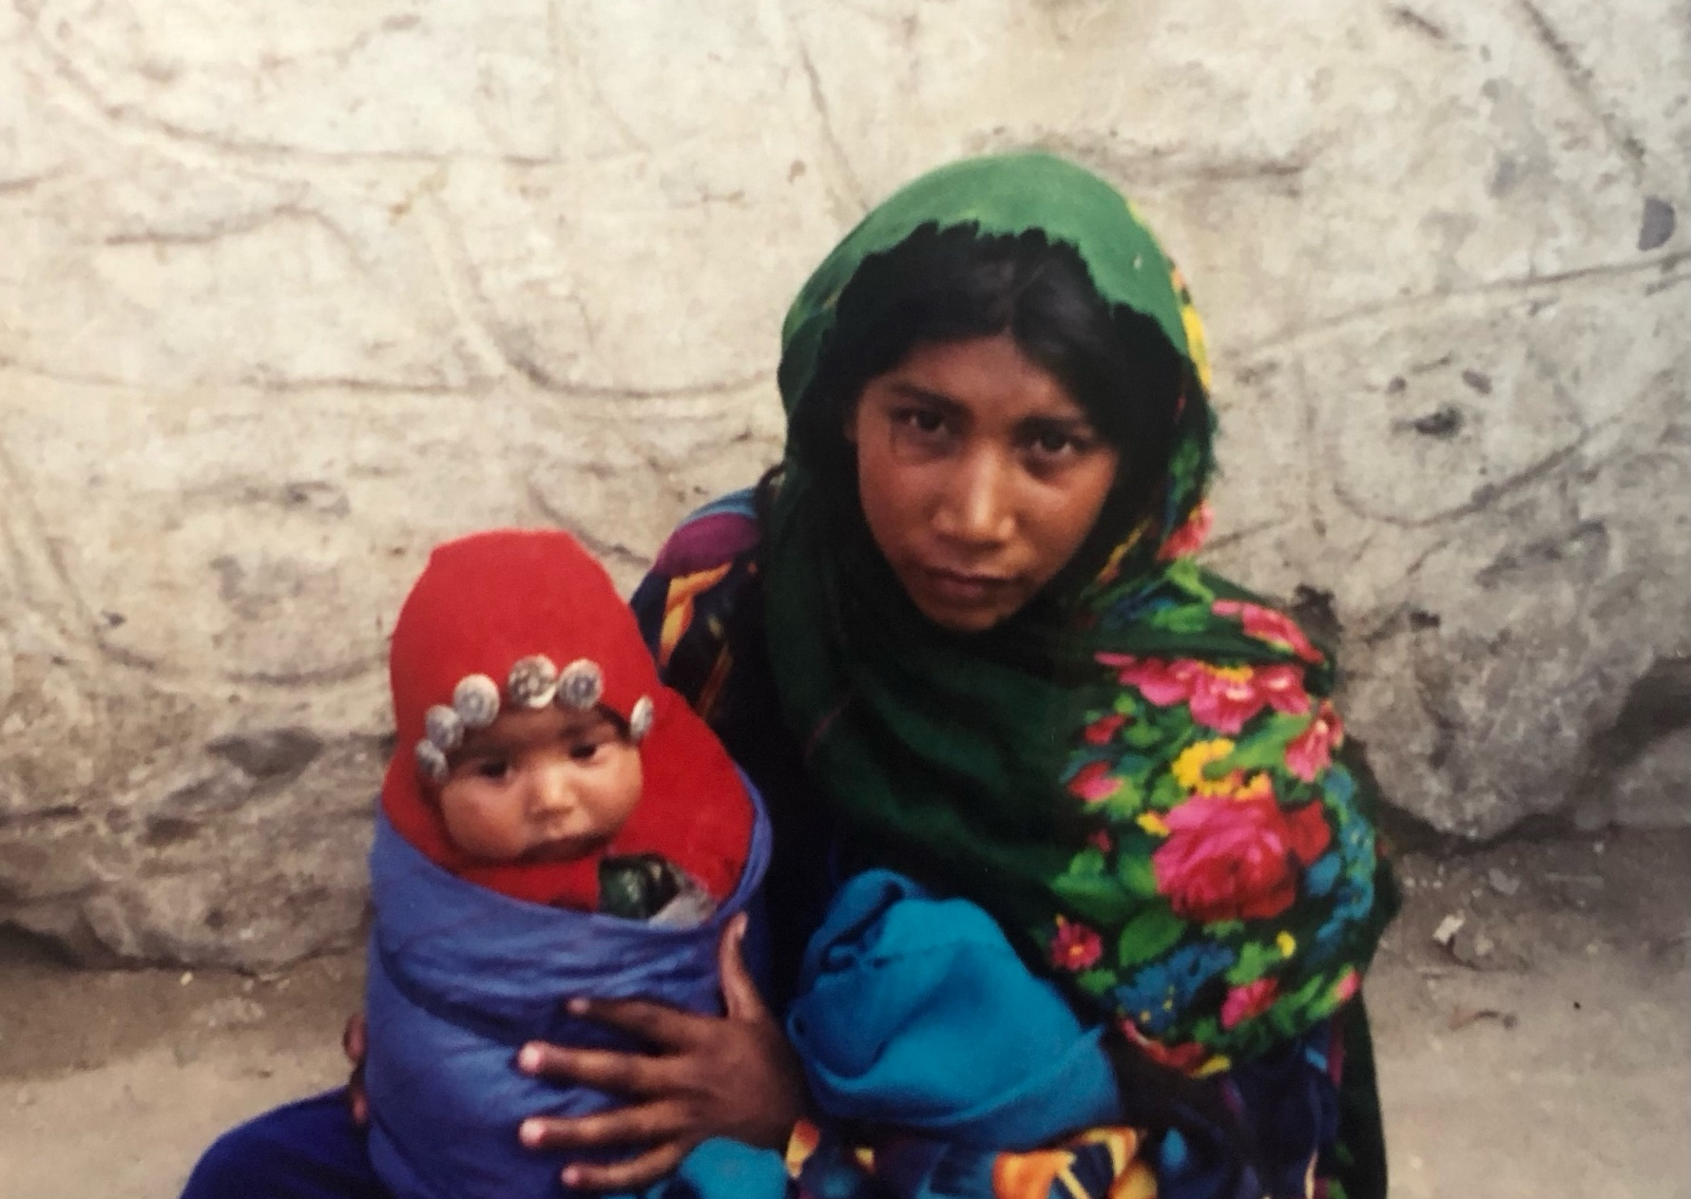
Preparedness, Anticipatory Actions, NiE and the Climate crisis
Cécile Basquin (GNC) and Géraldine Bellocq (GNC)
Gwenaelle Garnier (WFP)
Diane Holland (GNC)
MENA/SA/EAP Regional Consultations
March 2024
Notes:
Cecile

Slide 44
overall objectives
Provide an overview of mechanisms and initiatives used to reduce the impact of crisis
Hear from countries and learn from their experiences
Identify collective actions needed to make progress & the support needed from regional and global levels
MENA/SA/EAP Regional Consultations
ERP, AAs, NiE and Climate crisis
March 2024
Notes:
Cecile
We will provide an overview….
You will hear from countries and…
We will identify actions…

Slide 45
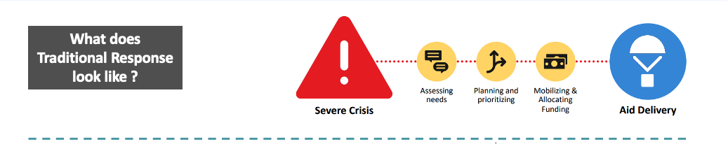
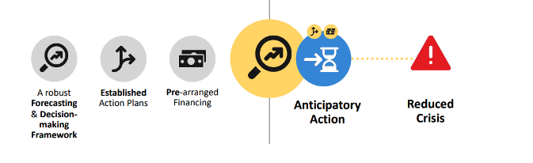
Shifting away from reactive TO PROACTIVE
Disaster risk reduction,
prevention & mitigation
ERP planning & Anticipatory Actions
Preparedness
What does preparedness, and anticipated actions look like?
Towards A more timely and effective response
MENA/SA/EAP Regional Consultations
ERP, AAs, NiE and Climate crisis
March 2024
Notes:
Cecile
Adapted from the framework for UNICEF’s Anticipatory Actions, June 2023

Slide 46
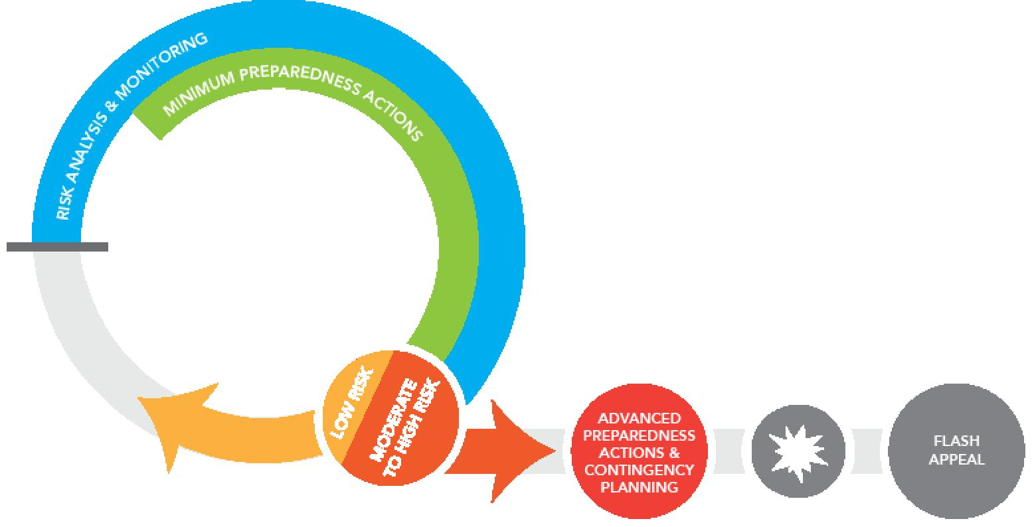
Emergency Response Preparedness (ERP)
The GNC strategy includes a strong focus on ERP to improve Nutrition Clusters/sectors’ capacities not only to respond but to become better prepared for any emergency
To strengthen Nutrition Clusters/sectors’ Preparedness capacities, and to standardize and systematize the ERP approach
The IASC ERP guidance was expanded into a step-by-step approach
MENA/SA/EAP Regional Consultations
ERP, AAs, NiE and Climate crisis
March 2024
Notes:
Cecile

Slide 47

ERP key messages
  Preparedness has proven benefits.
  ERP is a continuous and dynamic process.
  ERP planning is not a standalone process.
  Build on your current response and use ERP to overcome challenges from previous experiences.
  The Nutrition specific ERP plan must complement and align to national plans.
  Use existing risk analyses to develop a crisis scenario.
  The ERP approach must be collaborative.
  For more information, please see the GNC ERP step by step guide (available in English, Spanish and French)
MENA/SA/EAP Regional Consultations
ERP, AAs, NiE and Climate crisis
March 2024
Notes:
Cecile and Geraldine – two voices
Preparedness has proven benefits. Investing in ERP saves time and money in the humanitarian response. Time saved in response implementation is critical in emergencies since the speed of response implementation has direct implications on lives saved.
ERP is a continuous and dynamic process. The ERP plan needs to be maintained and adapted to reflect emerging risks, evolving hazards, and the changing Nutrition situation. It is also an incremental process, meaning the more preparedness actions taken, the stronger the level of Preparedness achieved.
ERP planning is not a standalone process. Elements of preparedness planning must be mainstreamed in all phases of the HPC and become an adopted mindset in the regular day to day workstreams of the Nutrition cluster.
Build on what you have and use ERP to overcome challenges from previous responses. In HRP countries that are facing recurring crisis, it is important to develop an ERP approach to scale up rapidly and bring a surge response in case additional needs arise (beyond the HNO/HRP). In those cases, what worked well for a quick response should be kept and integrated in the ERP. Then put the focus on finding solutions and preparedness actions to overcome what did not work.
The Nutrition specific ERP plan must complement and align to national plans. Information from existing organization specific plans can be use and and feed into a multi-sectoral ERP plan.
Use existing risk analyses to develop a crisis scenario. In most countries, hazard identification and risk analysis already exists and as a Nutrition cluster/sector, these can be used to build crisis scenario with a nutrition lens.
The ERP approach must be collaborative. Joint ERP planning reinforces collaboration and contributes to build stronger alliances and partnerships that will be instrumental later on for timely scale up / effective implementation.

Slide 48
ERP
Remaining challenges
ERP tends to be seen as a single / one time activity
Nutrition specific contingency plans do not result in early response implementation
Few countries have a comprehensive Nutrition ERP plan that guides preparedness and early response
Preparedness actions tend to rely on availability of supplies only
MENA/SA/EAP Regional Consultations
ERP, AAs, NiE and Climate crisis
March 2024
Notes:
Geraldine

Slide 49

Nutrition ERP status
Questionnaire online for expression of interest sent out in September 2023
Request support from regional
and global level
Focal point on ERP within the GNC, working in
coordination with RO
 | Existing ERP plan and needs for revision | Need for ERP orientation to partners | Need for ERP blended training
Syria | YES, Q4 2023 | YES, Q4 2023 | YES, Q4 2023
Nepal | YES, Q2 2024 | YES, Q1 2024 | YES, Q1 2024
Myanmar | YES, Q1 2024 | YES, Q1 2024 | YES, Q1 2024
Fiji | NO | YES, Q4 2023 | YES, Q4 2023
More countries?
MENA/SA/EAP Regional Consultations
ERP, AAs, NiE and Climate crisis
March 2024
Notes:
Geraldine
Where do we stand now? Share an overview of where do we stand in the region on ERP from a GNC perspective

Slide 50
Country experience on erp approach
Points to think about while identifying collective actions and areas for support from RO and GNC:
What is the status of your Nutrition ERP?
If your ERP is not so advanced, what are the reasons why?
What opportunities do you see for making progress on ERP in the future?
Who needs to be involved? Who can be your best allies?
What can you commit to advance ERP and strengthen your capacity to respond to any crisis in 2024?
MENA/SA/EAP Regional Consultations
ERP, AAs, NiE and Climate crisis
March 2024
Notes:
Geraldine
These are points to think about when filling in the collective actions at the end of the consultation:
Why is is so hard to be prepared for disaster?
What is the status of your Nutrition ERP process in your country?
Have mapped you existing response capacities (partners? Trained personnel? necessary guidance and protocols? Supply stock mapping?)?
Are your operational arrangements anticipated? (for coordination, IM, assessment and response provision)?
Do you have an early nutrition response plan for the initial phase of a crisis
Do you have a preparedness actions workplan?
Do you have a multi-risk Nutrition ERP plan?

Slide 51
MENA/SA/EAP Regional
Consultations
Thank you

Slide 52

COFFEE BREAK

Slide 53

Anticipatory Actions and Nutrition
Domitille Kauffmann
(WFP HQ)
12 March 2024

Slide 54
Session outline
Definition and key characteristics
Global overview
Anticipatory Actions and Nutrition
Regional Experience

Slide 55


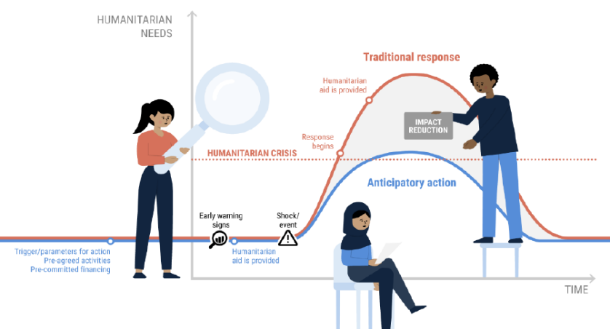




What is ANTICIPATORY ACTION?
Anticipatory Action (AA) is defined as
“acting ahead of predicted hazards to prevent or reduce acute humanitarian impacts before they fully unfold”.
Key characteristics
Time bound
Protective & mitigatory intent
Pre-agreed & risk-informed
triggers
No-regrets approach
Pre-arranged financing
Notes:
Triggers/parameters for action : developed based on forecasts to monitor the risks and determine when to intervene.
Pre-agreed interventions : Set of activities planned based on the identified threats & developed considering the risks and impact on people.
Pre-arranged financing: funding committed at the planning phase and ready for disbursement to enable activities to be undertaken in a timely manner.

Slide 56








Understanding the concept - FRAMEWORK
Preparedness, Anticipatory Action and Response
In anticipation of the crisis …
… after the crisis
Early warning
PP & CP
Readiness
Anticipated actions
Crisis impact / shocks
Needs assessment & Response
Preparedness & Contingency Plan
Anticipatory/Early Actions
Early Response
Crisis
Response
Session Title: Anticipatory Actions and Nutrition
Date: 29 January 2024
ESA Regional
Meeting
Notes:
Contingency plans, Preparedness and AA
Refers to the preparedness activities (Monitoring and analyzing risks, developing contingency plans, conducting simulation exercises and preposition stockpiles), do not fall under the humanitarian response.
AA sits between preparedness and response, in a window of opportunity between an early warning (or another trigger for action) and the onset of a crisis.
Early Response, Humanitarian Response and Anticipatory Action
Early response: no trigger mechanisms, but undertaken at the early stage of the emergency
Traditional response: based on the assessed needs (long process)

Slide 57
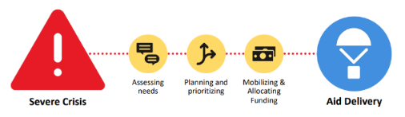
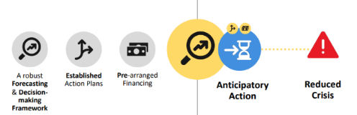
Understanding the concept – How is it different?
Anticipatory action is different from traditional humanitarian response in three ways:
Timing: before rather than after a shock or, at a minimum, before the manifestation of humanitarian needs.
Targeting: people whose lives are at imminent risk rather than only people who are already in acute need.
Objective: to mitigate the impact of a shock to reduce a crisis and its humanitarian impact rather than respond to a fully evolved crisis and its humanitarian consequences
What does Traditional Response look like ?
What does Anticipatory Action look like ?
Notes:
Preparedness is crucial:
Early warning systems in place, impact based forecasting, triggers and monitoring
Set of activities to mitigate the identified risks, beneficiaries to target (context based) and readiness (prepositioning)
Funding piece: money should be ready for disbursement

Slide 58

Understanding the concept – OUTCOMES AND IMPACTS
Effective : substantial savings in time and money by acting in advance of emergencies.
Dignified way to assist people: enhance people’s dignity while protecting them from further exposure to shocks.
Nexus approach: contribute to the triple nexus with humanitarian interventions that are at the intersection of peace and climate action.
Photo credit: WFP

Slide 59
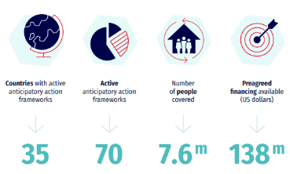
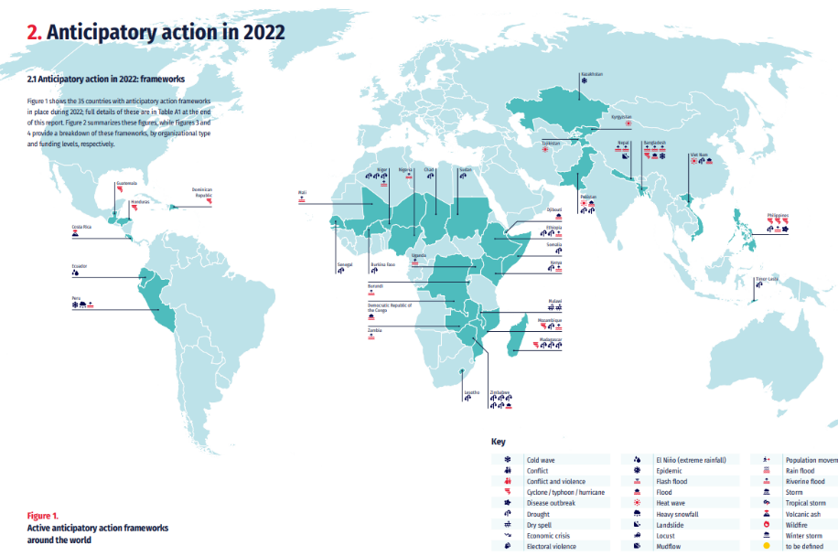
Anticipatory action – Global overview 2022
Active anticipatory action framework around the world
4.7 million people
covered by AA Plans
Source: Anticipation Hub, Anticipatory actions in 2022: A global overview
Notes:
Active AA framework en 2022 activer

Slide 60
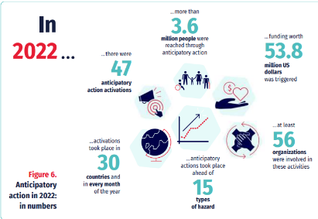
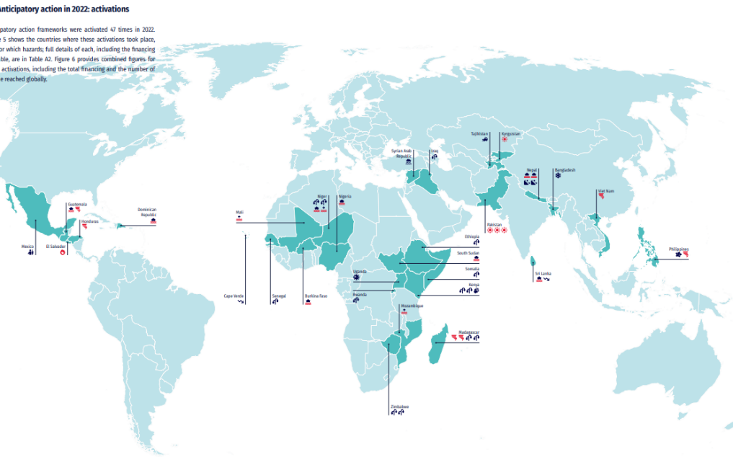
Anticipatory action – Global overview 2022
Anticipatory action frameworks activated in 2022
Source: Anticipation Hub, Anticipatory actions in 2022: A global overview
Notes:
Activation of framework one or the other

Slide 61
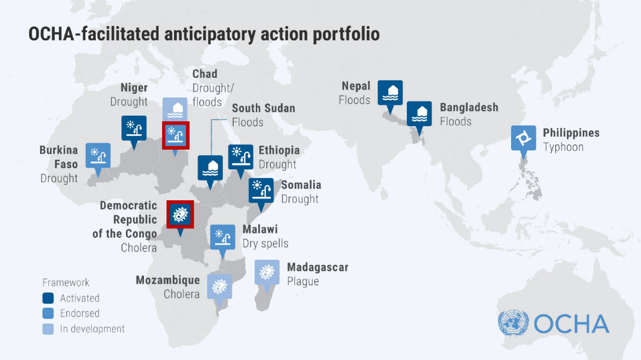
*As of March 2023
https://www.unocha.org/anticipatory-action
Source: https://www.unocha.org/our-work/humanitarian-financing/anticipatory-action
Notes:
As of December 2022
Working with FAO, WFP, IFRC and the Start Network, OCHA facilitated the development of collective AA country pilots:
5 in 2020: Bangladesh (monsoon floods), Ethiopia (drought), Malawi (dry spells/floods), Somalia (drought), and preliminary work in Chad
6 more in 2021: Burkina Faso, Madagascar, Nepal, Niger, the Philippines and South Sudan.
+ improved anticipatory action pilot in Bangladesh, as well as a multi-country framework focused on cholera.
Total frameworks : 12 + South Sudan (Early Action)
UNICEF engagement: 11 frameworks, and Mozambique which is in development/discussion
Sectoral engagement: WASH, Health and Nutrition, Child protection, Education

Slide 62




RAPID-ONSET AA TIMELINE - Floods
HARVESTING
DRY SEASON
HURRICANE/FLOOD SEASON
DAYS TO IMPACT
-11 -10 -9 -8 -7
-6 -5 -4 -3 -2 -1
0
READINESS
ANTICIPATORY ACTION
EARLY RESPONSE
(CRISIS ONSET)
MONITORING
FORECASTING
WINDOW OF INTEREST
WFP – Anticipatory Action: The Basics

Slide 63
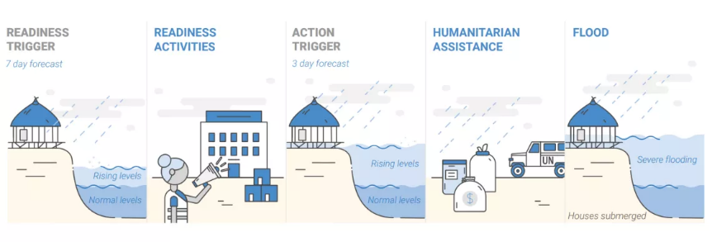




Example –AA TO MITIGATE THE IMPACT Of FLOODS In NEPAL
UNFPA, UNICEF, UN Women and WFP collaborated with the government and local implementing partners + FAO (2023)
Anticipatory action Activities
WASH
Equip health facilities to provide sexual- and reproductive healthcare services
Protection
Raise awareness on gender-based violence
Multi-purpose
cash transfers
Provide unconditional multi-purpose cash to vulnerable households
Health
Repair WASH facilities at evacuation sites
Raise awareness about hygiene promotion
Equip health facilities and midwifes with the means to safely deliver babies
Provide conditional cash to pregnant women to facilitate referrals and access to obstetric services
Distribute dignity kits
Deploy community psychosocial workers
Provide conditional cash to survivors of GBV
Distribute comprehensive relief packages
Notes:
The framework for Nepal is set up for severe flooding during the monsoon period. Under the leadership of the Resident Coordinator and building on existing structures, UNFPA, UNICEF, UN Women and WFP collaborated with the government and local implementing partners to design a more timely, effective, efficient and dignified response to the anticipated emergency.
Revised framework 2023:
FAO was included as a new partner to strengthen the provision of life-saving agricultural assistance to flood-affected households. The agency will provide early warning risk messages in agriculture and distribute hermetic seed storage bags to agricultural households in the five municipalities of eastern districts Saptari and Sunsari. The agency has already procured the bags, which will be transported to the flood sites after the readiness trigger and distributed after the action trigger. The CERF funds will then be used to replenish the stocks.
While the contribution of UN Women to the framework was highly appreciated, the decision was made to not include them as a direct recipient of CERF funding.
WFP will distribute their cash assistance within 11-61 hours upon flood impact based on rapid monitoring activities rather than directly after the action trigger.
UNFPA added Kanchanrup to their list of assisted municipalities in Saptari district.
Dissemination of Early Warning Messages (EWM) to 442,209 people through loudspeakers and radio broadcasts. SoDMA augmented this effort with an automated flood early warning message for all mobile phone users. All messages were translated into the local language to enhance people’s understanding and prompt action. The messages aimed at informing households about the possible risk from floods, giving them 1) guidance on flood risk reduction measures, 2) what to do during the flood and 3) recovery measures and advice on preventing future damage.
• Distribution of unconditional anticipatory cash transfers to 218,718 people who were most vulnerable to the floods. USD 81 per household was provided to meet basic food needs and other priority needs to reduce floods impacts. Out of the people reached with cash, 59% were women, enhancing their involvement in decision making.
• Strategic pre-positioning of nutrition commodities and boats to ensure efficient delivery of essential food and nutrition assistance to potentially flood-affected communities.

Slide 64




THE MONETARY BENEFITS OF AA
WFP – Anticipatory Action: The Basics
NEPAL:
limits damages caused by natural hazards on vulnerable people (75%) and assets (50%) of damage reduction on crops and cattle).
saves a significant amount of money in the immediate response (US$ 34 per dollar invested)
further decreases long-term recovery needs and costs
AA
Extreme Conditions
Outcome Indicator
AA
Effect of AA
Forecast Trigger
No AA
Time

Slide 65




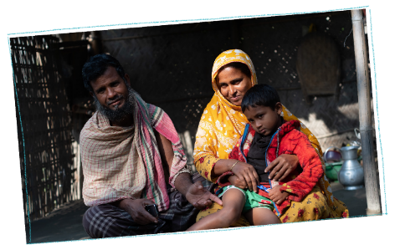
AA IN BANGLADESH: EVIDENCE GENERATION (FLOODS)
BANGLADESH – FLOODS
Transfer of cash – CBT:
In July 2019, WFP in coordination with the Government of Bangladesh and agencies provided cash transfers to 25,000 people three days ahead of a flood
In August 2020, WFP provided cash transfers
and early warning messaging to 142,180 people five days ahead of a flood
RESULTS:
Cash distribution was timely, reaching affected households 100 days earlier than previous WFP interventions in the same context
Cash was withdrawn and spent before/during the flood,
mostly to cover food needs
EVIDENCE OF POSITIVE IMPACT:
Child and adult food security and well-being, 36% less likely to go a day without eating during the flood
Higher adoption of preparedness measures ahead of the floods, lower asset loss and damage, lower debt accumulation and higher earning potential
Notes:
Bangladesh – Independent evaluation of WFP’s AA cash transfers – July 2020 Floods:
Anticipatory cash transfers were mostly spent on food and water, with households 36 percent less likely to go a day without eating during the flood.
• Three months after the flood, households that had received the transfer reported significantly higher child and adult food consumption and wellbeing. They also experienced lower asset loss, engaged in less costly borrowing after the flood, and reported higher earnings potential;
• Beneficiary households took more preparatory actions to reduce the impact of the flood. Households that received the cash transfer were 12 percent more likely to evacuate household members and 17 percent more likely to evacuate their livestock. As a result, transfer-receiving households were 8 percent less likely to lose small livestock and 5 percent less likely to lose poultry during and after the flooding.
• The cash transfers were more beneficial for harder to reach households located in vulnerable lands and areas where households are poorer. This highlights the potential for using geographical targeting to further scale up the impact of anticipatory humanitarian action.

Slide 66
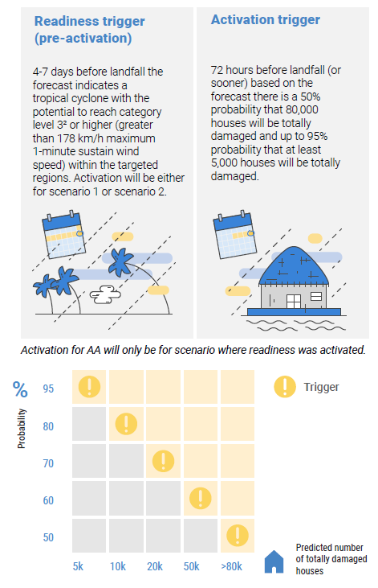
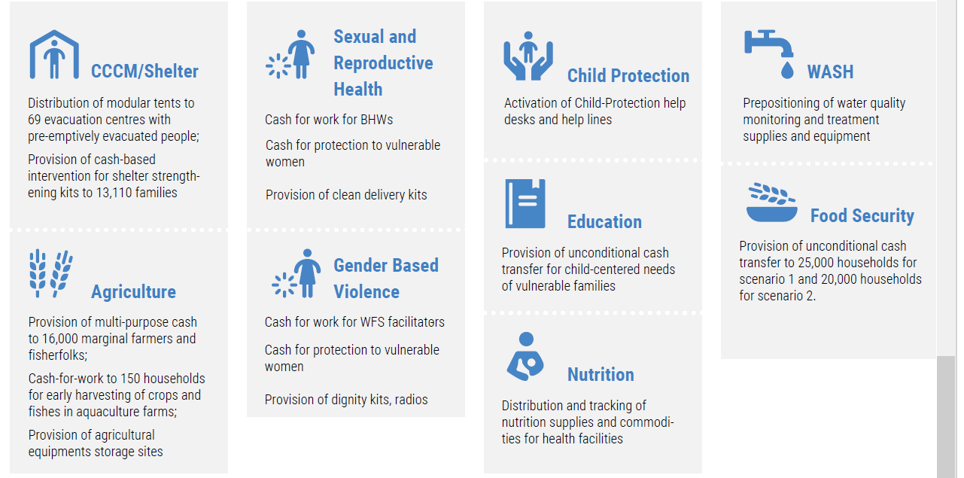
Example –AA TO MITIGATE THE IMPACT Of TROPICAL CYCLONES In THE PHILIPPINES
The Trigger mechanism
Anticipatory action Activities
Notes:
The framework for tropical cyclones in the Philippines, a country that annually exposed to over 20 tropical cyclones, was designed by humanitarian partners under the leadership of the Resident Coordinator, with support from OCHA. The framework was endorsed by the Resident Coordinator and pre-approved by the Emergency Relief Coordinator for the 2022 season for a period of up to two years. The objective of the framework is to mitigate the impact of tropical cyclones on vulnerable, at-risk individuals and communities through collective, cross-sectoral anticipatory action.
5 agencies: IOM, FAO, WFP, UNFPA, UNICEF
In Philippines, the AA framework was developed for tropical cyclone, under 2021-2022 cyclone season
2-stage trigger activation:
1. Readiness trigger (pre-activation): 4-7 days prior to forecast landfall
Tropical Cyclone with potential to reach category level 4 or higher (greater than 200 km/h maximum
Projected to directly impact areas within Region 5 and 8.
2. Activation trigger: on or before 72 hrs (3 days) prior to forecast landfall:
Threshold is reached and AA activated if 72 hours before landfall (or sooner) the predicted number of houses to be totally damaged fall within the range of 50% probability that 80,000 houses will be totally damaged to 95% probability that at least 5,000 houses will be totally damaged.

Slide 67

WHY ANTICIPATORY ACTION & Nutrition?
1
Climate change is a main driver of food insecurity and malnutrition, and complex emergencies.
Exposures to excessive rainfall, extreme temperatures, floods and droughts are risk factors for wasting and stunting
2
3
Ever increasing and more intense climate shocks, increasing humanitarian needs and costly responses
4
Need to shift from a reactive to a more forward-looking humanitarian system
5

Slide 68








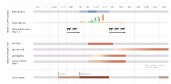
Integrating NUTRITION into THE ANTICIPATORY ACTION SYSTEM
ASSESS RISKS AND IMPACTS
ESTABLISH
CRISIS TIMELINE
DECIDE WHEN TO ACT BY DEVELOPING TRIGGER MECHANISM
2
1
Ensure the risks and impacts analysis and the crisis timeline consider the following questions:
Has the type of hazard possible diet and nutrition impacts? Direct or indirect? Would the hazard impact determinants of malnutrition that can be monitored? Is it captured in the crisis timeline built for the AA plan?
When can we expect the impacts on diets and nutrition to occur and how severe can we expect them to be?
Who is affected? Are nutritionally at-risk groups more at risk (incl. exacerbating existing nutrition issues)? Is it reflected in the analysis?
Supply side: have availability and physical access to nutritious foods and to basic health and nutrition services been assessed (incl. for most at-risk)? How will the hazard impact them?
Triggers and thresholds to be developed with nutrition situation/data, and the cost and availability of nutritious foods in mind – “impact-based triggers”
Notes:
Assess risks and impacts: to better understand the potential impact of extreme weather events on food- and nutrition insecure people, including nutritionally vulnerable groups, to inform the design and targeting of anticipatory mitigation actions
Decide when to act by developing trigger mechanisms: together with national disaster management actors to determine the magnitude of an extreme weather event that can lead to high, moderate and low-level impacts

Slide 69




Integrating NUTRITION into THE ANTICIPATORY ACTION SYSTEM
DEVELOP ANTICIPATORY ACTIONS
DESIGN SOPs
MONITOR FORECAST, ACT AND MEASURE IMPACT!
Choice of the type of actions highly dependent on the type of shock-i.e.; rapid- or slow-onset
Assess the need for nutrition-specific actions? Is it already covered by other partners? Is a clear timeline specified?
Make sure that early warning messages integrate messaging on nutrition, healthy dets, hygiene, and leverage on existing community-based platforms and SBC activities to also reach caregivers and other community members
Consider providing prevention of malnutrition package (e.g.;. cash top-ups coupled with GFA / through SRSP; prepositioning of nutritious items / temporary fresh food markets; ….)
Maximize diet and nutrition outcomes of other actions (e.g.; nutrient-dense drought-resistant / early maturing crops)
Consider including nutrition-sensitive indicators in M&E framework and adding questions related to diet and nutrition outcomes in after-action reviews/impact evaluations
Notes:
Develop anticipatory actions : Based on multi-stakeholder consultations, risk and historical post- disaster assessments, identify high, moderate, and low-risk actions that can be completed in the window between forecast and extreme weather event
Design SOPs: SOPs outline the actions, along with the actors, costs, thresholds, triggers, and predetermined funds to be mobilized in anticipation of an extreme weather event. The SOPs should be aligned with national disaster risk management plans and validated together with key actors through simulations
Monitor forecasts, act and measure impact: In response to a high, medium or low-level trigger, coordinate with key stakeholders to implement anticipatory actions as per the SOPs. Analyze impact, assimilate lessons learned and generate the necessary evidence to scale up

Slide 70



SLOW ONSET AA Timeline - Droughts
DRY SEASON
PLANTING
GROWING
HARVESTING
CONTINGENCY
PLANNING
DROUGHT RESPONSE
JUN JUL AUG SEP
OCT
NOV
DEC
JAN
FEB
MAR
APR
MAY
JUN
JUL
AUG
SEP
OCT
NOV
READINESS
SUB-SEASONAL MONITORING
ANTICIPATORY ACTION, e.g.:
Early warning dissemination and climate information services
Provision of safe and potable water (e.g. water catchment/storage systems)
Provision of drought-tolerant agricultural inputs
Anticipatory cash transfers
FORECASTING WINDOW
Forecast-based readiness trigger
Forecast-based activation trigger
AUTOMATIC DISBURSEMENT
OF PRE-ALLOCATED FUNDS

Slide 71
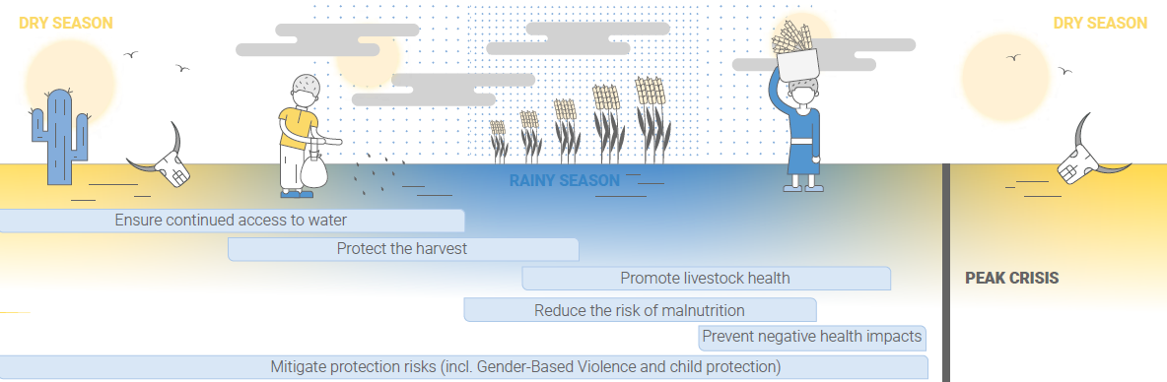
ExamplE of Ethiopia FRAMEWORK – Getting ahead of drought
src OCHA, CERF pilot
Notes:
Somalia example:
UNICEF’s work in Somalia with $4M of CERF-allocated funding in anticipation of severe drought across the country.
Interventions: provision of safe water, critical nutrition services, child protection support, immunization and emergency health care to drought-affected children and caregivers.
Impact: Anticipatory rehabilitation and upgrading of boreholes improved household finances, strengthened mental health, kept livestock healthier, reduced disputes related to water sources, and mitigated migration.

Slide 72
Example – AA to mitigate EL NINO’s FLOOD IMPACT in SOMALIA
WFP and the Somali Disaster Management Agency (SoDMA)
7 districts prone to floods in Somalia, namely Beletweyne, Bulo Burto, Jalalaqsi, Jowhar/Mahaday, Baardhere, Luuq and Afgooye.
Multi-year funding and investment in Anticipatory Action systems by the Government of Germany.
Objective: to safeguard the lives and livelihoods of people in anticipation of floods by:
                increasing the awareness and access to timely and useful early warning information and advisories related to floods
                maintaining improved food and nutrition consumption status,
                incurring minimal damage/loss of lives.
Notes:
Dissemination of Early Warning Messages (EWM) to 442,209 people through loudspeakers and radio broadcasts. SoDMA augmented this effort with an automated flood early warning message for all mobile phone users. All messages were translated into the local language to enhance people’s understanding and prompt action. The messages aimed at informing households about the possible risk from floods, giving them 1) guidance on flood risk reduction measures, 2) what to do during the flood and 3) recovery measures and advice on preventing future damage.
• Distribution of unconditional anticipatory cash transfers to 218,718 people who were most vulnerable to the floods. USD 81 per household was provided to meet basic food needs and other priority needs to reduce floods impacts. Out of the people reached with cash, 59% were women, enhancing their involvement in decision making.
• Strategic pre-positioning of nutrition commodities and boats to ensure efficient delivery of essential food and nutrition assistance to potentially flood-affected communities.

Slide 73


Example – AA to mitigate EL NINO’s FLOOD IMPACT in SOMALIA
Anticipatory Action Plan for floods developed
Minimal preparedness actions
Alert
Anticipatory Action implemented
Triggers thresholds based on river risk levels (4.5 to 7.5 m) established by the Somalia Water and Land Information Management’s Flood and Response Information Management System
community engagement, HHs’ targeting and registration, esp. involving minority groups, and development of early warning messages
flood forecasts indicated that the trigger for readiness and activation of AA would be reached within 10 days in the target districts.
Dissemination of Early Warning Messages to 442,209 people through loudspeakers and radio broadcasts.
Distribution of unconditional cash transfers to 218,718 people (incl. 59% women)
Strategic pre-positioning of nutrition commodities and boats
First semester of 2023
Sept 2023
10 Oct 2023
12th to 24th Oct 2023
Notes:
Dissemination of Early Warning Messages (EWM) to 442,209 people through loudspeakers and radio broadcasts. SoDMA augmented this effort with an automated flood early warning message for all mobile phone users. All messages were translated into the local language to enhance people’s understanding and prompt action. The messages aimed at informing households about the possible risk from floods, giving them 1) guidance on flood risk reduction measures, 2) what to do during the flood and 3) recovery measures and advice on preventing future damage.
• Distribution of unconditional anticipatory cash transfers to 218,718 people who were most vulnerable to the floods. USD 81 per household was provided to meet basic food needs and other priority needs to reduce floods impacts. Out of the people reached with cash, 59% were women, enhancing their involvement in decision making.
• Strategic pre-positioning of nutrition commodities and boats to ensure efficient delivery of essential food and nutrition assistance to potentially flood-affected communities.

Slide 74
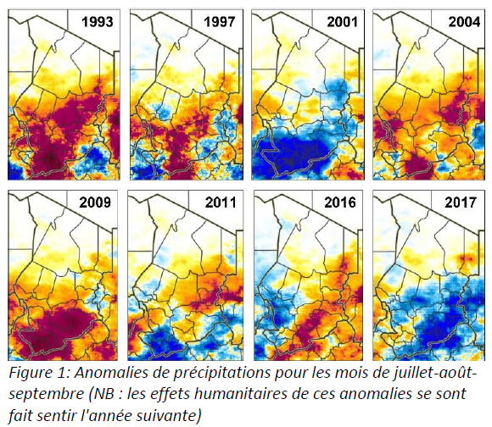
ExAmple: aa to reduce the impact of drought in Chad
Significant impact of drought on people's economy and livelihoods
Demonstrate how anticipatory collective humanitarian action through a package of multi-sectoral activities reduces the humanitarian impact of drought on people at risk.
In the event of severe drought, humanitarian needs often arise earlier than usual and with greater intensity.
Multisectoral package: food security and livelihoods; water, sanitation and hygiene; nutrition; protection; health.
Precipitation anomalies for July-August-September
(NB: the humanitarian effects of these anomalies were felt the following year)
Notes:
Climate change is one of the most serious threats facing Chad, with significant impacts on the economy and people's livelihoods.
Crisis timeline: For this pilot, partners have established a crisis timeline to answer the question: How does a severe drought alter the intensity and timing of humanitarian needs in Chad through the beneficiaries of this pilot's partners?
Two things become clear. Firstly, in the event of severe drought, humanitarian needs often arise earlier than usual and with greater intensity. Secondly, there are three windows of opportunity: two aimed at protecting agricultural and pastoral livelihoods, and one aimed primarily at reducing early humanitarian impacts.

Slide 75
ExAmple: aa to reduce the impact of drought in Chad
Three windows of opportunity: two aimed at protecting agricultural and pastoral livelihoods, and one aimed primarily at reducing early humanitarian impacts.
Trigger model
42.5% probability that total precipitation for the July-August-September period will be below average.
Activities in "window 1" are triggered
March or April
Rainfall forecast
Activities in "window 2" are triggered
May or June
Threshold of at least 80% anomaly
Activities in "window 3" are triggered
Biomass observation
September
Sécurité alimentaire et moyens d’existence
Eau, assainissement et hygiène
Nutrition
Protection
Santé
Notes:
The trigger model adopted for decision-making in this pilot was developed in partnership with the FAO, the Direction des Ressources en Eau et de la Météorologie (DREM) within the Ministry of Environment and Water, the OCHA Humanitarian Data Center (CDH) and Columbia University.
The pilot has three trigger "windows" for three packages of anticipatory interventions:
- Activities in "window 1" are triggered if the IRI forecast published in March or April reaches a threshold of 42.5% probability that total rainfall during the period July-August-September will be below average.
- Window 2" activities are triggered if the IRI forecast published in May or June reaches a threshold of 42.5% probability that total precipitation for the July-August-September period will be below average.
- Window 3" activities are triggered if the analysis of biomass observation data published in September reaches a threshold of at least 80% anomaly.
Five UN agencies have identified anticipatory actions in five sectors: food security and livelihoods ; water, sanitation and hygiene; nutrition; protection; health.

Slide 76
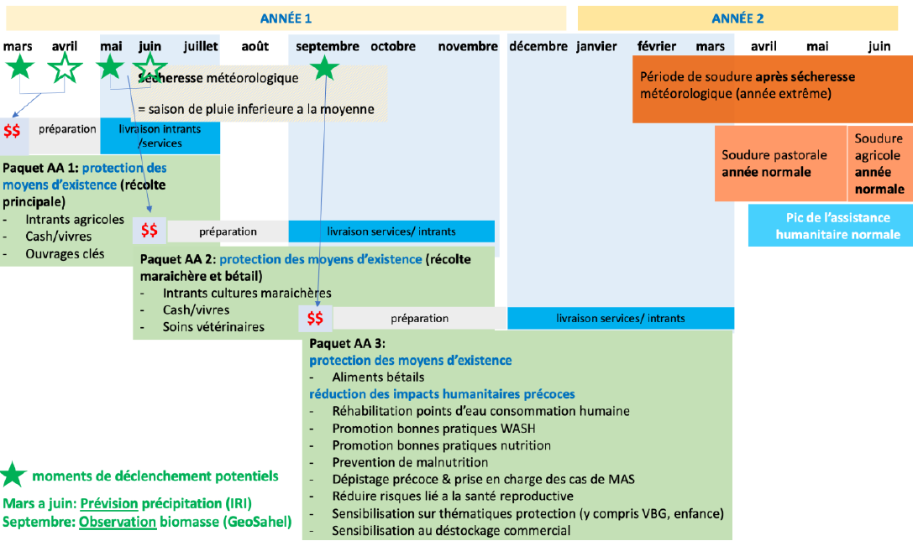
Lutter contre la secheresse – Tchad

Slide 77



ESA Regional
Meeting
Thank you

Slide 78
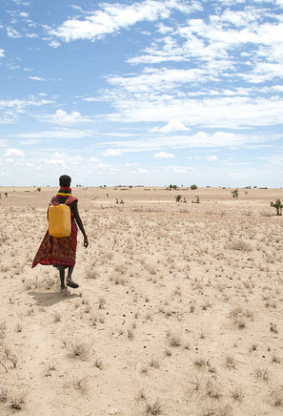
Nutrition in Emergencies and the Climate Crisis
Diane Holland (GNC)
March 2024
Notes:
The objectives of this presentation
To ground participants in a common understanding of nutrition challenges in the context of the climate crisis globally (evidence, commitments, gaps)
To share efforts to help prioritize what NIE in the context of the climate crisis means globally,
And in the working group session after the break:
To hear/learn country experience on NIE in context of climate crisis,
To identify priority asks for regional and global efforts for NIE in the context of climate crisis action. (which will happen during the group work session)
We acknowledge that this is a brief session, and that some terminology and approaches may differ between countries and agencies, so will aim to offer clarity where it is available, and also acknowledge that part of the reason to have this session is to identify ways to bring diverse perspectives together around this critical issue.

Slide 79
Overlapping climate and environmental hazards, shocks and stresses
and an evolving nutrition crisis
Climate and Environmental Hazards, Shocks and Stresses
Prevalence of children under 5 who are not growing well (stunted,
wasted or overweight), 2018
Sensitivity and adaptive capacity
Seasonality, shocks, long term stressors
Figures from The Climate Crisis is a Child Rights Crisis:: Introducing the Children’s Climate Risk Index. New York: United Nations Children’s Fund (UNICEF), 2021.
Figures from UNICEF (2019). The State of the World’s Children 2019. Children, Food and Nutrition: Growing well in a changing world. UNICEF, New York.
Session Title: NIE and the Climate Crisis
Date: 19 Feb 2024
Notes:
Climate change has shifted our humanitarian landscape.
We are facing overlapping climate and environmental hazards, shocks and stresses. The 2021 analysis by UNICEF explored how 8 different climate related risks, hazards and stresses related to each other. The map on the left shows the overlapping distribution within and across countries of these risks.
We also face overlapping nutrition challenges. In 2019, UNICEF introduced a new indicator of “children growing well- e.g. children who are free from stunting, wasting, overweight or combinations of stunted, stunted and overweight, or stunted and wasted."
At that time, “Globally, at least one in three children under the age of 5 was not growing well- they were stunted, wasted or overweight and, in some cases, suffered from a combination of two of these forms of malnutrition.”
Children are not the only ones impacted. “UNICEF has been tracking the nutritional status of pregnant and breastfeeding adolescent girls and women in the most affected countries in the Horn of Africa, central Sahel and other countries in crisis. We find that the estimated number of acutely malnourished pregnant and breastfeeding adolescent girls and women increased by 25 per cent between 2020 (5.5 million) and 2022 (6.9 million) ”

Slide 80
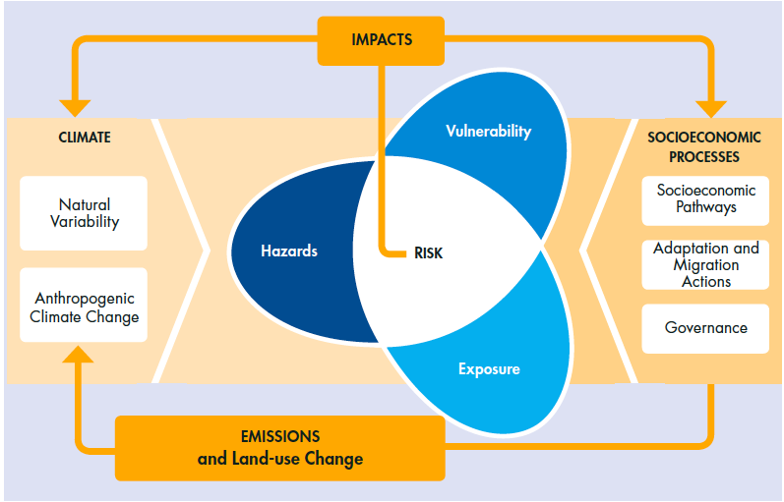
Leading to increased risks and impacts:
malnutrition, displacement, morbidity and mortality
Notes:
These overlapping crises are resulting in:
Increased frequency, severity and duration of climate-related emergencies
Around 1 billion children (50%) worldwide, living in countries at extreme risk of climate change impacts
An estimated 30 million people displaced internally each year due to climate crisis events.
For this session, propose to take a climate crisis lens (as opposed to climate change), specifically focusing on:
Where climate variability (e.g. seasonality of rains) impacts nutritional risk (e.g. hunger seasons)
Climate and weather shocks- like flood, drought, extreme heat, cyclones,
Longer term stressors (changes in temperature, rainfall, sea level rise) that ultimately impact communities and their ability to nourish themselves in a sustainable way.

Slide 81
A collective architecture to address the climate and nutrition crises, though gaps remain to be addressed
Climate governance architecture
United Nations Framework Convention on Climate Change (UNFCC)
Paris Climate Agreement
Nationally Determined Contributions (NDCs)
National Adaptation Programmes of Action (NAPAs) and National Adaptation Plans (NAPs)
Conference of Parties (COP)
Intergovernmental Panel on Climate Change (IPCC)
Sustainable Development Goals (SDGs)
Opportunities to strengthen at country level
Limited nutrition & climate overlap in only:
2% of National Determined Contributions
16% of National Action Plans
1% of official development assistance
ESA Regional
Meeting
Notes:
There are a number of global commitments and platforms to address the climate crisis. At the same time, progress is slow at country level.
The Initiative on Climate Action and Nutrition (I-CAN) undertook an analysis of the degree to which nutrition and climate are currently linked in these discussions- which highlights critical gaps:
just 2% of Nationally Determined Contributions (NDCs) and 16% of National Action Plans (NAPs) include distinct plans to mobilize resources for action connecting climate and nutrition, while 60% of NDCs and 21% of NAPs did not make the connection between nutrition and climate.(I-CAN).
Only 1% of official development assistance funding to climate in 2019– 2021 explicitly mentioning nutrition. (I-CAN)
REFERENCE TEXT- NOT TO SPEAK TO IN THE PRESENTATION
“The United Nations Framework Convention on Climate Change (UNFCCC) is the main international, intergovernmental mechanism for addressing climate change. The Convention has currently been ratified by 197 nations. “
“The Paris Climate Agreement, adopted in 2015, ushered in a new era in the response to climate change and is the world’s first widely supported agreement.1 The agreement aims to keep the global rise in temperature this century at less than 2°C above pre-industrial levels and to pursue efforts to limit this even further, to 1.5°C. The agreement identifies the right to health as central to national climate action and recognises the social, economic and environmental value of voluntary mitigation actions, as well as their co-benefits for adaptation, health and sustainable development. “
“At the core of the Paris Agreement are Nationally Determined Contributions (NDCs). The NDCs lay out national plans to reduce greenhouse gas (GHG) emissions to meet the goals of the 2015 Paris Climate Agreement and are renewed every five years. They reflect self-defined adaptations by countries to climate change impacts, while improving their resilience to climate change.
Under the UNFCCC, countries have also been developing cross-sectoral National Adaptation Programmes of Action (NAPAs) and, more recently, National Adaptation Plans (NAPs), which allow countries to identify priority actions to adapt to climate change. While NAPAs and NAPs usually identify health, agriculture and food security as priority sectors, they often do not consider nutritional aspects “
“The Conference of the Parties (COP) is the supreme decision-making body of the Convention, at which all states that are Parties to the Convention are represented. “
“The IPCC is an independent, scientific body founded by World Meteorological Organization and the United Nations Environment Programme. It regularly reviews and assesses the most recent scientific, technical and socioeconomic information related to climate change. The IPCC outputs and data are used by the UN as the foundation for making science-based decisions on climate change. “
“While UNFCCC is the primary international forum for coordinating action on climate change, the Sustainable Development Goals (SDGs) also include climate-related commitments. “
(Text drawn from ENN stocktake on climate and nutrition)

Slide 82
A systems approach to addressing the crises of climate and nutrition
From FAO. 2023. Climate action and nutrition – Pathways to impact. Rome. https://doi.org/10.4060/cc8415en
Notes:
A 2023 review of pathways between climate action and nutrition from FAO tells us that
“...looking closely at systems that impact nutrition can provide important guidance for responding jointly to climate change and malnutrition, in ways that go beyond only looking at impacts on agrifood systems.
◗ Four key systems linking climate and nutrition are: agrifood, water, social protection, and health.
◗ Across all systems, there are many options for jointly addressing both climate and nutrition. Efforts should focus on scaling these responses, while generating more evidence to identify ways to achieve maximum impact.
◗ Taking action across these four systems to address climate- and nutrition-related challenges will help reduce overall gender inequities, improve livelihoods and access to water and sanitation for women, and boost social protection and health services for women.”
At the same time, the evidence base for the pathways to work with other systems to address nutrition risks in the context of the climate crisis varies.

Slide 83
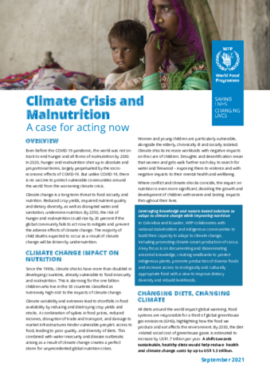

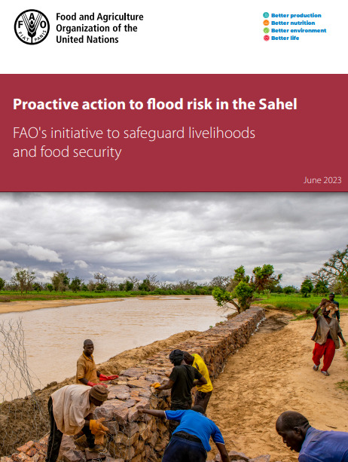
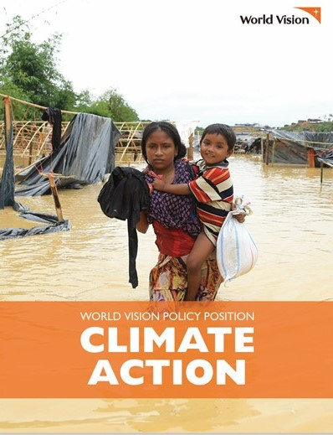
An opportunity to amplify
decades of experience addressing climate shocks
organizational and collective commitments for NIE and the climate crisis
Notes:
This is a moment of opportunity to amplify decades of collective experience addressing climate shocks and risks- predictable and unpredictable- through development of ways of preparing for and responding to emergencies through the humanitarian planning cycle.
This is also a moment of opportunity to amplify organizational and collective commitments for NIE and the climate crisis – including policy briefs, technical guidance, research across GNC partner agencies and governments

Slide 84
GNC Climate Crisis Working Group
Established 2022
  Raise awareness on nutrition and climate crisis
  Stimulate technical consultation
  Coordinate actions to address gaps in guidance, partnerships and action
2022 Survey confirmed interest and diversity of concerns
Workplan buckets
  Preparedness/resilience - increasing number of emergencies, more climatic events; resilience; including conflict linked with climate change and climate refugees/displaced
  Food systems and nutrition & nutrition programming
  Environmental justice, anti-racism and localisation
  Environmental impact - reducing impact of programming
Notes:
The cross-cutting GNC Climate Crisis (WG) was established in 2022 to raise awareness on the relationship between nutrition programming and the climate crisis , to stimulate technical consultation, and to coordinate actions to address pressing gaps in guidance, partnerships, and action. The GNC Climate Crisis WG undertook a brief survey in October 2022 through en-net and the GNC newsletter which confirmed the need for technical support and a platform to voice concerns and to share experiences across country, regional and global levels on how nutrition programming could be climate-adaptive and potentially contribute to climate change mitigation.

Slide 85
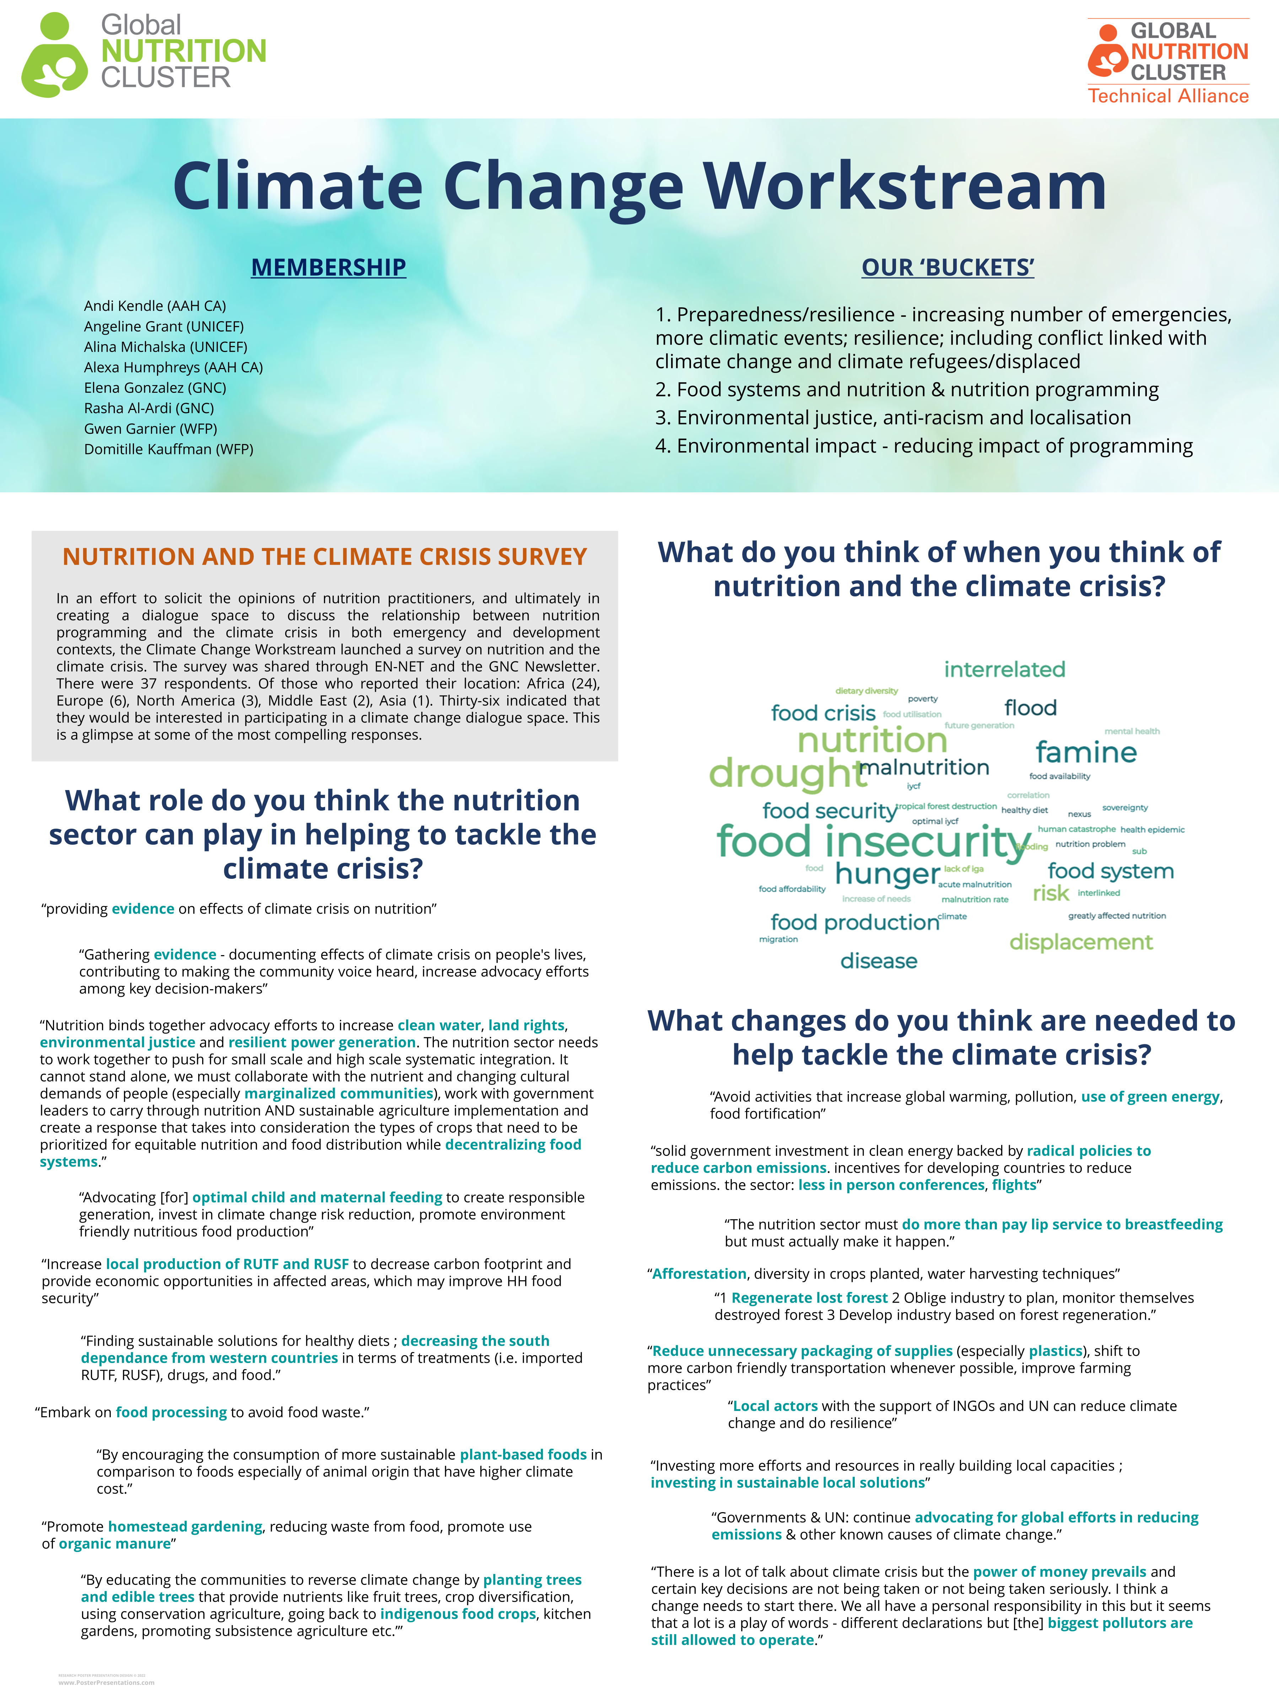
2022 Survey themes
Evidence
Nutrition programming
Advocacy- emphasis on food systems and environment, and issues beyond nutrition (energy)
Supply chain localization and waste management
Sustainable local solutions

Slide 86
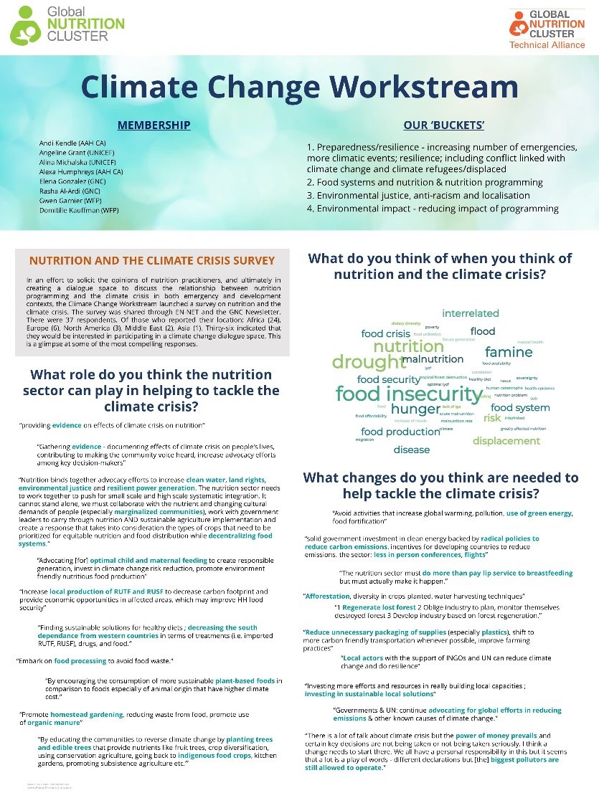
GNC action: NIE and climate crisis (Jan-June 2024)
Scoping NIE and climate crisis
Position paper
Case studies
Communication materials
Amplified conversation
Prioritized action
Improved positioning, legitimacy and resourcing
User needs
GNC Climate and Nutrition Working Group
Notes:
I am working on a consultancy in the first half of the year to support the GNC to further articulate its approach in the context of the climate crisis.
This will be an iterative process that builds off of the work of the GNC Climate Crisis Working group.
It will include looking at how other clusters, GNC partners and countries are addressing the climate crisis.
The process includes desk review, key informant interviews, and some short surveys and will result in a position paper and communication materials.
We aim to discuss at the GNC annual meeting in March.
And we hope as a result of this work, to amplify the GNC’s conversation to date on NIE and climate crisis, have prioritized collective action, and support for improved positioning (partnerships, comparative advantage), legitimacy and resourcing
And how can you engage?
Share your experience and needs
Participate in upcoming surveys
Keep informed about the GNC Climate Crisis Working Group

Slide 87
MENA Regional
Meeting
Thank you

Slide 88



UNICEF and WFP Strategic Approach for
Early Actions to Address Wasting in Children and Women in Humanitarian Context with a focus on 15 Priority Countries (2024–2026)
Minh Tram Le, UNICEF HQ
Gwenaelle Garnier, WFP HQ
Notes:
Anu
Initially developed for BHA, but seeking further support from other donors

Slide 89

A new opportunity
WHO Guideline - an opportunity to foster programmatic shifts for wasting, under Government leadership
Targeting to the most vulnerable - increased needs and decreased resources
Prevention - strengthened programming linked with management
Partnership Process:
  BHA/ UNICEF/ WFP Meeting: April 2023
  Strategic Planning- June 2023
  Communication to Key countries - Strategic Note- July 2023
  Ongoing: Government Engagement; fundraising and implementation planning
Notes:
Tram
2022-23 – remarkable funding and response for UNICEF and WFP for child wasting
Re-setting the way we have been working
15 priority countries but implications for all GAP and other countries with wasting programming
Will take time to change – and will need support of donor agencies and senior management at WFP/UNICEF

Slide 90
Agreed shifts in programming for children with wasting
Prevention and treatment as standard for the same populations
UNICEF and WFP will ensure a complementary set of preventive actions for young children and pregnant and breastfeeding women
UNICEF will lead on supporting national governments to provide services to enable children with severe wasting and children with moderate wasting at higher risk of death recover using ready-to-use therapeutic food (RUTF)
WFP will use a diverse range of interventions to supplement other children with moderate wasting to ensure their additional dietary needs for recovery (RUSF or local nutrient dense foods)
WFP will lead on supporting support communities to ensure access to nutritious family foods through food assistance to vulnerable households
Notes:
Tram + Gwen
Will go into further detail on prevention and management on following slides.
UNICEF/WFP’s Strategic Approach to supporting government and partners, to move towards new ways of working prevention/management of wasting, that includes aligning to the new WHO guidelines.
So it serves to guide agency teams on how both agencies are going to work together on wasting – in humanitarian contexts – of course, part of this is working closely with government, UN and NGO partners….
RUTF for HRMAM only a supplementation, other portion of diet will need to be met with strong referral/links to other interventions (e.g. cash, SBC, GFA)
Other MAM also need medical assessment and will be provided where possible – health services or community platforms can provide – not be overwhelmed.

Slide 91
Some key principles and ways of working
Alignment with WHO
  Context-specific approach: co-created with government
  Prioritization of needs: IPC, GAM, hotspots, other aggravating factors
  Transfer modalities: informed-by market functionality and other assessments
  Not forgetting hard to reach populations
  Multisectoral approach and platforms
Management and prevention interventions to feature as standard package in food insecure humanitarian settings
Management of wasting:
  UNICEF: Children with wasting at higher risk of mortality (SAM and MAM at higher risk- SFF)
  WFP: Other children with wasting (SFF or local nutrient- dense foods)
Nutritionally adequate food or social assistance will form the fundamental basis of an effective humanitarian nutrition response
Notes:
Tram + Gwen
Cash/SBC/local foods used where possible, but SNF will be warranted where local foods not available
approaches not clear or evidence based, and investment needed in learning/research etc.
multi-sectoral approach including water, sanitation and hygiene, social protection, health and food systems
In collaboration with other GAP agencies – WHO, FAO, UNHCR – where relevant
Focus on IPC 4-5, and IPC 3 with high GAM rates

Slide 92
EXAMPLE: Possible integrated country package of services supported by WFP and UNICEF in humanitarian contexts
6-23 months
24-59 months
PBW/G
SAM
Treatment Program
(RUTF)
Treatment Program
(RUTF)
HR MAM
Treatment Program
(RUTF)
All other MAM
Supplementation w/local food mix+ MNPs
Supplementation w/local food mix + MNPs
Fortified blended food + oil
Non malnourished in food insecure HH
Cash Top up + MNPs
Cash top up + MMS + antenatal and postnatal care
Cash- based assistance to food insecure households
*Agencies will monitor the proportion of malnourished coming from non-food insecure households
Non malnourished in non food insecure HH
Preventive Program
(MNPs)
MMS + antenatal and postnatal care
SBC / IYCF counselling
Notes:
Gwen

Slide 93
2024 – 2026 Transition Plan
2026
Afghanistan, Somalia, Yemen
Somalia, Afghanistan and Yemen
Full guidelines
2025
Burkina Faso, Chad, DRC, Mali, Niger, Ethiopia, Sudan,
2024
Haiti, Kenya, Madagascar, Nigeria, South Sudan
Notes:
Gwen
The 15 priority countries have been allocated to three phases.
Implication: Means that these countries are being prioritized for global/regional level support including fundraising efforts, does not mean that country teams cannot move faster than this if they want.
Decision making : determined (with UNCIEF/WFP country teams) to be more ready and more suitable for the transition, based on several factors.
Phase 1: Joint preparation and planning will start in 2023, and programme shifts in 2024. This includes ensuring government agreement and all necessary steps are taken, such as building partner buy-in, identifying target regions, and developing a comprehensive plan for 2024, including costing, funding, development of tools and trainings.
Target areas
Learnings from phase 1 countries will be used to inform transition of other countries.
Phase 2: Detailed consultations with national level partners to start in 2023, with agreement on transition expected end of 2024. Programmatic shifts to start in 2025.
Phase 3: Discussions to start in 2023, programmatic shifts to starts towards the end of 2025 and expansion towards the end of 2026.
Parameters considered for overall readiness and pace for transition:
Operating/programming environment
Government readiness and policy environment
UNICEF and WFP readiness at CO level
System capacity
Supplies and Supply chain readiness
Funding

Slide 94
Global Areas of collaboration between UNICEF and WFP
Joint support to countries for transition
Nutrition Information - data and context analysis (refining vulnerability, indicators and PIN)
Programme monitoring, evidence generation and learning (home/local foods; risks/success with transition; CHW role)
Supply chain strengthening (forecasting, readiness and responsiveness, last mile delivery)
Advocacy and resource mobilisation
Notes:
Tram
Technical support to country teams: UNICEF and WFP headquarters and regional teams will provide technical support to their country teams with transition planning, implementation and monitoring. UNICEF and WFP country teams will support national and sub-national governments and partners with the transition planning, scale-up, monitoring and reporting.
Nutrition information: UNICEF and WFP will invest in the use of diagnostics tools and analytics to better understand and prioritize their programmes based on nutritional vulnerabilities. This will include Hotspot Analysis and the Nutrition Vulnerability Assessment in Crisis. UNICEF and WFP will support the nutrition and food security clusters in their Humanitarian Needs Overview/Response Plans processes to make necessary adaptations. UNICEF and WFP joint efforts will strengthen engagement in national and global processes such as the IPC and establish networks to ensure that sudden increases in child wasting can be predicted, detected and responded to more effectively.
Programme monitoring and evidence generation: UNICEF and WFP will generate evidence on the programmatic shifts with focus on hard-to-reach areas and will closely monitor implementation and progress of the transition. We will work with partners to design and implement operational research studies to document the effectiveness of programmatic shifts. Operational research priorities will align with gaps highlighted by the WHO Guideline Review Process and the Global Nutrition Cluster and Food Security technical groups.
Supply chain strengthening: UNICEF and WFP will work together on transparent sharing of information about global and national demand and supply of specialized nutritious foods to ensure timely allocation to countries. This will enable optimal production capacity of lipid-based ready to use therapeutic and supplementary foods for those children most in need. In addition, at global and country levels both agencies will work together on optimizing supply chains for lipid-based specialized nutritious foods and improving the tracking of supplies and their programmatic use.
Advocacy: UNICEF and WFP will jointly advocate to donors and partners for support to the programmatic shifts including increased investments on prevention actions in humanitarian settings. Donor advocacy will be supported by the Action Review Panel on Child Wasting, the Global Nutrition Cluster and the Global Food Security Cluster, alongside National Nutrition and Food Security clusters. Both agencies will advocate together for other key sectors that are active in humanitarian settings to increase investment in and attention to child wasting and to ensure efforts of health and immunization, water and sanitation, and social policy and protection converge.

Slide 95
Thank you

Slide 96
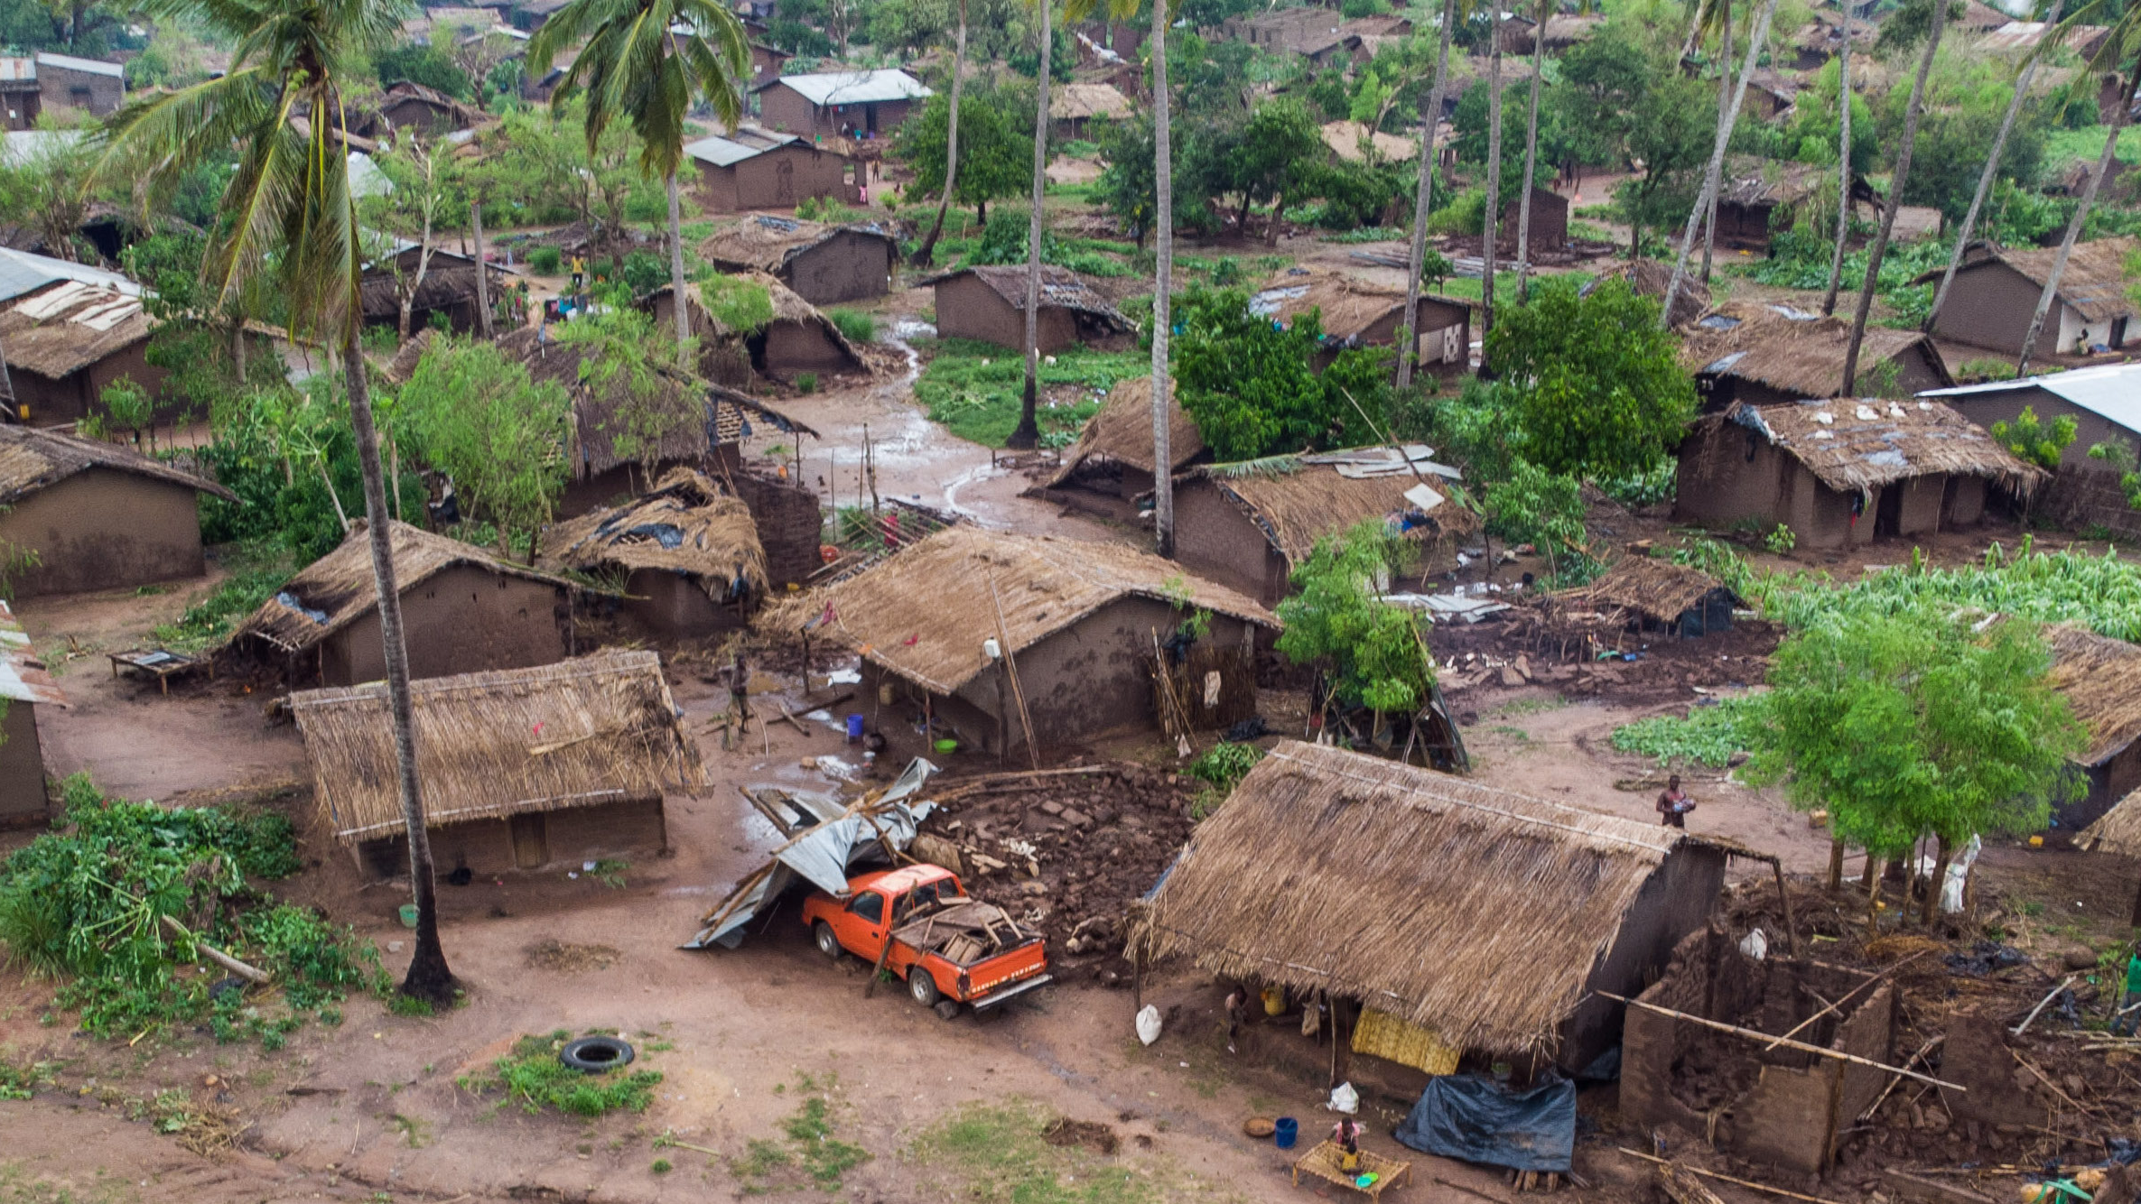
COLLECTIVE ACTIONS

Slide 97

CLOSING REMARKS

Slide 98

ROSA / EAP Regional
Meeting
Thank you

